Slide 1



People Soft ePerformance Module
Overview – Approver/Next Level Manager
Office of Human Resources
September 2020
Notes:
The University has invested in Oracle’s PeopleSoft suite of applications as its Enterprise Resource Planning (ERP) systems. The iRattler Human Capital Management (HCM) application administers the University’s Human Resources, Benefits, and Payroll. The HCM application will be upgraded to v9.2 and PeopleTools 8.56.04.
Upgrading the application provides the opportunity for the transformation of business processes, elimination of manual processes and includes several customizations, streamlining of workflow, and the introduction of a more user-friendly system. In addition, the University will leverage new features and improved functionality such as mobility enhancements and fluid mechanisms, to provide improved customer service.
Further, the University will use the upgrade to assess its current business environment and identifying opportunities for improvement, automation, integration and better reporting. This upgrade will also ensure the University has Oracle support for the application software.

Slide 2
ePerformance Training – Approver – Next Level Manager
Notes:
Performance documents will be submitted for approval by the Manager and will route to the Manager’s next level Manager

Slide 3
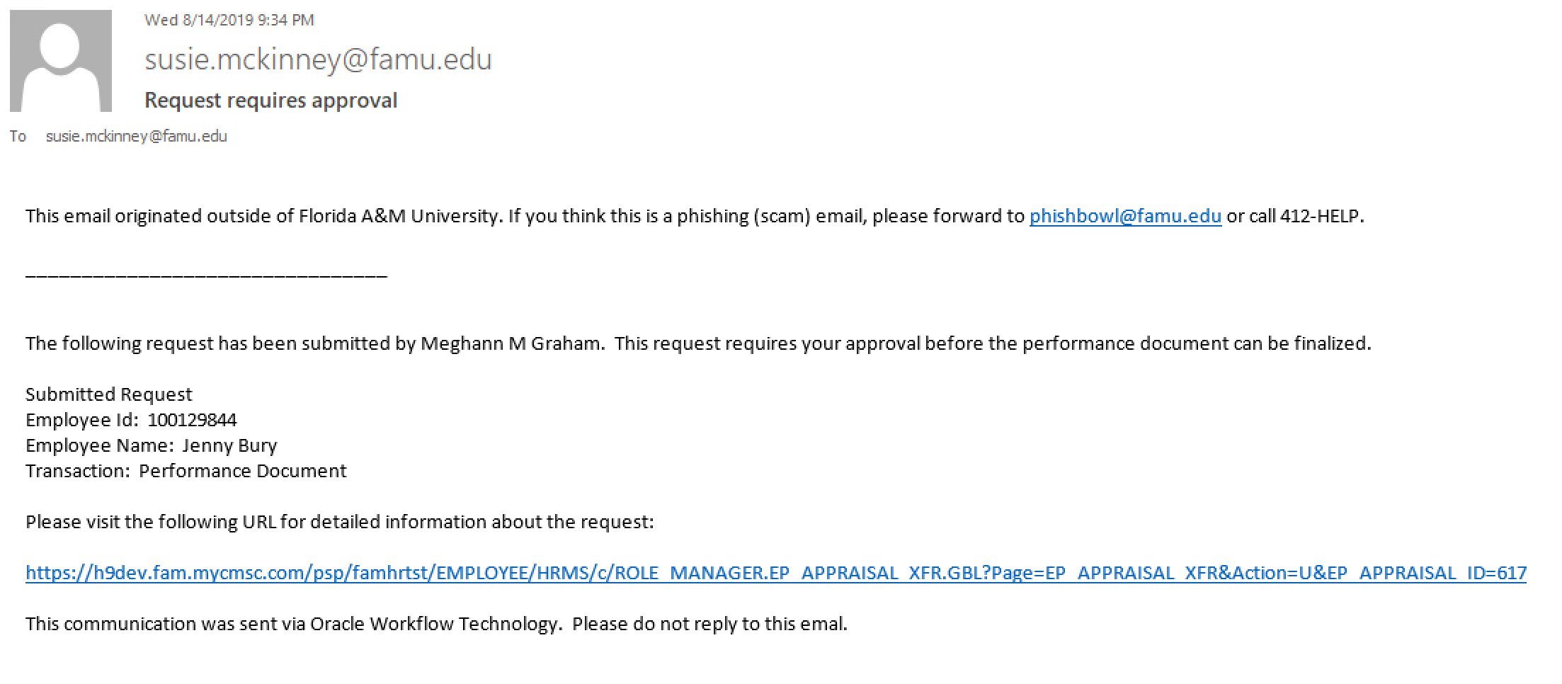
Approver – Receives Email Notification
Approver/Next Level Manager will receive an email notification stating that there is a performance document requiring approval

Slide 4
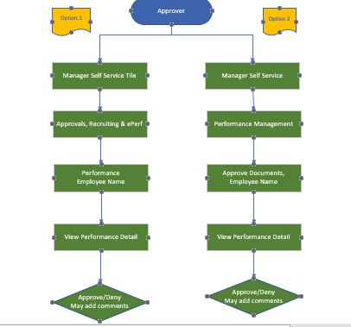
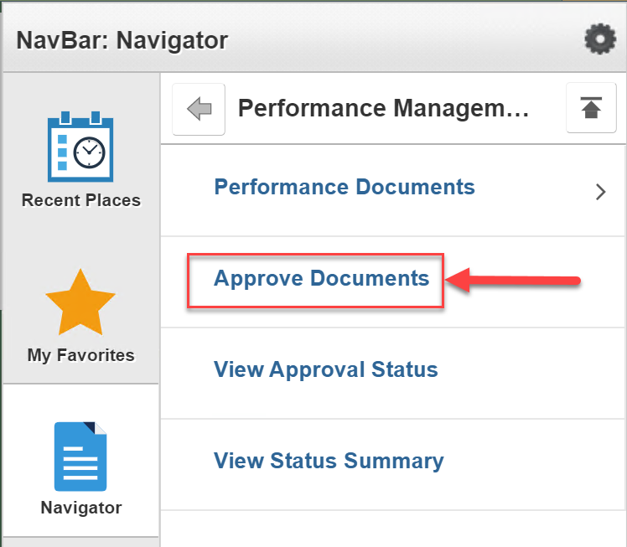
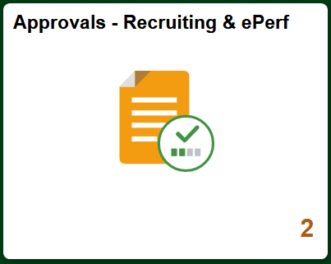
Approver Process - Flow chart
Notes:
There are 2 ways to access performance documents for approval:
Option 1: Logon to IRattler→ click on Manager Self Service Tile→ click on Approvals, Recruitment & ePerformance Tile → click on ePerformance
Option 2: Logon to iRattler→ navigate using Navbar: Navigator to Manager Self Service > Performance Management > Approve Documents

Slide 5
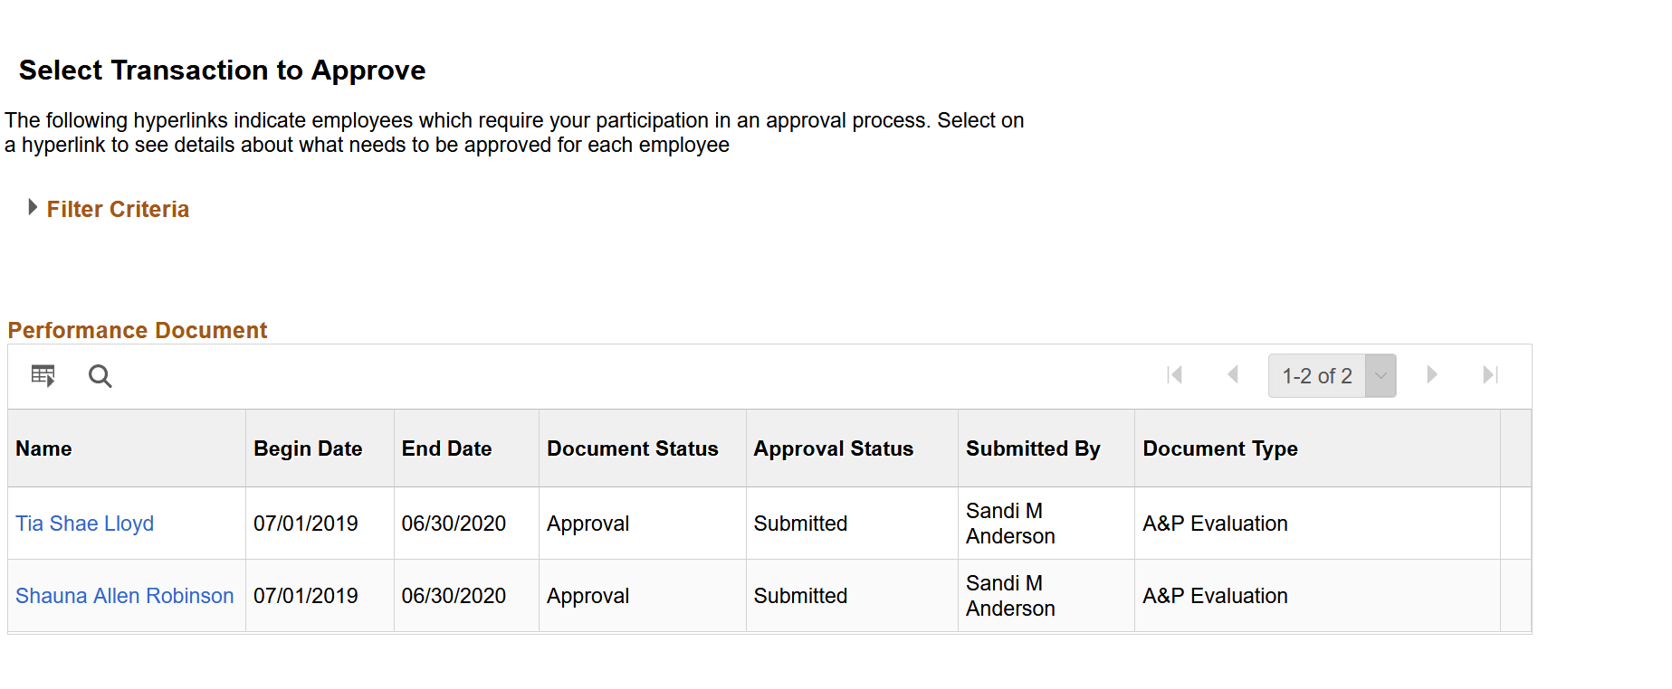
Approver – Receives Email Notification
Approver/Next Level Manager will select the performance document to review by clicking on the name of the employee

Slide 6
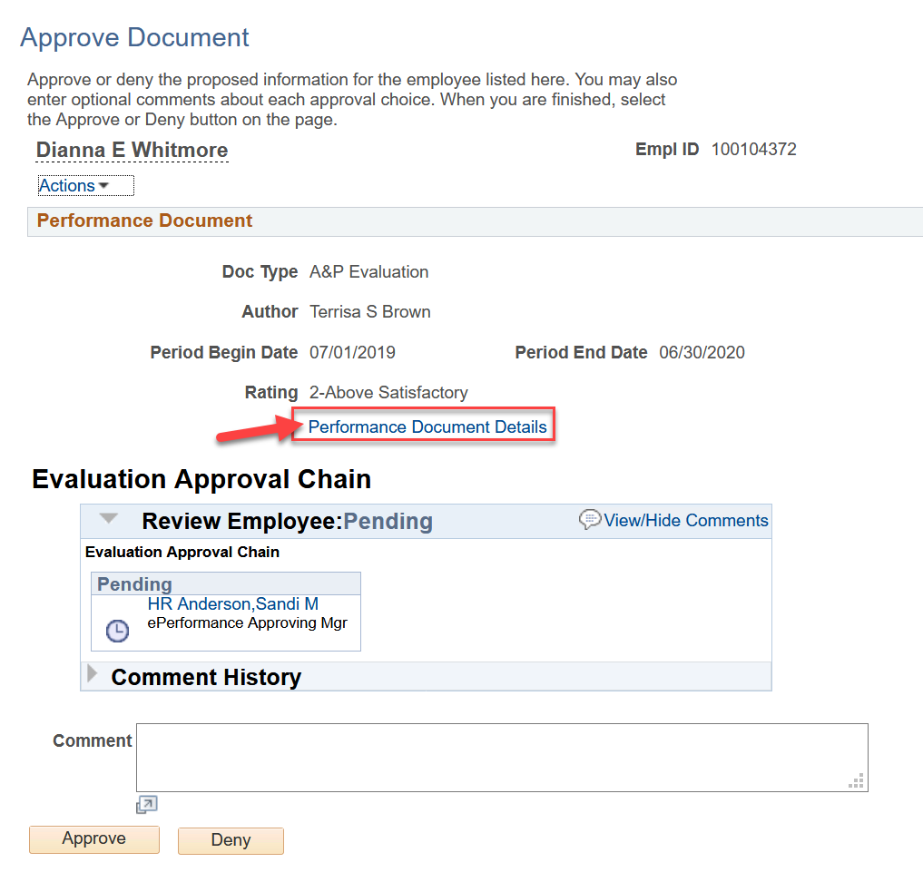
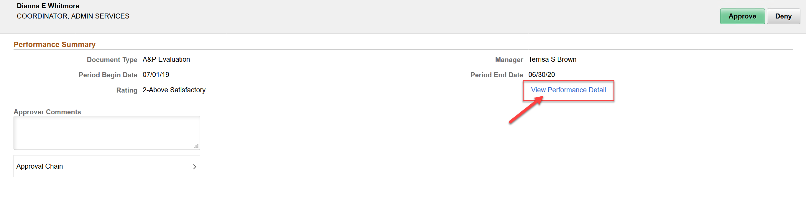
Approver – Reviews Performance Evaluation
Approver/Next Level Manager will access document to Review by clicking on the Performance Details

Slide 7
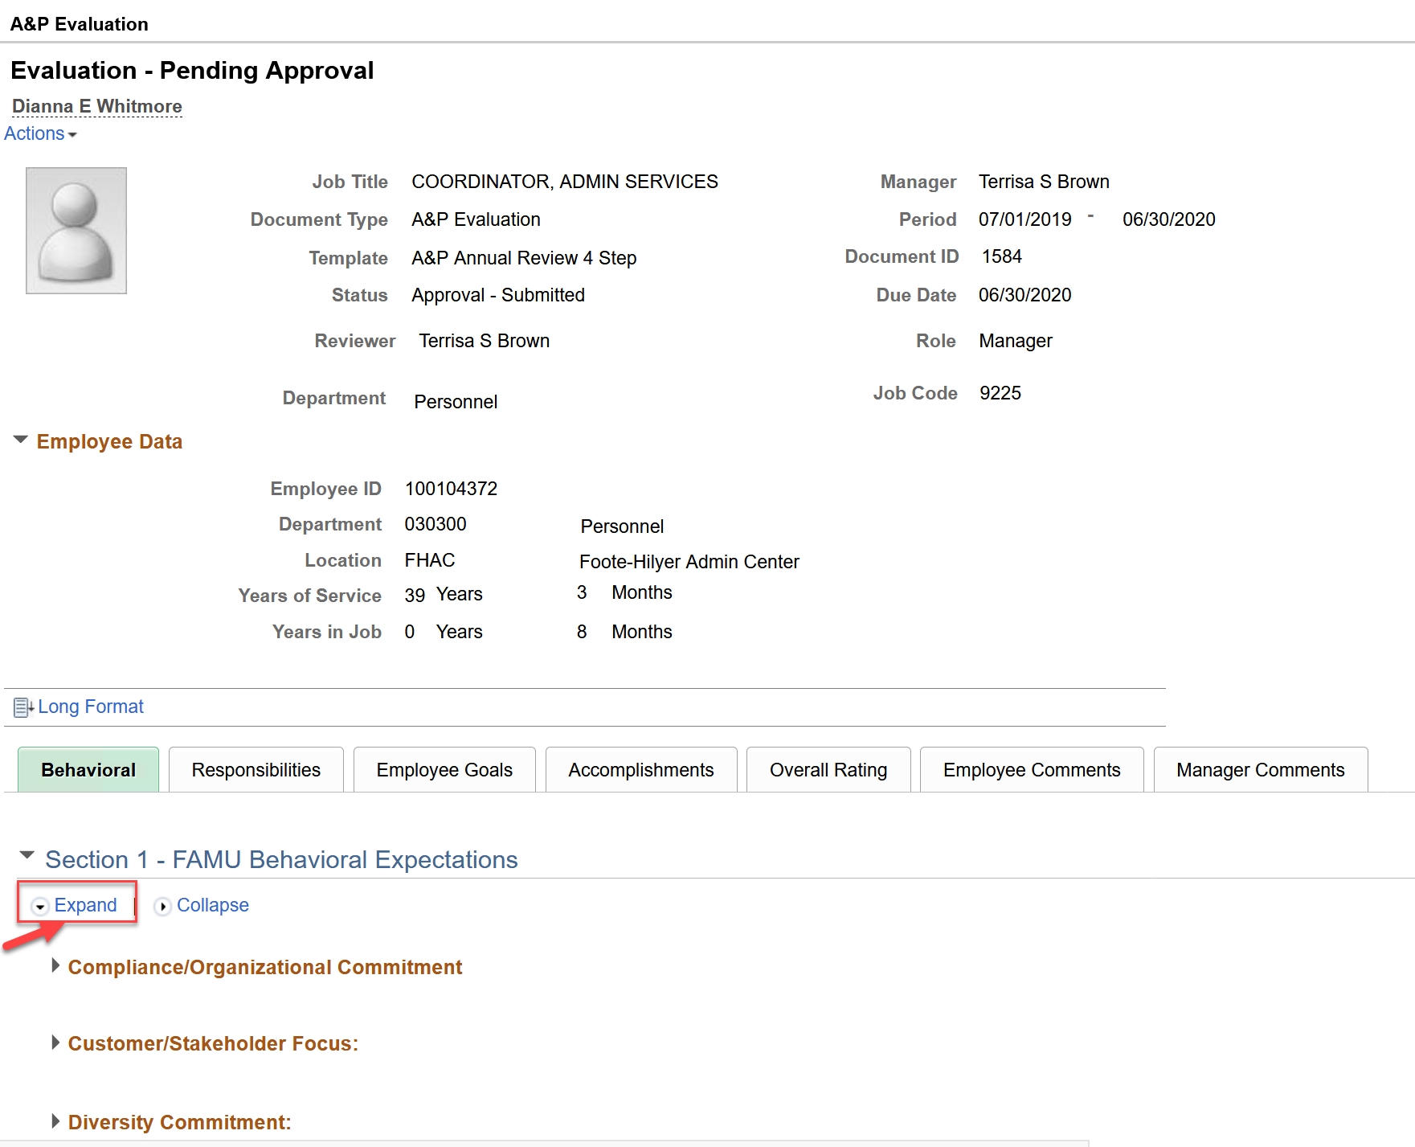
Approver – Reviews Performance Document
Approver/Next Level Manager will review each section of the performance review and will click on the expand link to review the ratings and comments
Notes:
Next-level manager/approver will click on the expand link to view the ratings and comments

Slide 8
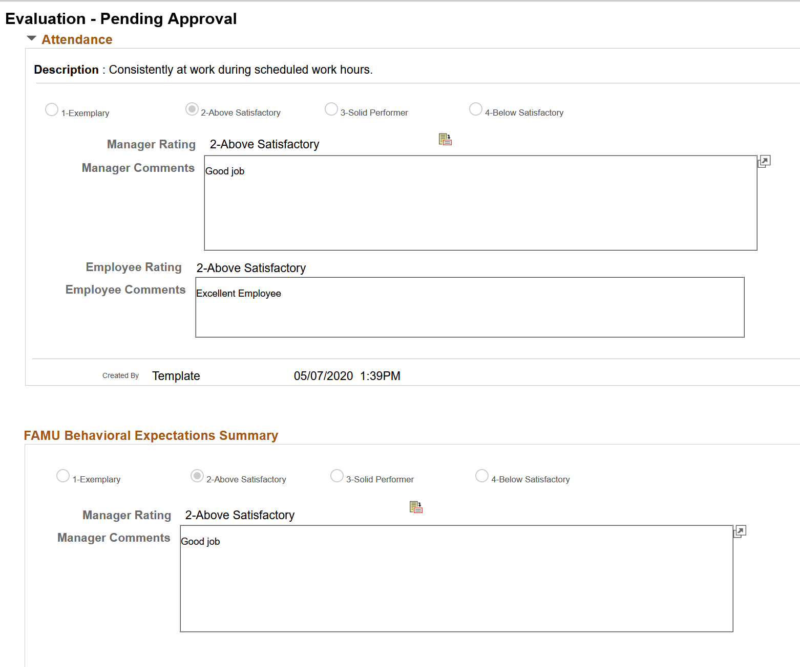
Approver – Reviews Performance Document (cont.)
All of the Manager and Employee ratings along with their comments will be visible to the Approver/Next Level Manager

Slide 9
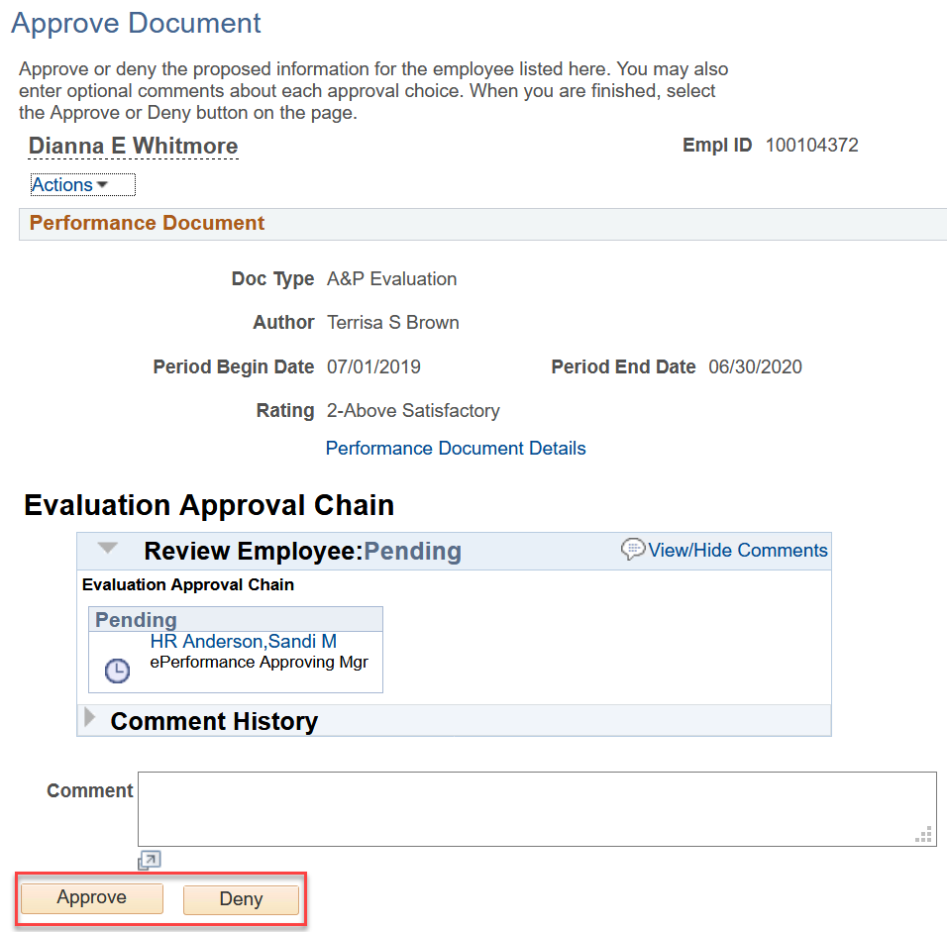
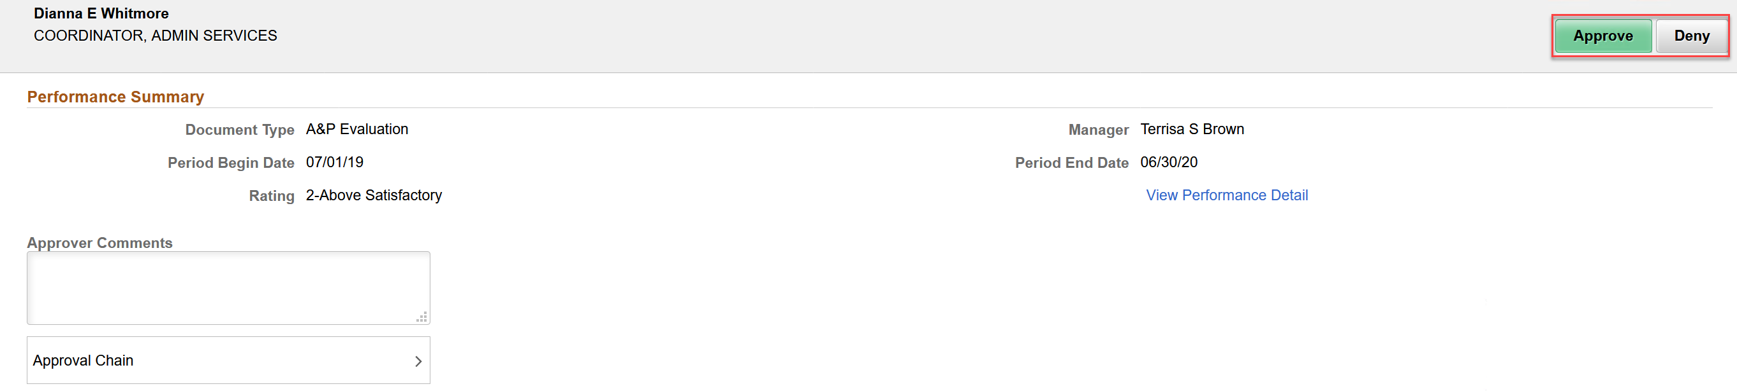
Approver – Approves Evaluation
Approver/Next Level Manager will Approve or Deny the Evaluation and can also add comments
Please note that comments are Mandatory when document is denied

Slide 10

Notes:
Manager will receive an email that the performance document has been approved and the performance document is now closed

Slide 11
Closing Remarks/Questions
Thank you!

