Slide 1



PeopleSoft ePerformance Module
Overview - Nominees
Office of Human Resources
September 2020
Notes:
The University has invested in Oracle’s PeopleSoft suite of applications as its Enterprise Resource Planning (ERP) systems. The iRattler Human Capital Management (HCM) application administers the University’s Human Resources, Benefits, and Payroll. The HCM application will be upgraded to v9.2 and PeopleTools 8.56.04.
Upgrading the application provides the opportunity for the transformation of business processes, elimination of manual processes and includes several customizations, streamlining of workflow, and the introduction of a more user-friendly system. In addition, the University will leverage new features and improved functionality such as mobility enhancements and fluid mechanisms, to provide improved customer service.
Further, the University will use the upgrade to assess its current business environment and identifying opportunities for improvement, automation, integration and better reporting. This upgrade will also ensure the University has Oracle support for the application software.

Slide 2
ePerformance Training - Nominee
Notes:
Nominees – are employees of the organization that has been asked to participate in the performance evaluation of an employee. A Nominee can be an indirect supervisor, team lead, customer, peer, etc.

Slide 3
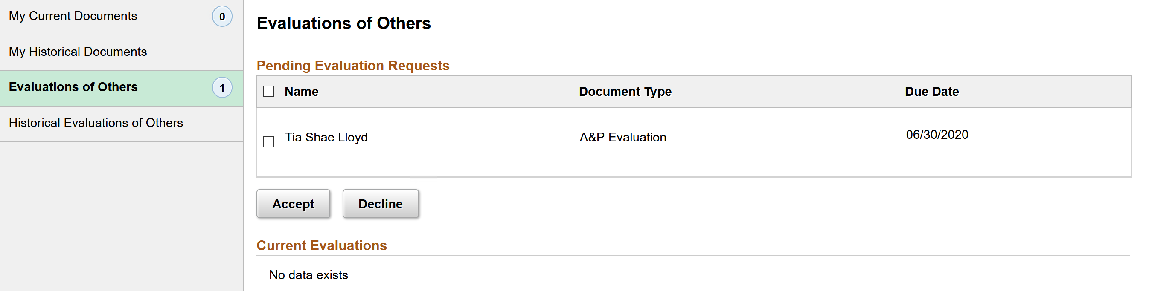
Nominee – Pending Evaluation Requests
Nominee can review all Pending Evaluation Requests
Nominee will have the option to Accept or Decline request
Notes:
A Nominee that has been invited to participate in an Employee’s performance review will receive an email from the Manager to participate in the evaluation.
A Nominee can navigate to Employee Self Service tile and click on Performance Tile, then click on Evaluation of Others.
Any pending requests will be shown here.
The Nominee will Accept or Decline the invite. Select the name of the invite request before accepting.

Slide 4
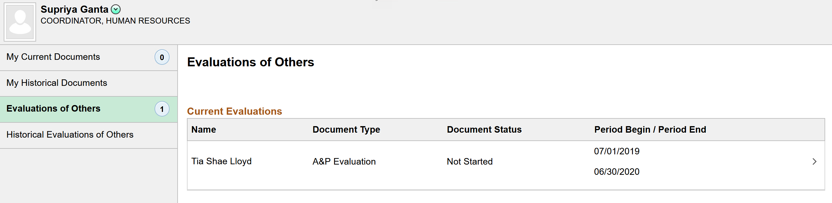
Nominee – Accesses Performance Evaluation
Nominee will access the employee’s performance evaluation
Notes:
Once accepted, the performance evaluation will be immediately available for the Nominee to complete the Nominee Evaluation.
You will now be on the Evaluation of Others, Current Evaluations page.
Click on the name of the employee to access

Slide 5
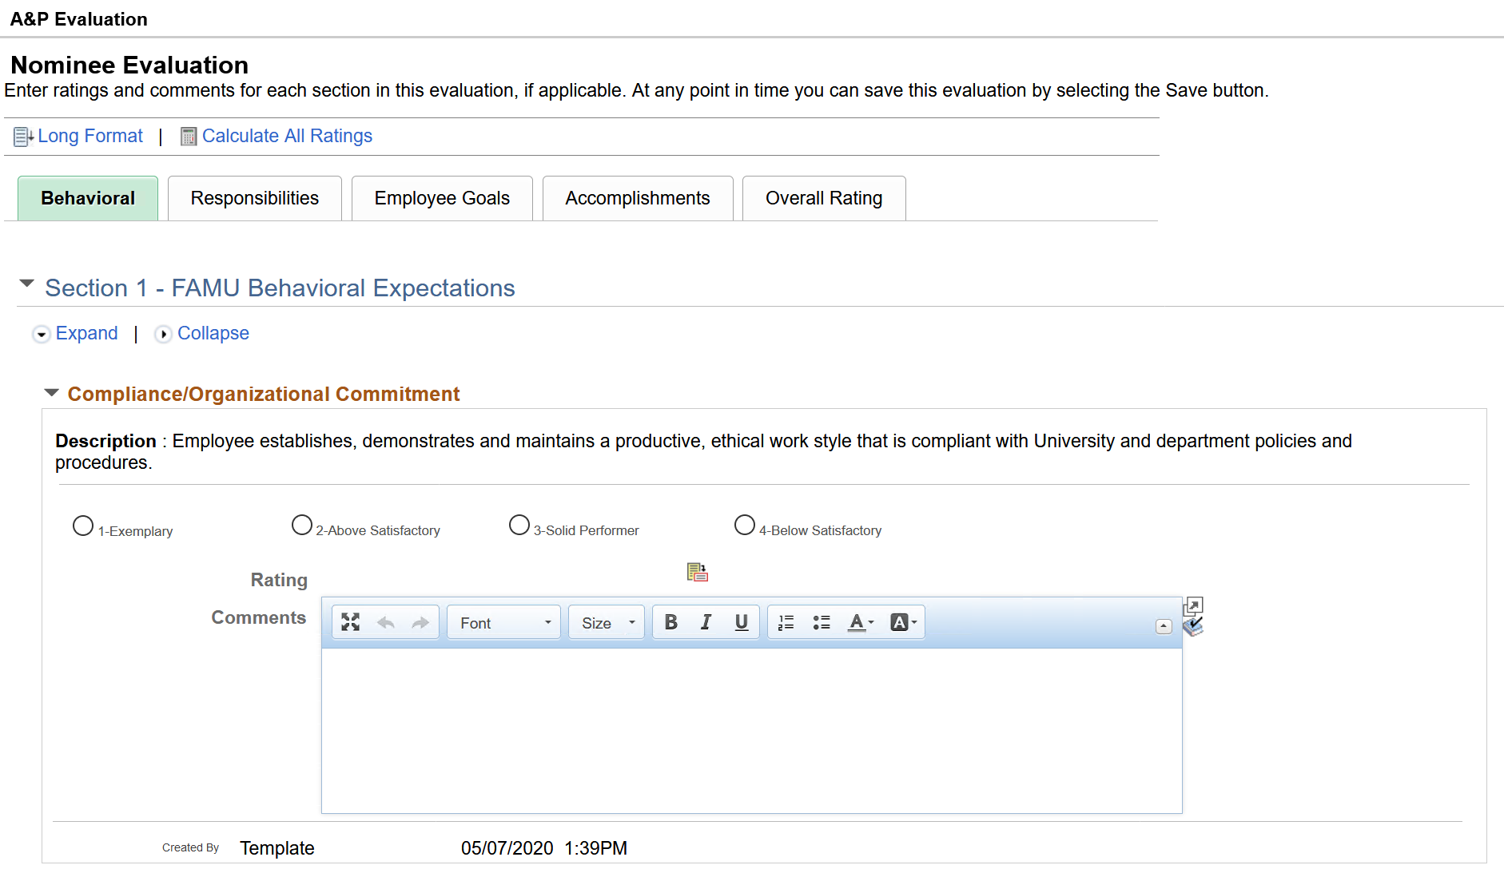
Nominee – Behavioral Section
Nominee can rate and provide comments for the Behavioral Items
Nominee can provide comments for the Behavioral Section Summary
Notes:
The Nominee can provide a rating and a comment for each item within each of the 4 sections Behavioral, Responsibilities, Goals, and Special Accomplishments.
It is not required that the Nominee rate each item or section. The Nominee can complete and rate the items that they are familiar with.
For example, the Nominee may not be aware of the Employee’s Goals and Accomplishments, so the nominee may not want to provide a comment for these sections.

Slide 6
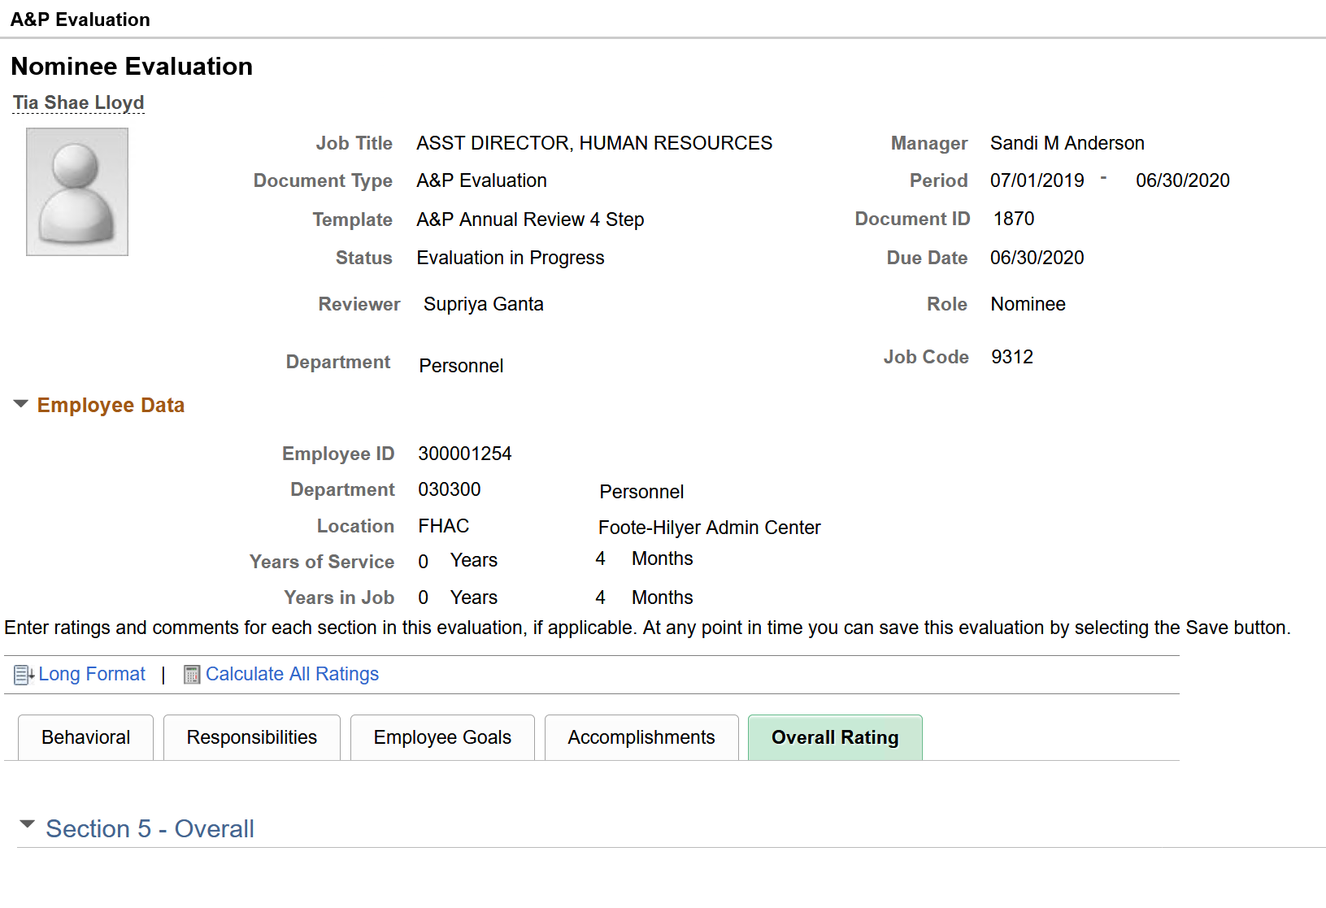
Nominee – Overall Summary
Nominee will only add comments for the overall summary as the Manager will provide an overall rating for the Employee
Notes:
For the Overall Summary section, the Nominee will only add comments, as the Manager can only provide an overall rating for the Employee

Slide 7
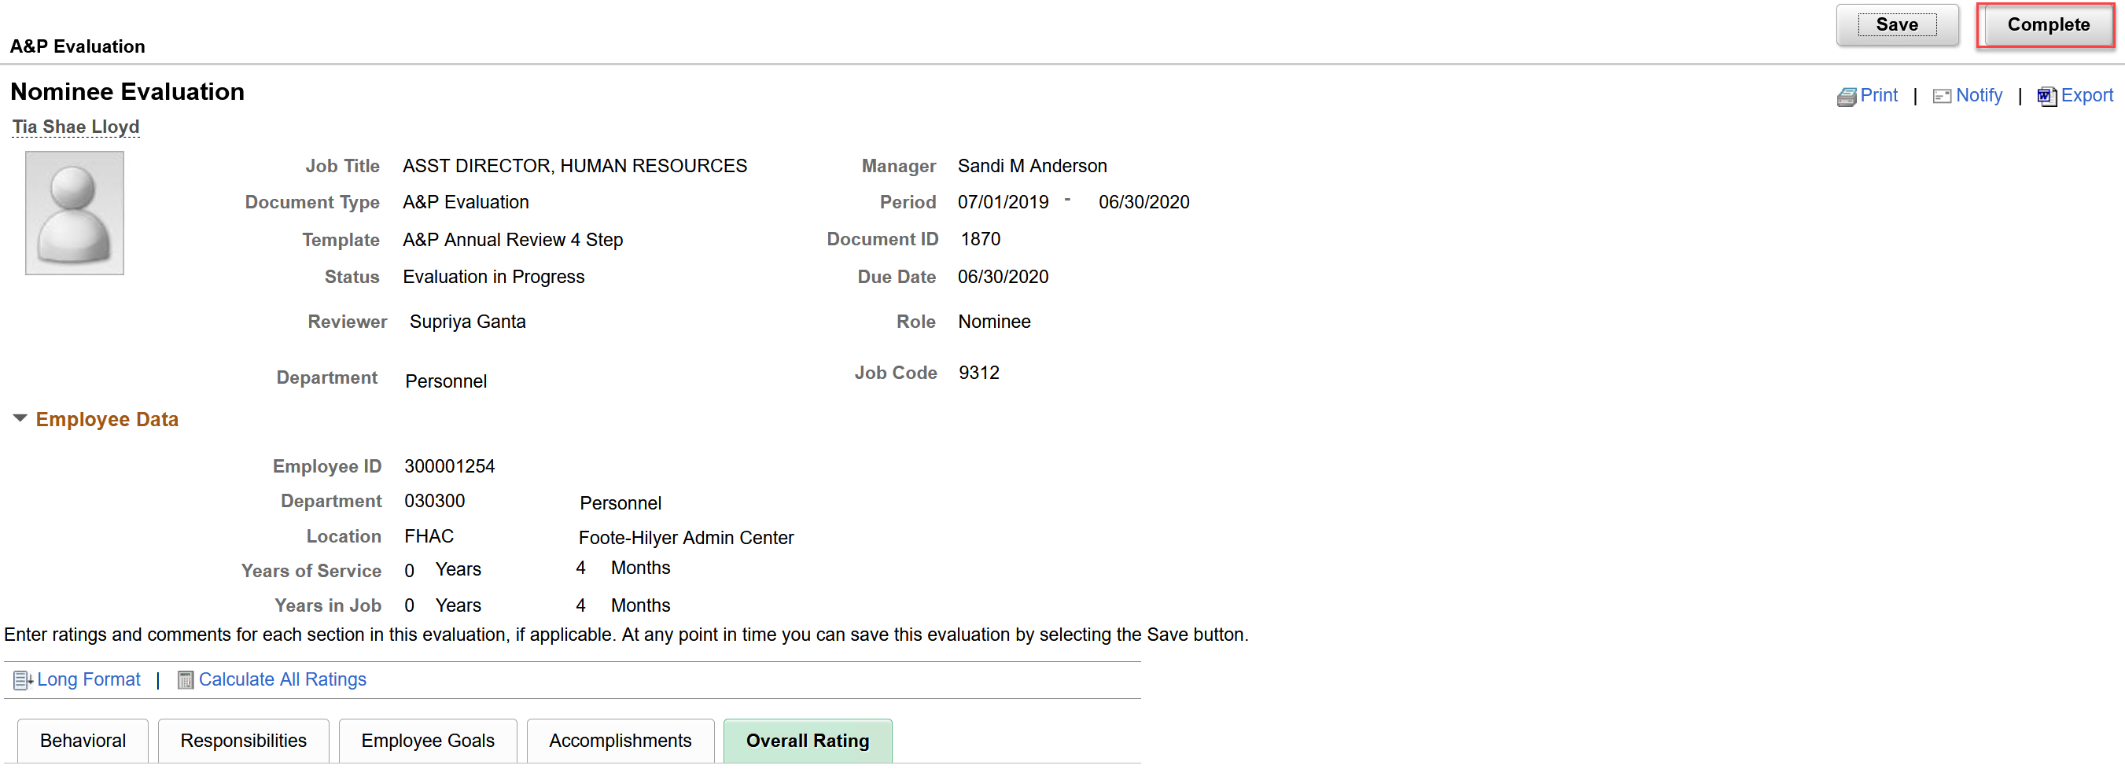
Nominee – Completes Evaluation
Nominee will mark the evaluation as complete
Notes:
When Nominee has completed the Nominee Evaluation, the Nominee will mark the evaluation as complete.
Once marked complete, the Manager and Employee will receive an email notification that the Nominee evaluation is complete

Slide 8
Resources
ePerformance Guide 101
OvERVIEW OF EPERFORMANCE PROCESS
summary of changes
step-by-step training guide
frequently asked questions (FAQs)
Links to other resources
HR website
hr contacts
Notes:
The ePerformance Guide 101 in the go to resource for everything relating to ePerformance. Some of the topics you will find inside the guide is an overview of the ePerformance process; a summary of what’s changed from the manual process; a step-by-step training guide for the manger and employee; frequently asked questions – when learning a new process, many employees will have the same questions. The FAQs is the place to see what questions have been asked and the answers to those questions; The ePerformance Guide 101 also has links to other helpful resources such as FAMU Regulations that govern the ePerformance process and related collective bargaining agreements (CBAs). Additionally, you have as a resource the Human Resources website where the ePerformance Guide 101 resides. Lastly, you have a list of HR contacts for ePerformance when you aren’t able to find answers using the ePerformance Guide 101 or HR website.

Slide 9

Notes:
Joyce

Slide 10
Closing Remarks/Questions
Thank you!
Notes:
Joyce

