Slide 1



PeopleSoft ePerformance Module
Overview - Managers
Office of Human Resources
September 2020
Notes:
The University has invested in Oracle’s PeopleSoft suite of applications as its Enterprise Resource Planning (ERP) systems. The iRattler Human Capital Management (HCM) application administers the University’s Human Resources, Benefits, and Payroll. The HCM application will be upgraded to v9.2 and PeopleTools 8.56.04.
Upgrading the application provides the opportunity for the transformation of business processes, elimination of manual processes and includes several customizations, streamlining of workflow, and the introduction of a more user-friendly system. In addition, the University will leverage new features and improved functionality such as mobility enhancements and fluid mechanisms, to provide improved customer service.
Further, the University will use the upgrade to assess its current business environment and identifying opportunities for improvement, automation, integration and better reporting. This upgrade will also ensure the University has Oracle support for the application software.

Slide 2
ePerformance Training - Manager

Slide 3
Define Criteria Step
Notes:
Define Criteria is the first step in the Performance process where the Manager and Employee will define the criteria in which the employee will be rated on.
When HR creates the performance evaluations, The Manager will receive an email notification.
Once the evaluations have been created the manager can access team performance documents and begin the Define Criteria Phase

Slide 4
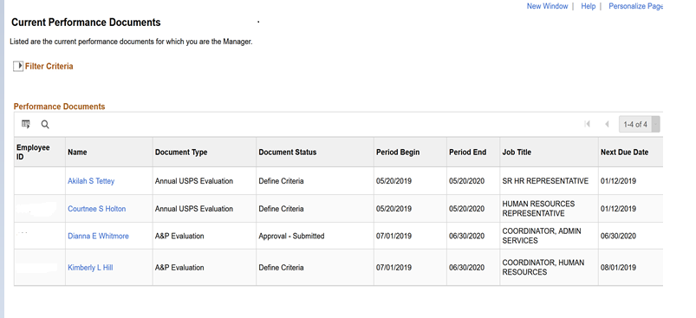
Manager – View Team Current Documents
Manager will access employees Performance Documents to Define Criteria
Notes:
Managers will access performance documents via Manager Self Service.
Click on Manager Self Service tile, click on Team Performance, you should be able to view current documents for those employees that report directly to you.

Slide 5
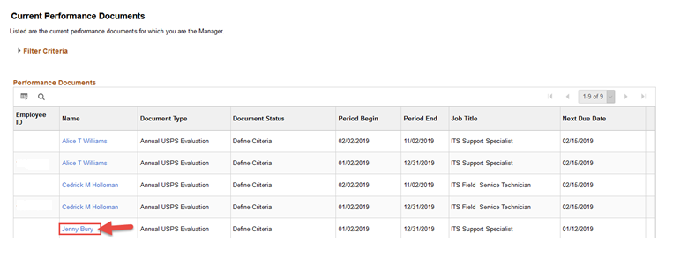
Manager – Access documents
Manager will access employees Performance Documents to Define Criteria
Notes:
To access a document click on the employee’s name. This will take you to the Define Criteria page

Slide 6
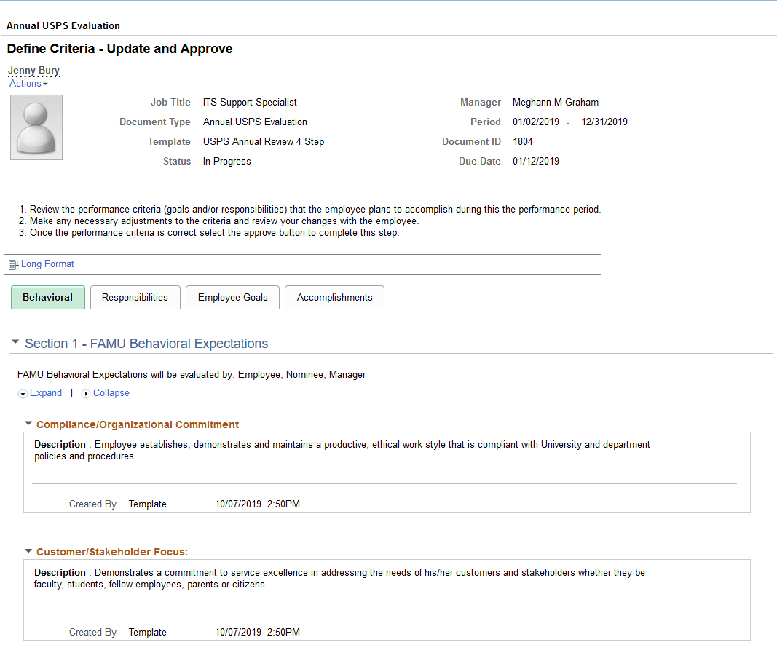
Manager – Behavioral Section
Managers can only review the pre-defined Behavioral Criteria during the Define Criteria step
Notes:
The manager will review the Behavioral criteria. To do this click on expand to view all content
Behavioral content is defined by leadership and cannot be modified.

Slide 7
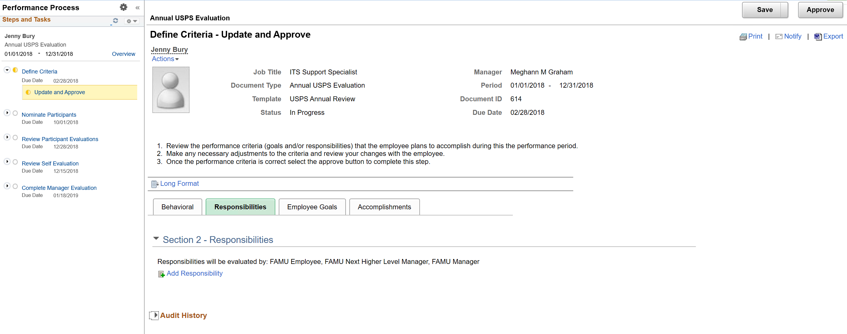
Manager - Responsibilities
Managers will have the ability to add responsibilities
Notes:
The Manager will add the responsibilities to the performance document.
The responsibilities must be added based on the employee’s Job Description. Please note that responsibilities are required.
If the responsibilities do not match the job description, now is the time to update the job description and contact HR

Slide 8
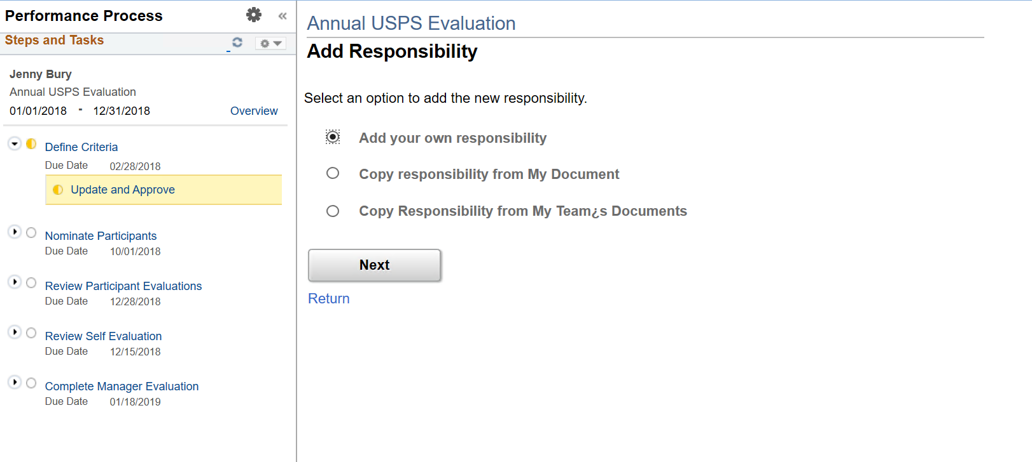
Manager – Add Responsibility
Managers will have the ability to:
  Add own responsibility
  Copy responsibility from My Document
  Copy responsibility from My Teams Documents
Notes:
In adding a responsibility, you will initially select “Add your own responsibility”.
Once you have added the responsibilities for one performance document and you have subsequent employee’s that have the same job description, you can select the “Copy responsibility from My Teams Documents”

Slide 9
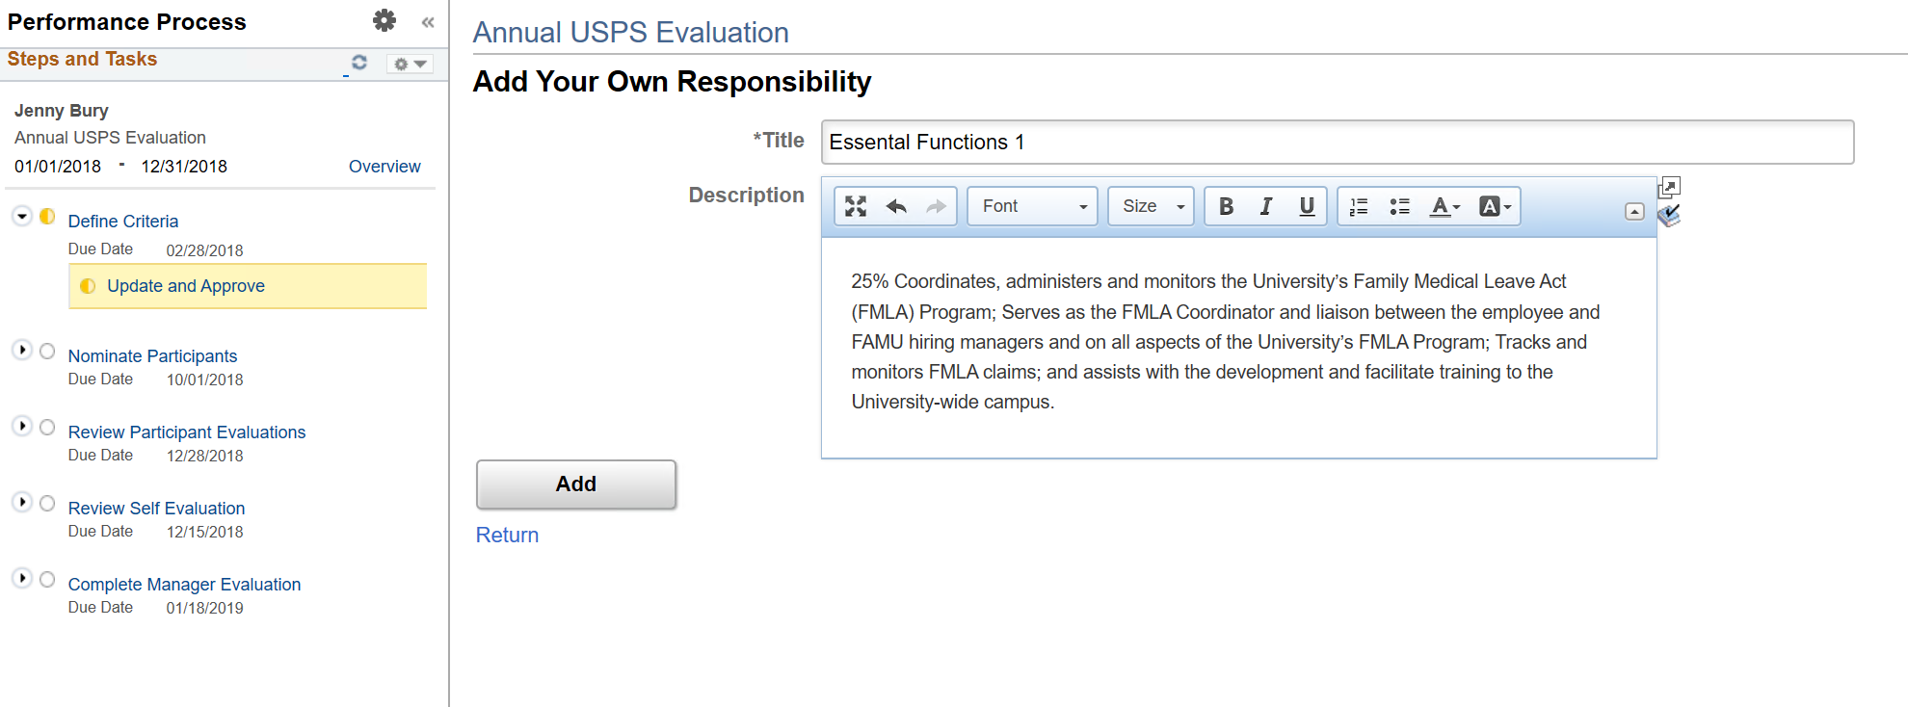
Manager – Add Your Own Responsibility
Manager selects Add your own responsibility
Notes:
The Manager will either type, or copy and paste each responsibility into the performance document from the Job Description

Slide 10
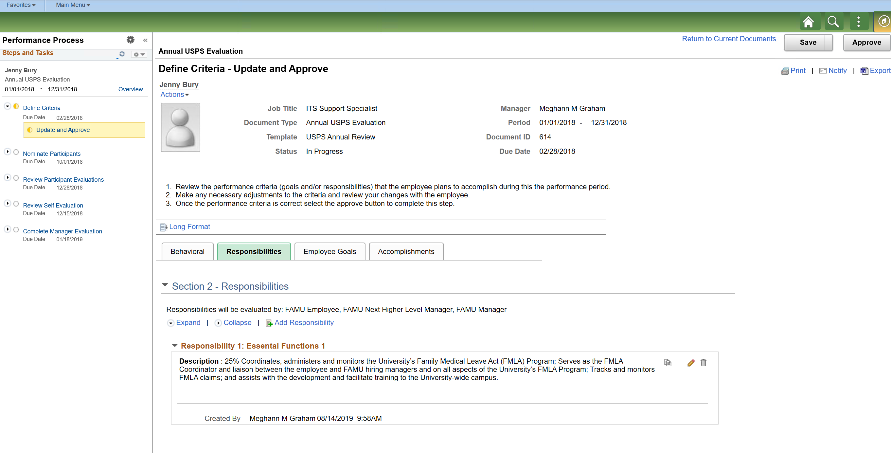
Manager – Responsibility Section (cont.)
Manager has the ability to:
  Copy to other documents
  Edit Details
  Delete Responsibility
Notes:
If you make a mistake, don’t worry, the Manager will have the ability to edit the details and to also delete a responsibility while in the define criteria phase of the review process

Slide 11
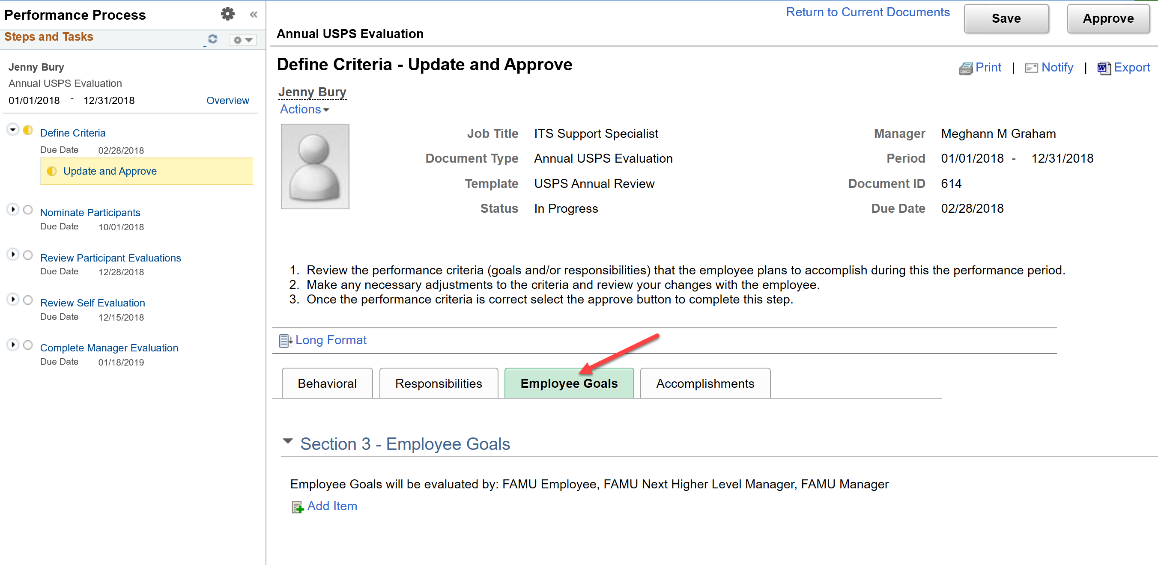
Manager – Employee Goals
Managers will have the ability to add Employee Goals
Notes:
The Manager will have the ability to add an employee goal.
Please note that adding a Goal is optional and is not required for the Employee Performance Evaluation

Slide 12
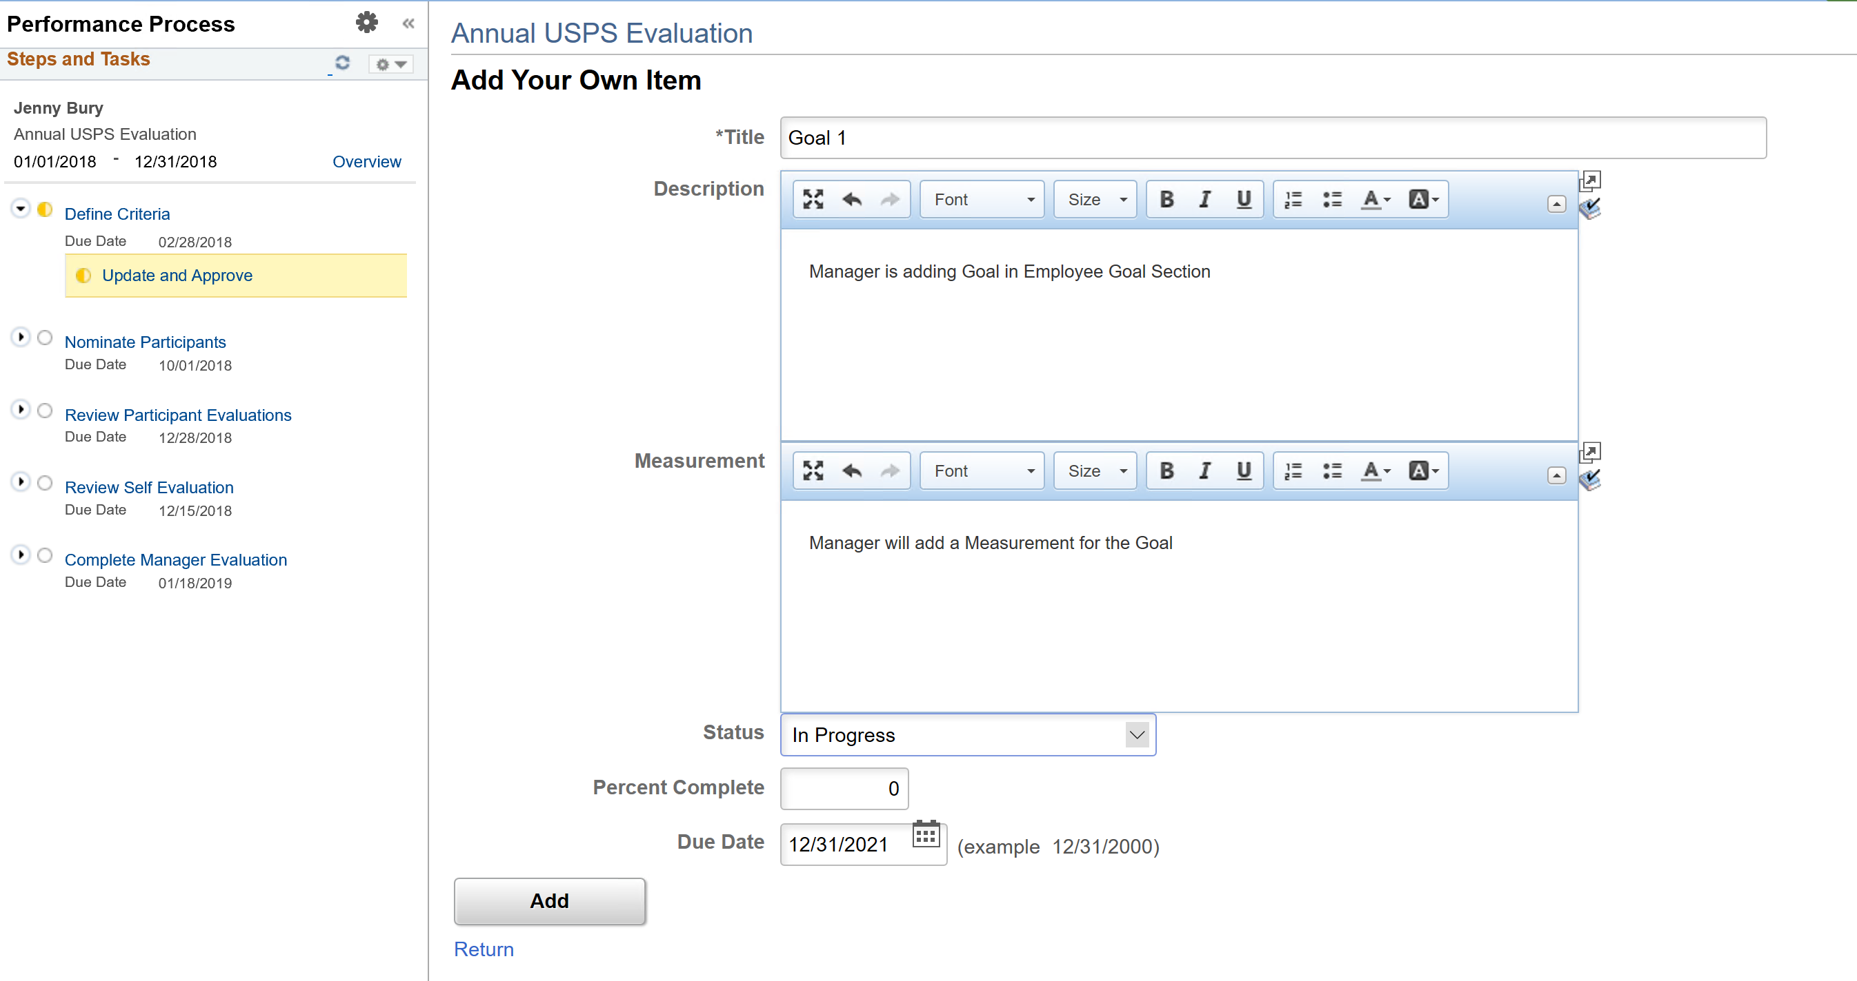
Manager – Goal Section (cont.)
Managers will have the ability to:
  Add Title
  Description
  Measurement
  Status
  Percent Complete
  Due Date (can be short-term or Long- term goal)
Notes:
When adding a Goal, you should add a title for the goal, description, is there a way to measure the goal, if so, you would add a measurement.
If you know the status you will enter a status of “Not Started”, “In Progress”, or “Not Applicable”.
If you select status of “In Progress”, you may want to provide a Percent Complete value. If this goal should be completed by a certain date, you may want to provide the date in which it should be completed.

Slide 13
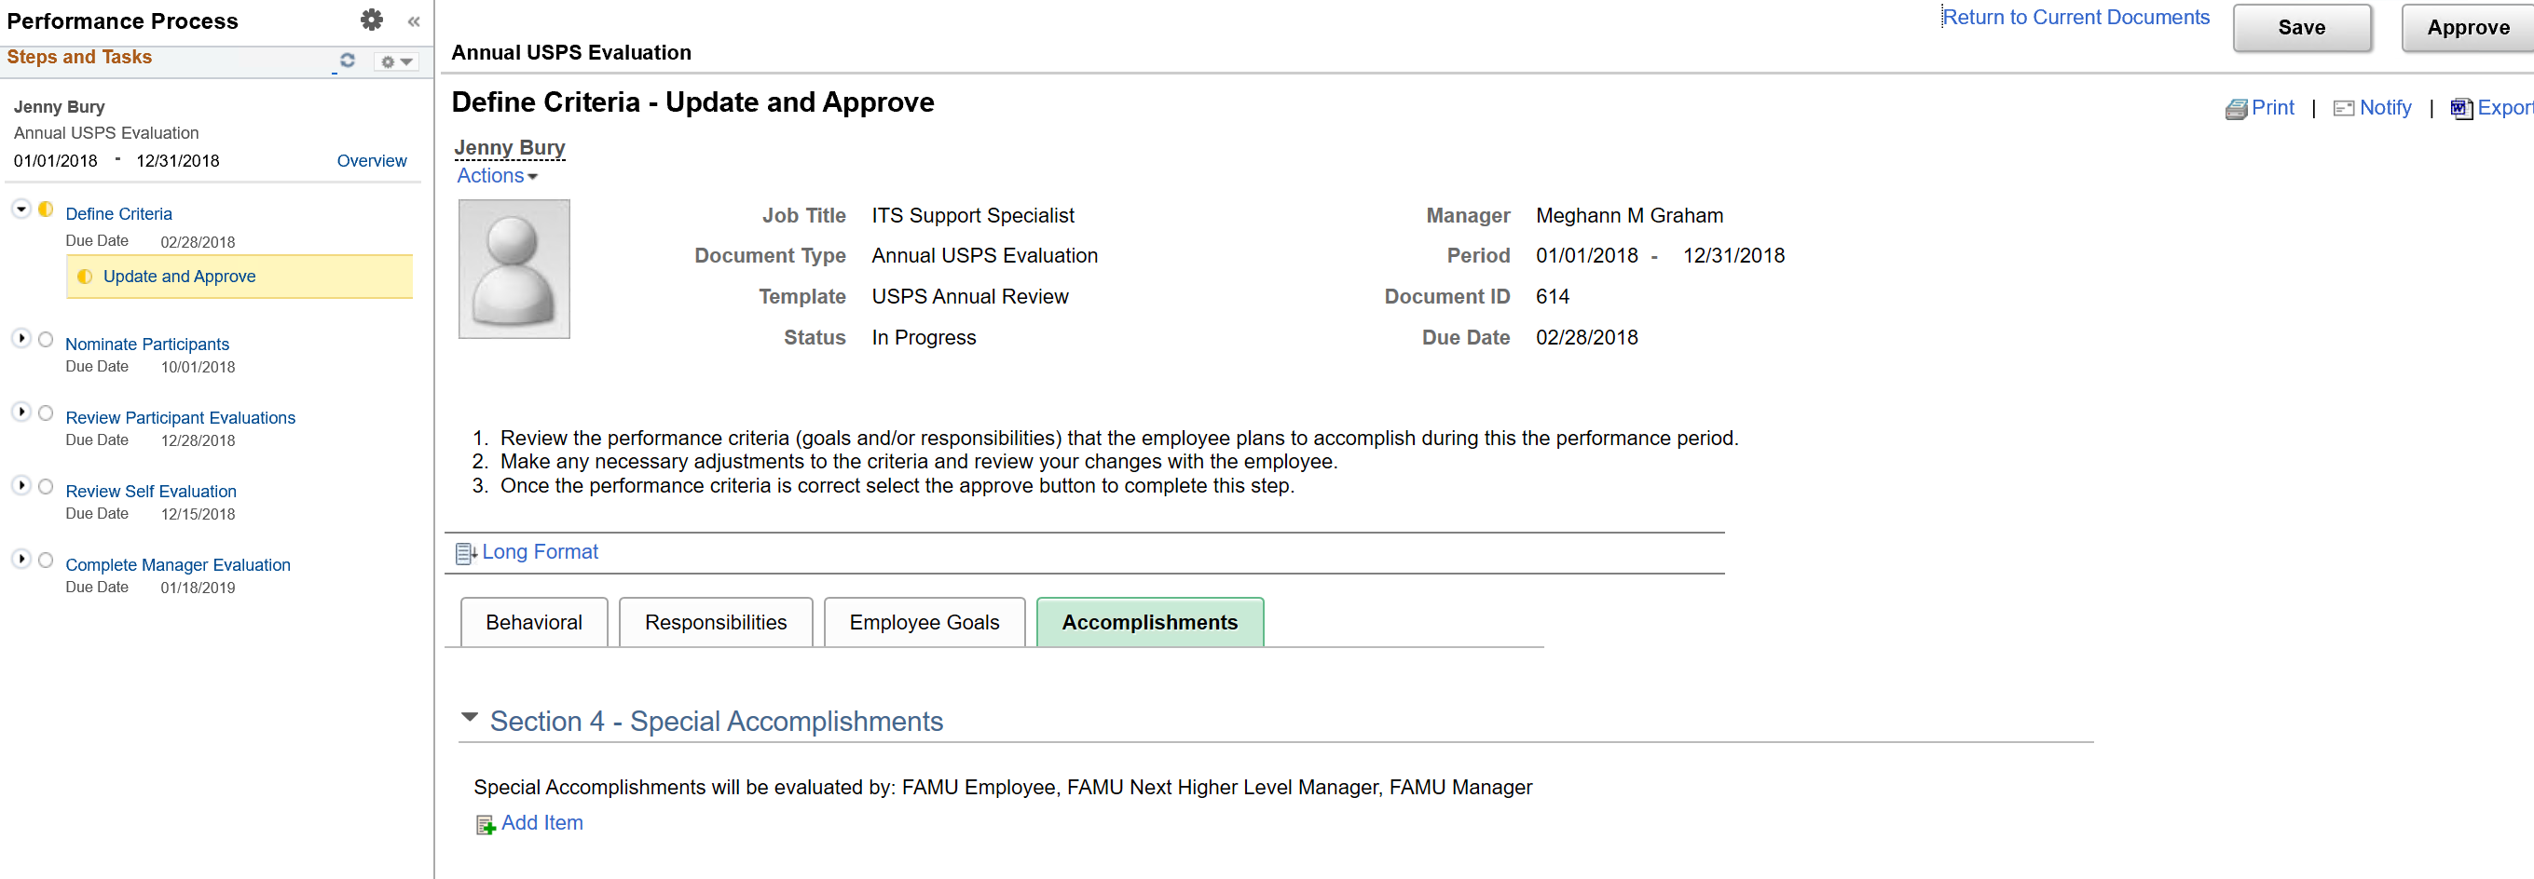
Manager – Special Accomplishments
Managers will have the ability to add Special Accomplishments
Notes:
Manager will add any special accomplishments for the employee if it is appropriate.

Slide 14
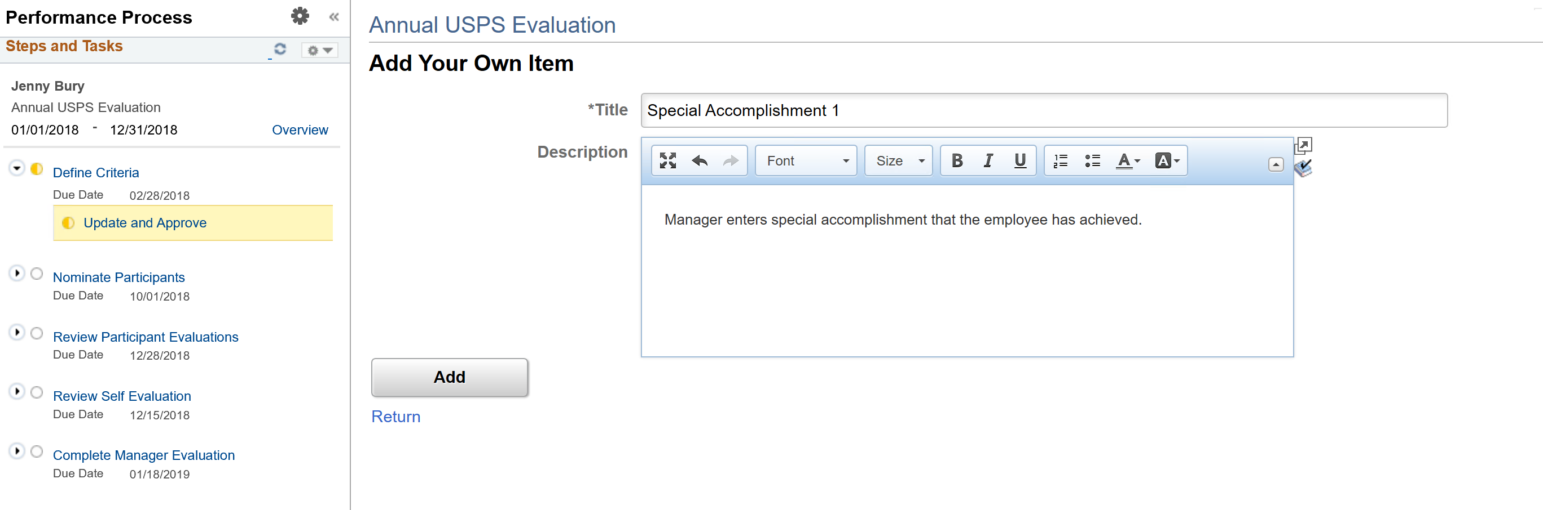
Manager – Adds Special Accomplishment
Managers will have the ability to:
  Add Title
  Description
Notes:
Managers will add a title and description when adding a special accomplishment. Please note that the adding of a goal and special accomplishment is optional and is not required.
Once you have completed adding all of the criteria, you will notify the employee via email, or phone and ask the employee to review the criteria and add any additional goals or accomplishments.

Slide 15
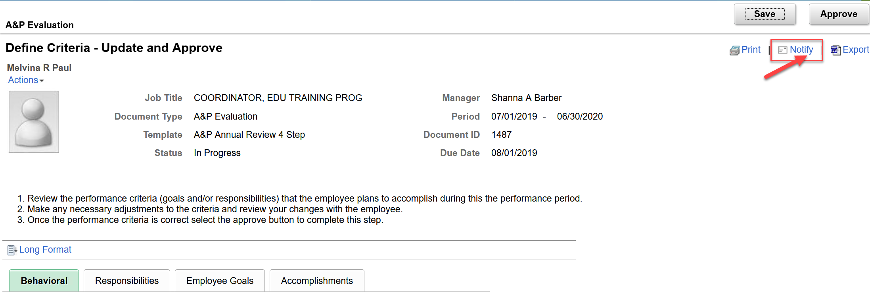
Manager – Notifies Employee
Manager will notify the Employee that they can access the evaluation to review the criteria and add any Achievements from the previous year
Notes:
Once the Manager has completed entering the Responsibilities, Goals, and Accomplishments, the manager may notify the employee.
This notification can be via outlook email, phone call, or via PeopleSoft application by clicking on the Notify link.

Slide 16
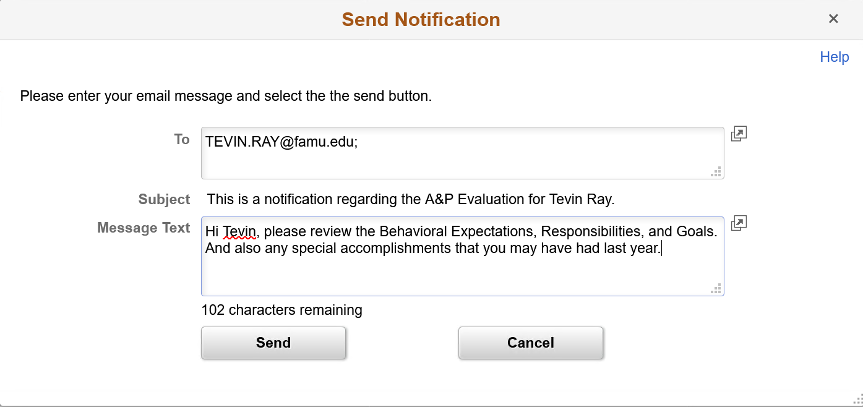
Manager – Notifies Employee
Sends an email to the employee
Notes:
Enter the employee’s email address and type a message to the employee that you would like for them to access his/her performance document and add any additional goals or accomplishments.

Slide 17
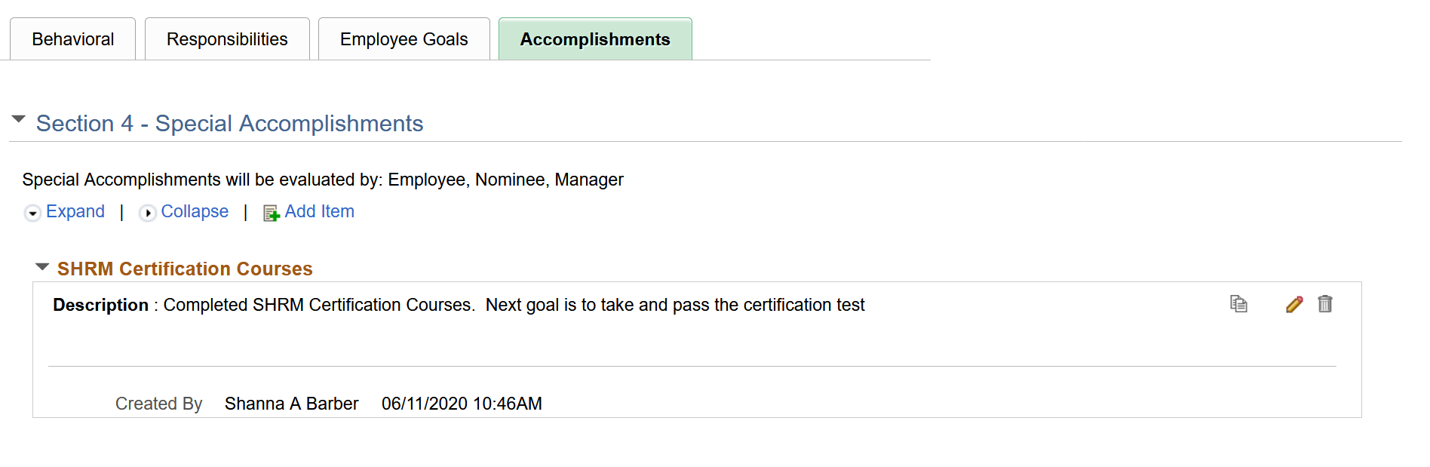
Manager – Review Content entered by Employee
Manager will review Special Accomplishments that were added by the employee.
Manager will have the ability to:
  Edit the Details
  Delete the Special Accomplishment
Notes:
If the employee adds additional accomplishments to the performance document, the Manager will receive an emal notification that an accomplishment has been added. The Manager will review the special accomplishment added and will have the ability to edit the details and can also delete the special accomplishment
If the employee adds any additional goals and/or accomplishments the Manager will receive an email notification that a goal or accomplishment has been added
The Manager will access the employee performance document to review all items entered by the employee. The manager will have the ability to edit the details or delete an item that may have been added by the employee.

Slide 18
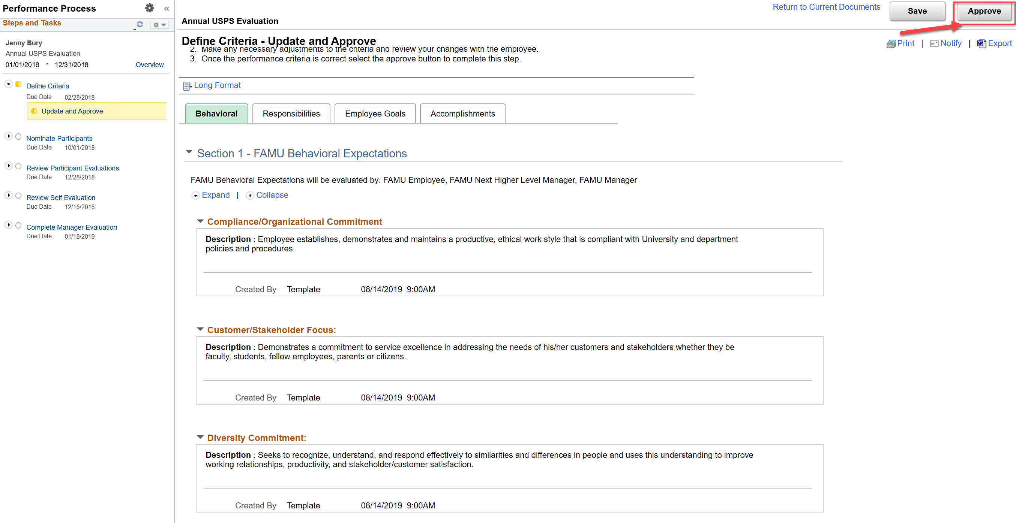
Manager – Approves Criteria
Manager reviews all sections of the Performance Document and will approve the Criteria by Due Date
Note: Employee does not have access to approve the criteria and once approved will no longer have access to add.
Notes:
Manager will review all sections one more time, setup time to meet and review with the employee before approving the criteria.

Slide 19
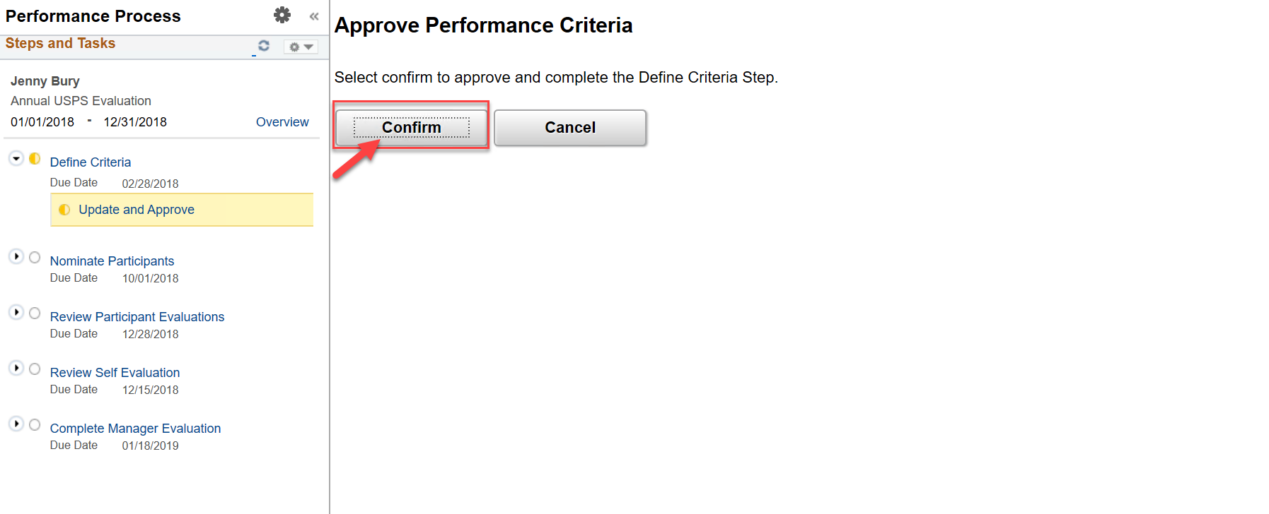
Manager – Confirms Approval of Performance Criteria
Manager approves Performance Criteria
Note: Employee does not have access to approve the criteria and once approved will no longer have access to add.
Notes:
Once the criteria is confirmed, the Define Criteria step is considered finalized.
To make changes, the Manager will need to reopen the criteria.
Additionally, the employee will no longer have access to add content to the performance document.

Slide 20
Invite Participants phase - Optional
Notes:
The Manager has the option to invite others within your organization to participate in the performance review of an employee. This may be an indirect report such as a Supervisor, Team Lead, Customer, etc.

Slide 21
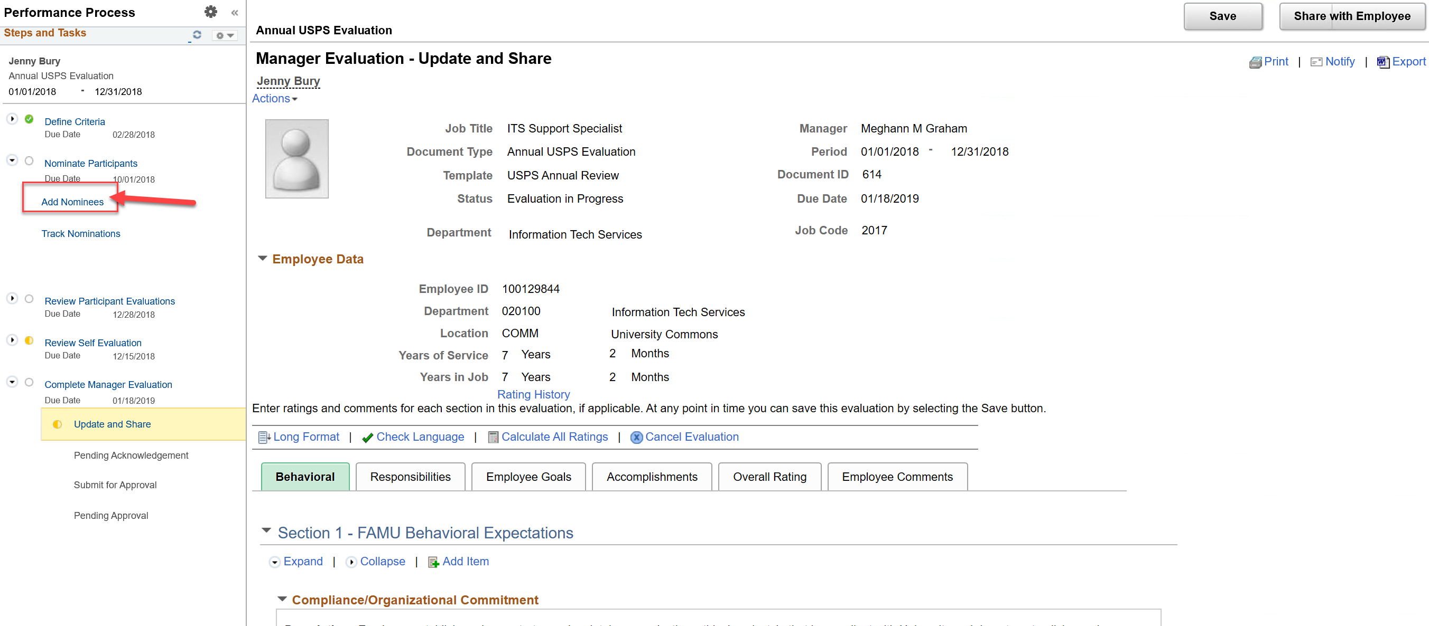
Manager – Adds a Nominee
After approving the Criteria, the Manager has the ability to Nominate a Participant for the Employee Review
Manager will Add a Nominee
Notes:
Manager will click on the Add Nominee link to add a Nominee. A Manager can invite up to 5 individuals to participate in the performance evaluation of an Employee

Slide 22
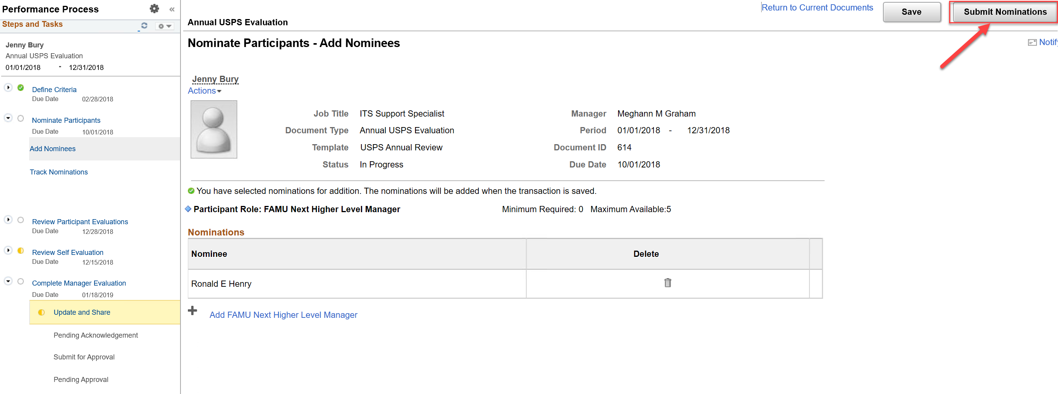
Manager – Submits the Nomination
After selecting Nominee(s) the Manager will submit the request
Notes:
After selecting the Nominee(s), the manager will submit the request.
Once submitted, all individuals will receive an email notification indicating that they have been invited to participate in the evaluation.
The employee will have the option to accept or decline the invite. If accepted or declined, the Manager will receive an email notification stating the decision of the Nominee.

Slide 23
Managing Nomination Requests
Notes:
The Manager will have the ability to track and manage the nomination requests.

Slide 24
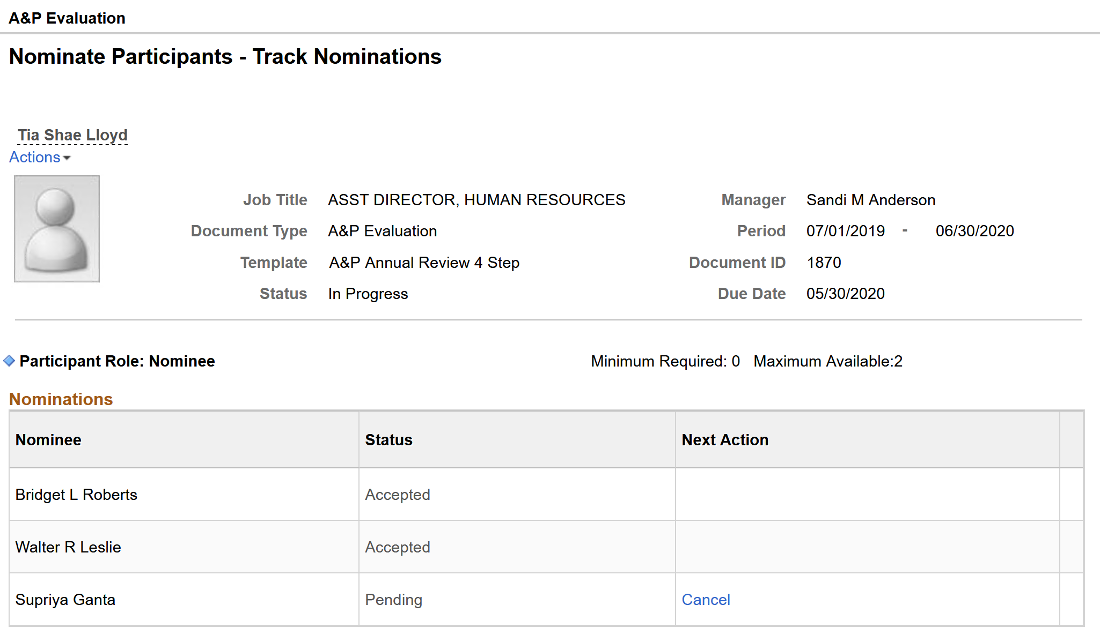
Manager – Track Nominations
The Manager will have the ability to view Nomination requests
Notes:
The Manager will have the ability to view the nomination requests that were sent for the employee review. You can see if the invite was accepted or if the invite is still pending.
If there is a request still pending the Manager can cancel the request or they may just want to reach out to the participant to let them know that you have requested feedback from them before cancelling the request.

Slide 25

Manager waits for Nominee to complete Nominee-Evaluation
Notes:
When the Nominee completes the Nominee Evaluation, the Manager will receive an email notification that the nominee-evaluation has been completed. Manager can the review the Nominee’s evaluation of the employee.

Slide 26
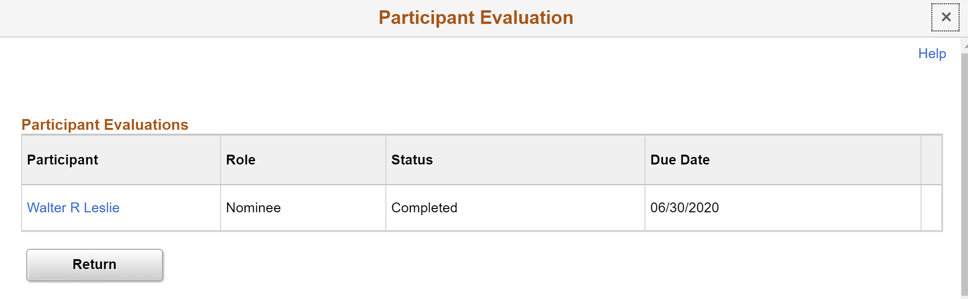
Manager – Review Nominee Evaluation
The Manager will access and review the Nominee Evaluation
Notes:
The Manager will access and review the Nominee’s evaluation by clicking on the Review Participant Evaluations link from the Steps and Tasks to the left of the employee’s evaluation.
The Nominee Evaluation will pop up in another window so you may want to ensure that your popup blocker is disabled.
If you run into issues with popup blocker, please contact the Help Desk

Slide 27
Manager waits for Employee to complete self-evaluation
Notes:
Manager can begin completing the Manager’s evaluation at any time after the Define Criteria phase is complete but should wait until the Nominee evaluation and Employee self-evaluation have been completed.
The Manager’s evaluation provides a 360 degree feedback view for the Manager. This means that the Manager is able to view the Employee and Nominee(s) ratings and comments before assigning the Manager rating and comments.
If the due date for the completion of the self evaluation is approaching the manager may want to reach out to the employee via email or phone to ask that the employee completes the self-evaluation

Slide 28
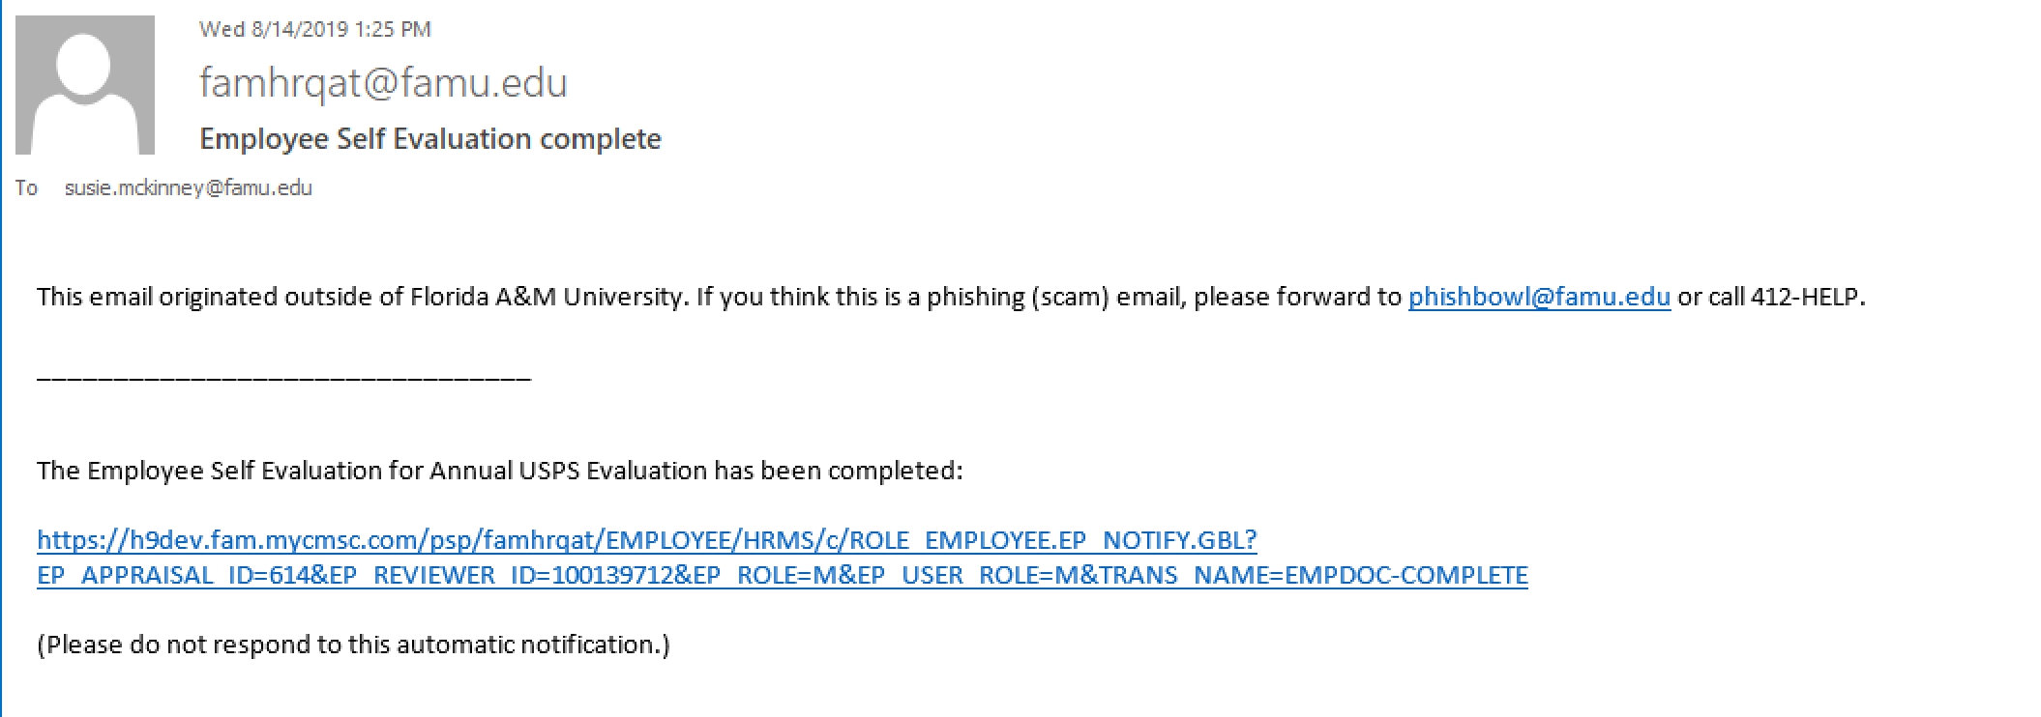
Manager – Receives Email Notification
Manager receives email notification that Employee has completed the Self Evaluation
Notes:
Once the employee completes the self evaluation, the manager will receive an email notification that the employee self evaluation have been completed.
If the Employee does not complete the self evaluation by the due date, the manager can still move forward with the managers evaluation without the employee evaluation

Slide 29
Manager begins the Manager Evaluation
Notes:
The important thing to remember is that Managers will have total ability to keep the performance evaluation steps moving to meet the due date requirements

Slide 30
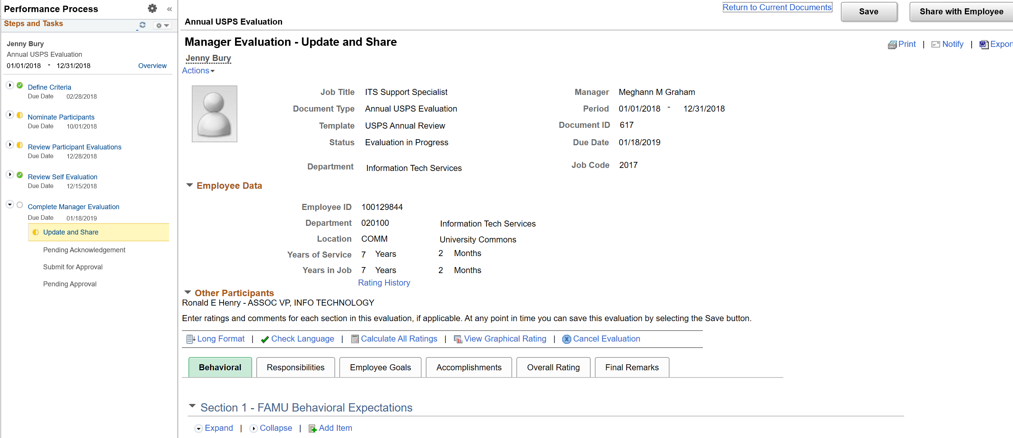
Manager –Manager Evaluation
Manager will begin adding ratings and comments
Notes:
The Manager will begin to add a rating and a comment for each item within each section.

Slide 31
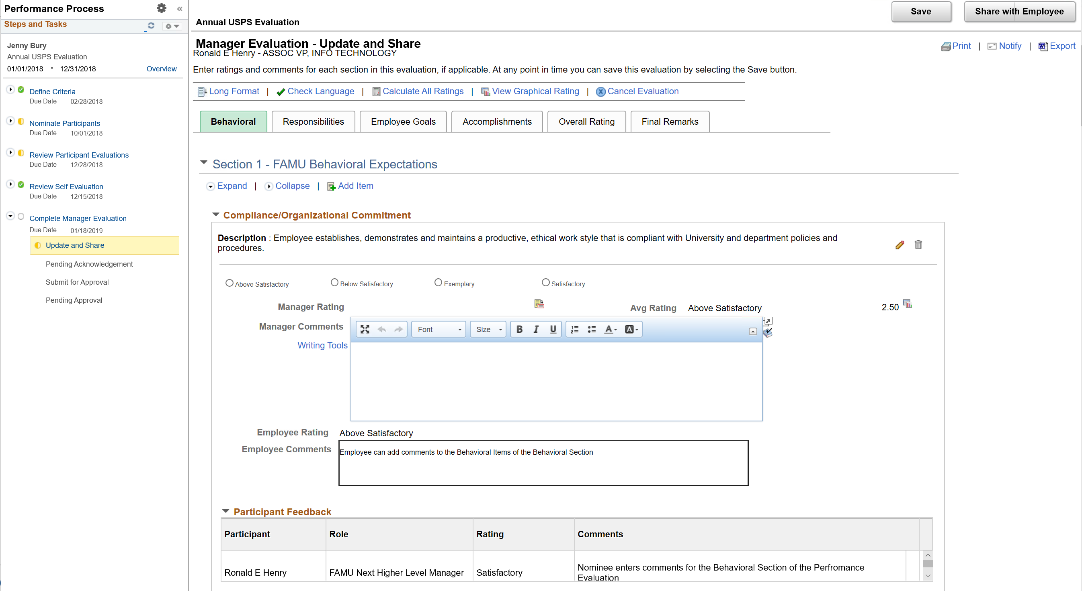
Manager –Manager Evaluation – Behavioral Section
Manager has the ability to review both the Employee and Nominees Rating and Comments
Notes:
While the Manager is adding ratings and comments, the Manager can review the Employee and Nominee(s) ratings and comments. This provides for the 360 degree feedback.
Manager’s may add an attachment if needed as part of the evaluation process.
Always remember to click the save button to save your work.

Slide 32
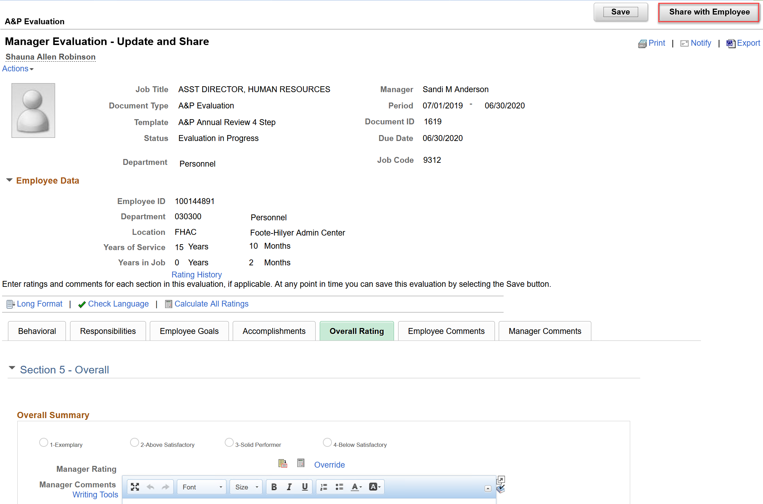
Manager – Manager Evaluation – Share with Employee
Manager will Share Evaluation with Employee
Notes:
Once the manager has completed the manager’s evaluation, they will share this information with the Employee by clicking on the “Share with Employee” button.
Once shared with employee, the manager will schedule an in-person meeting with the employee to review and discuss together.

Slide 33
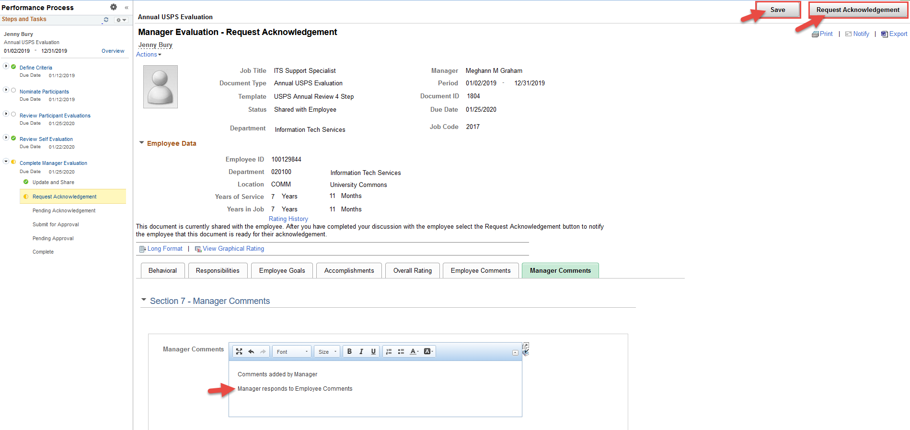
Manager – Requests Acknowledgement
Manager will request Acknowledgement from Employee
Notes:
After the meeting has taken place, the Manager will request acknowledgement of the performance document from the Employee.
Once the Employee has acknowledged the performance document, the Manager will receive an email that the document has been formally acknowledged.

Slide 34
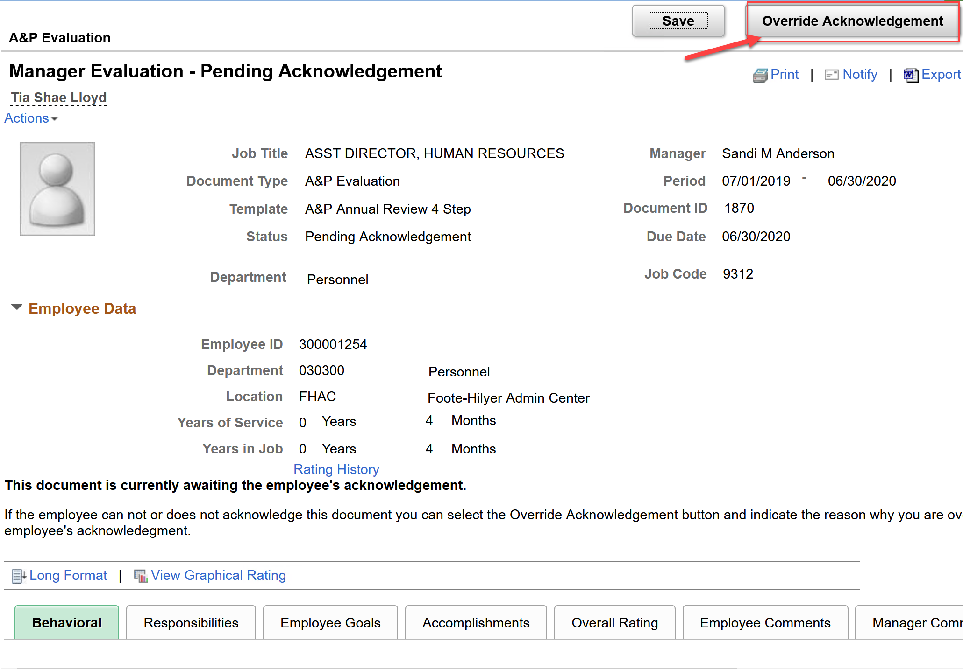
Manager – Overrides Acknowledgement
Manager can override an Employee’s acknowledgement
Notes:
If the Manager has requested acknowledgement from the Employee and the employee has not acknowledged the document by due date, the Manager has the ability to override the employee acknowledgement.
This is important because all of the steps within the performance document have due dates and you may have to override the acknowledgement in order to keep the performance process moving.

Slide 35
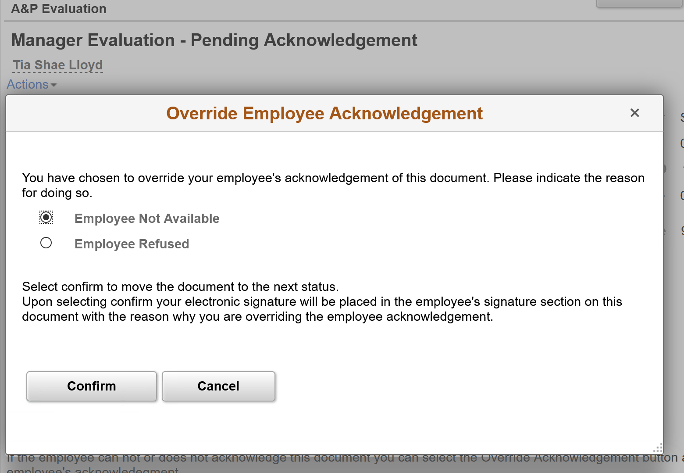
Manager – Overrides Acknowledgement
Manager will select a reason before confirming the override of the employee acknowledgement
Notes:
When overriding an Employee Acknowledgement, the Manager will select one of the two reasons prior to confirming the override of the employee acknowledgement

Slide 36
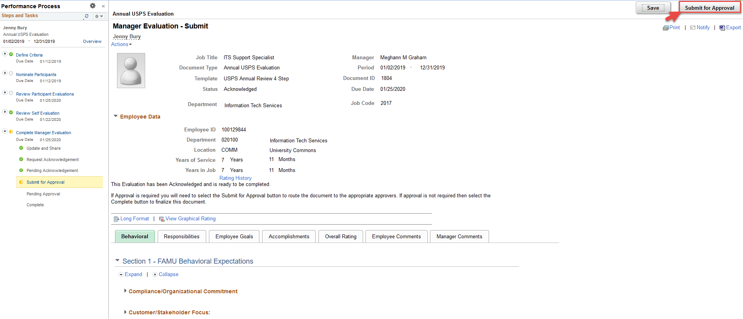
Manager – Submits Evaluation for Approval
Manager submits evaluation for Approval
Notes:
Once the performance evaluation is acknowledged via Employee Acknowledgement or Override of the acknowledgement, the Manager will then submit the evaluation for approval from next level manager
Notification is received when document has been approved.

Slide 37
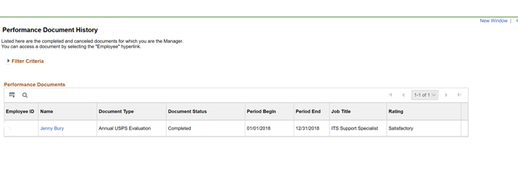
Manager – Performance Document Complete
Performance Document is now completed
Manager can access document under performance document history
Notes:
Once approved the system will close the performance document and the evaluation is considered closed. Manager can now access the performance review from within Manager Self Service, Team Performance, Historical Documents.

Slide 38
Resources
ePerformance Guide 101
OvERVIEW OF EPERFORMANCE PROCESS
summary of changes
step-by-step training guide
frequently asked questions (FAQs)
Links to other resources
HR website
hr contacts
Notes:
The ePerformance Guide 101 in the go to resource for everything relating to ePerformance. Some of the topics you will find inside the guide is an overview of the ePerformance process; a summary of what’s changed from the manual process; a step-by-step training guide for the manger and employee; frequently asked questions – when learning a new process, many employees will have the same questions. The FAQs is the place to see what questions have been asked and the answers to those questions; The ePerformance Guide 101 also has links to other helpful resources such as FAMU Regulations that govern the ePerformance process and related collective bargaining agreements (CBAs). Additionally, you have as a resource the Human Resources website where the ePerformance Guide 101 resides. Lastly, you have a list of HR contacts for ePerformance when you aren’t able to find answers using the ePerformance Guide 101 or HR website.

Slide 39

Notes:
Joyce

Slide 40
Closing Remarks/Questions
Thank you!
Notes:
Joyce

