Slide 1



People Soft ePerformance Module
Overview
Office of Human Resources
September 2020
Notes:
The University has invested in Oracle’s PeopleSoft suite of applications as its Enterprise Resource Planning (ERP) systems. The iRattler Human Capital Management (HCM) application administers the University’s Human Resources, Benefits, and Payroll. The HCM application will be upgraded to v9.2 and PeopleTools 8.56.04.
Upgrading the application provides the opportunity for the transformation of business processes, elimination of manual processes and includes several customizations, streamlining of workflow, and the introduction of a more user-friendly system. In addition, the University will leverage new features and improved functionality such as mobility enhancements and fluid mechanisms, to provide improved customer service.
Further, the University will use the upgrade to assess its current business environment and identifying opportunities for improvement, automation, integration and better reporting. This upgrade will also ensure the University has Oracle support for the application software.

Slide 2
ePerformance Overview
ePerformance module is an evaluation management application.
It is used for assessment of performance of employees in the organization.
The roles responsible for administering the process are HR Administrator, Employee, Manager, Nominee and Higher-level Manager.
ePerformance supports the entire planning and evaluation process, from planning and aligning employee performance or development goals with enterprise objectives, through assessing and rewarding employee performance results within the right behaviors.
Notes:
ePerformance is a self-service evaluation management module for managers, employees, and human resources administrators. The ePerformance module can be used as a tool for planning, collaboration, communication, assessment, and monitoring evaluations for two purposes: performance and development.
What is ePerformance?
• Streamlines the performance management process into one FAMU‐wide, web‐
based solution, creating a common employment experience across the University
• Allows all FAMU employees and managers to develop, review, and assess employee goals and competencies required for their roles
Allows all employees and managers to align their personal goals to University‐wide and School initiatives

Slide 3
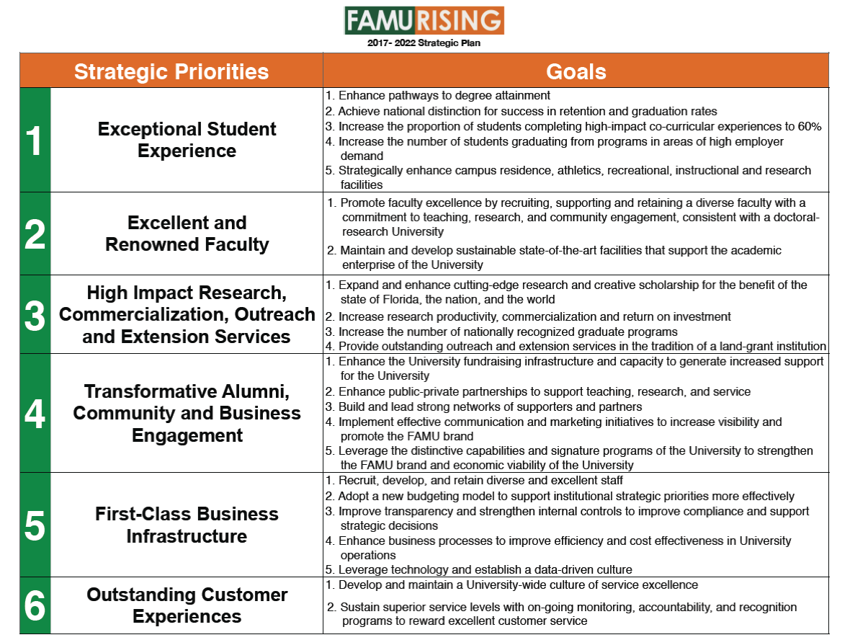
University Strategic Plan – FAMU RISING
Notes:
The Office of Human Resources has three Strategic Imperatives that are aligned with the University Strategic Plan SP 5 First Class Business Infrastructure. They are Diversity & Inclusion, Operational Effectiveness and Efficiency and Talent Management.
ePerformance falls under the HR Strategic Imperative - Operational and Effectiveness and Efficiency
As you are aware, we have six (6) Strategic Priorities in the University’s Strategic Plan – we are in year two of the plan.
Our goals though education and communication, and alignment to ensure that our team members have a direct line of sight between what they do and how they support the Division and University.

Slide 4



ePerformance @ FAMU
Notes:
Easy
Fast
Paperless

Slide 5
ePerformance @ FAMU
What’s Changing? What’s Improving
Changes/Enhancement – Overall
New form; One (1) form for all A&P including A&P Executive Service and USPS employees
USPS Rating Cycle – January 1 – December 31
Change ratings for A&P and USPS
Universal Behavioral Expectations
ePerformance Workcenter
Notes:
New form; 1 form for all
Universal Behavior Expectations
USPS Rating Cycle - Jan 1 - Dec 31
Change ratings for A&P and USPS to
Leading performance
Strong performance
Solid performance
Not meeting expectations
The automated workflow of ePerformance will streamline the current, clunky paper process

Slide 6
Universal Behavioral Expectations
Compliance and Ethics
Customer Satisfaction and Engagement
Diversity and Inclusion
Teamwork
Safe, Secure Work Environment
Non-Hostile Work Environment
Attendance

Slide 7
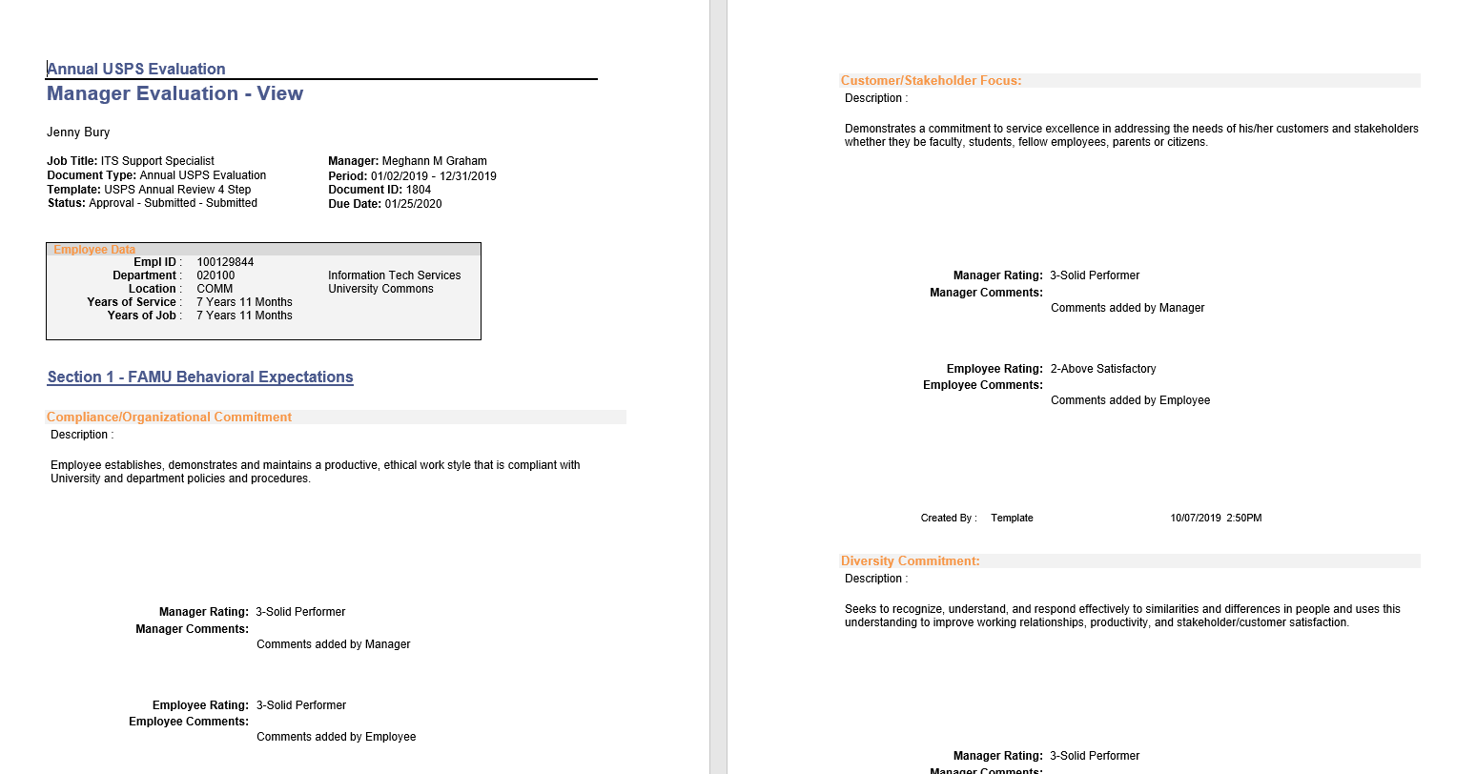

One Form, New Form

Slide 8
Rating Cycle for A&P and USPS
A&P Rating Period - July 1 - June 30 (Fiscal Year)
*NEW USPS Rating Period - January 1 - December 31 (Calendar Year)

Slide 9
New Ratings - Same for A&P and USPS Employees
Exemplary
Above Satisfactory
Solid Performer
Below Satisfactory

Slide 10
New Ratings con’t
Rating | Description
Exemplary | Employee performance level exceeds expectations surpasses requirements and is at the highest level of performance. Work serves as an example of others.
Above Satisfactory | Employee performance level is higher than adequate expectations and requirements for the position and approaching the highest levels of performance. Working towards an exemplary rating.
Solid Performer | Employee performance meets adequate expectations, and requirement for the position but not approaching higher level of performance. Working towards an above satisfactory
Below Satisfactory | Employee performance level fails to meet adequate expectations and requirements for the position. Sustained improvement is needed.

Slide 11
ePerformance @ FAMU Implementation
The Performance Management process for A&P and USPS employees will be paperless.
Supervisors will have direct access to performance evaluations of their direct reports.
All parties involved will receive an email notification when action is required by the participant.
All A&P and USPS employees will be trained prior to obtaining access to the system.
Notes:
BEFORE Implementation:
POST Implementation:

Slide 12
ePerformance @ FAMU Implementation con’t
Improvements to Key Processes:
Improved operational efficiency and effectiveness through the use of new features, functions and enhancements that will boost productivity, consolidate tasks and enhance delivered support.
New capabilities for an enhanced, simplified user interface, to include mobile friendly and individually customizable navigations.
Continued integration between HCM, other iRattler PeopleSoft applications and third-party applications.
Notes:
For example, the upgrade will improve the screening of applicants to ensure they meet the minimum qualifications.
For example, improvement of accountability and accuracy of time reporting and approvals.
For example, employees should be able to perform basic functions within iRattler via their cellular phones.
For example, campus directories and bolt on electronic personnel forms like the epaf that connect directly to HCM tables making HR transactions more efficient.
For example, the ability to apply tax updates and the financial reporting processes should be improved.

Slide 13
ePerformance Process

Slide 14
ePerformance Process - Setup
  Document Types - identifies the types of documents that are valid for the performance evaluation
    A&P
    USPS
    Probationary
Notes:
First step in setting up ePerformance is to create the Document types. Document Types identify the types of documents that are valid for an organization. The document types that have been configured are: A&P, USPS, and Probationary

Slide 15
ePerformance Process - Setup
  Roles - enables you to include feedback from participants other than the employee and the employee's manager (for example, peers or customers which are referred to below as a Nominee)
  The roles that have been configured for the ePerformance documents are:
  Manager
  Employee
  Nominee
Notes:
Second step is to define the roles. Roles enables you to include feedback from participants other than the employee and the employee’s manager such as peers or customers.
The roles that have been configured are: Manager, Employee, and Nominee

Slide 16
ePerformance Process - Setup
  Sections - form the structure of a performance or development document
    Behavioral Expectations
    Responsibilities
    Employee Goals
    Accomplishments
    Overall Rating
    Employee Comment
    Manager Comment
    eSignature Section
Notes:
Third step in the ePerformance setup is to create the sections that will form the structure of a performance or development document. The sections that have been configured are:
Behavioural Expectations
Responsibilities
Employee Goals
Accomplishments
Overall Rating
Employee Comments
Manager Comments
eSignature Section

Slide 17
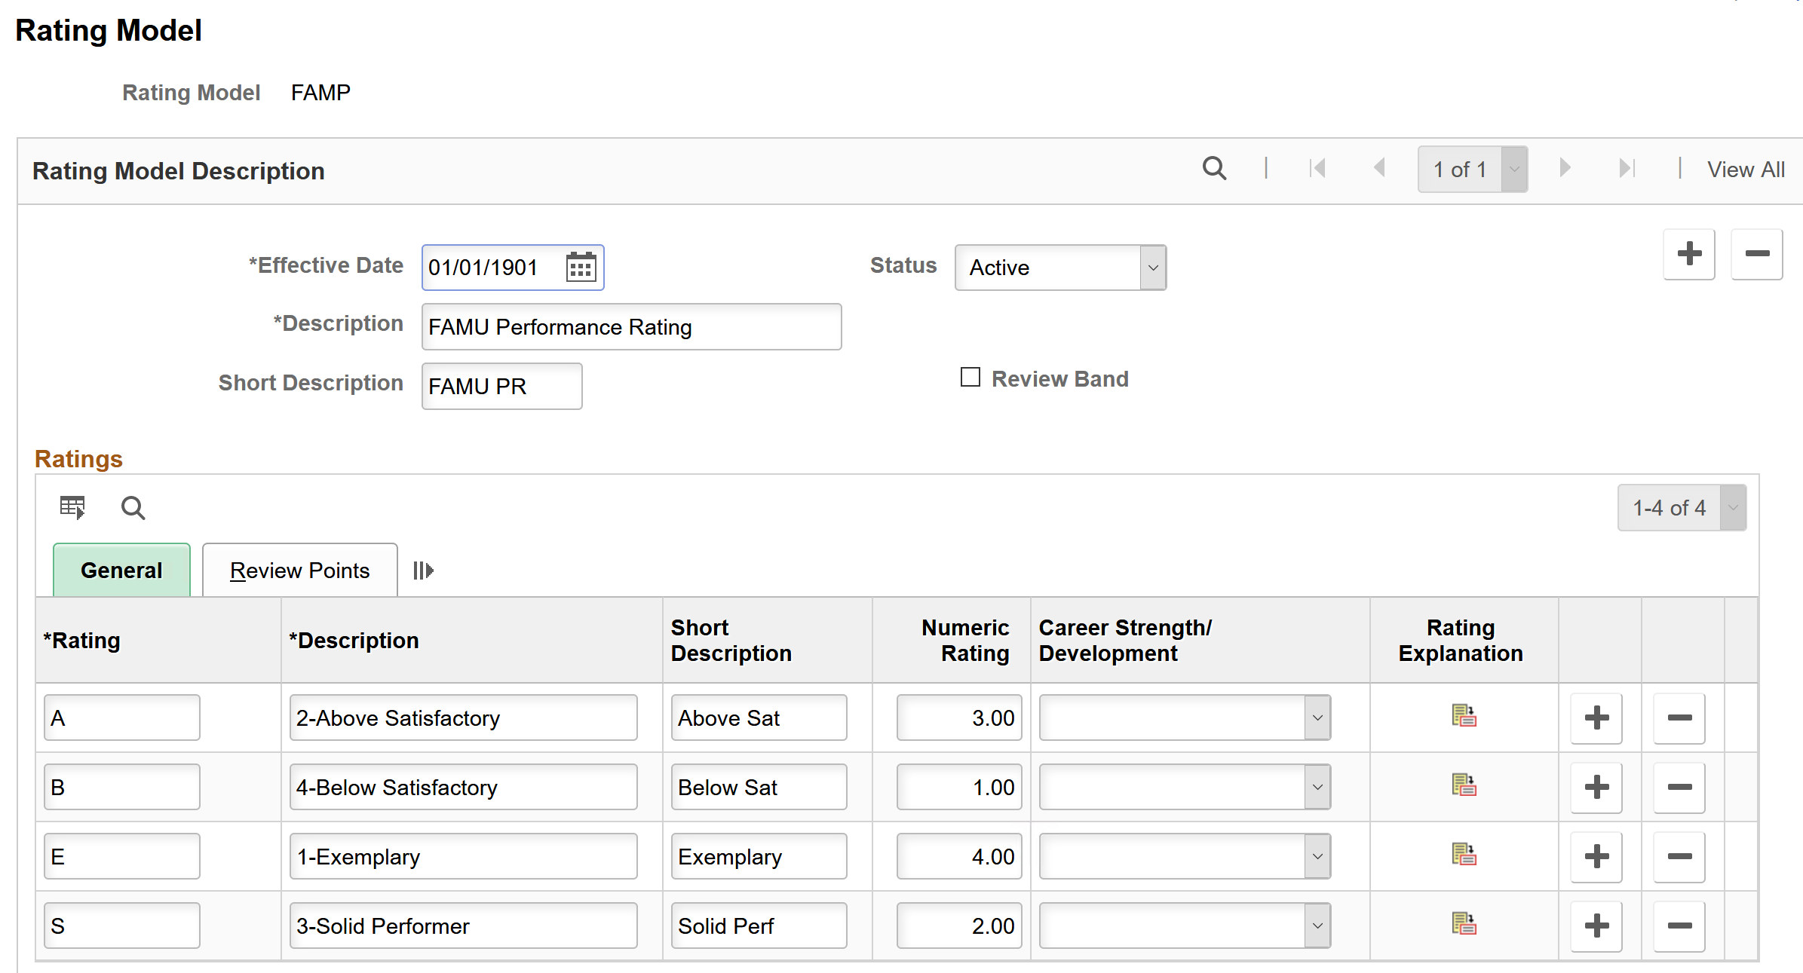
ePerformance Process - Setup
  Ratings - rating models are used to define values for the rating sections of a performance document as well as rating overall performance.
Notes:
The last step is to establish the Rating Model. Rating models are used to define values for the rating sections of the performance document and is also used to provide an overall rating of performance

Slide 18
ePerformance Process - Setup
  Templates - pulls together the document types, roles, and sections and allows the following:
    Enables you to activate steps in the business process.
    Defines which type of employees can participate in the performance or development process.
    The activities each role can perform
    Defines actions that each role or roles can perform for each process
Notes:
Once the Document Types, Roles, Sections, and Ratings have been defined they are all pulled together into an ePerformance Template.
Templates control the ePerformance process:
It enables the activation of steps in the business process, defines the type of employees that can participate in the performance process It also defines the activities that each role can perform along with the actions that the role can perform for each process.
as it is where the roles of those that can participate in the review process is established. It also provides the capability to define the activities that each role can perform. For example: Who will define the criteria for an ePerformance evaluation. Who has the authority to nominate others. Who can track the progress of nominated participants.

Slide 19
ePerformance Process - Setup
    Allows the establishment of tabs to be used in displaying the document sections
    Allows for the structure of rules for each section
    Allows for adding content values
Notes:
Templates will allow for the establishment of tabs to be used in displaying the document sections
Allows for the structure of rules for each section
Allows for adding content values

Slide 20
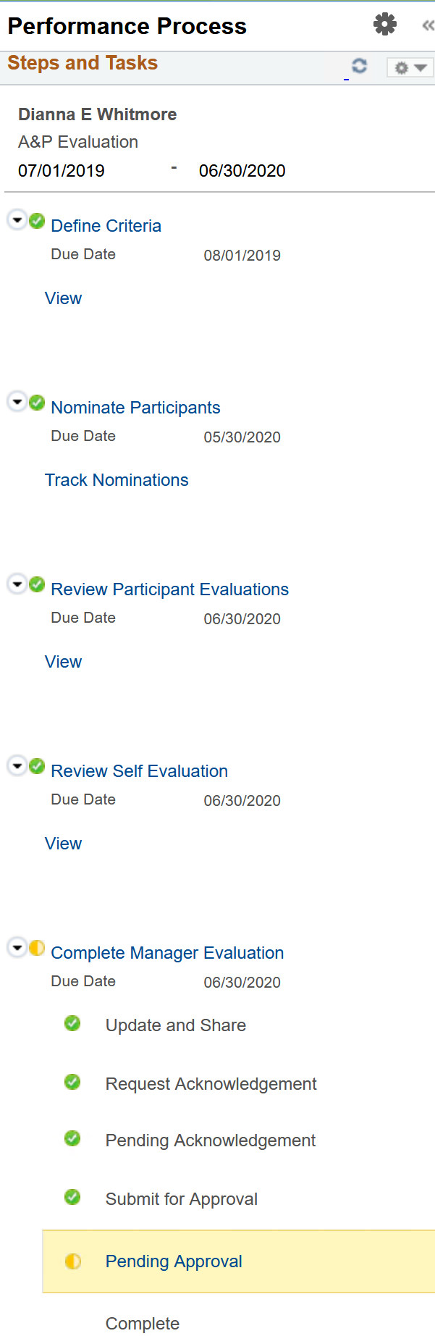
ePerformance Steps – Manager View
Define Criteria
Nominate Participants
  Track Nominations
Review Participant Evaluations
Review Self Evaluation
Complete Manager Evaluation
  Update and Share
  Request Acknowledgement
  Pending Acknowledgement
  Submit for Approval
  Pending Approval
    Complete
Notes:
Once the template has been defined and the Performance evaluation is created a listing of Steps and Tasks will appear for the Managers to follow. Based on the templates defined for A&P and USPS here is the Manager’s view.

Slide 21
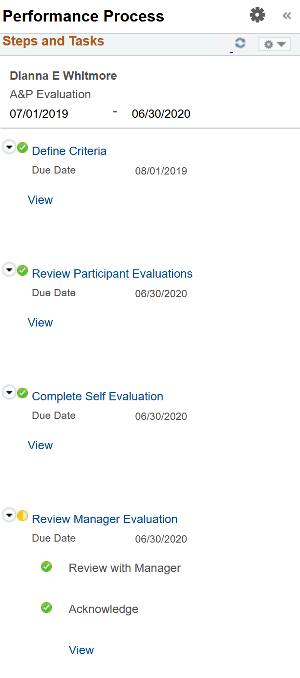
ePerformance Steps – Employee View
Define Criteria
Review Participant Evaluations
Complete Self Evaluation
Review Manager Evaluation
  Review with Manager
  Acknowledge
Notes:
Additionally, the Employee will have a different set of steps and tasks . Here is a view of the steps and tasks that the employee will follow in completing the evaluation.

Slide 22
ePerformance Process Steps
Define Criteria
Allows users to add goals and other content to the performance review.
Finalize and Approve
Allows you to define the role(s) who can complete the Finalize Criteria step in documents so the evaluation steps can begin.
Nominate Participants
Enables the Nominate Participants step, that provides 360-degree feedback functionality
Notes:
Define Criteria step
Allows the ability for users to add goals and other content to the performance review
Finalize and Approve
Allows you to define the roles as to who can complete and finalize the criteria step so that the evaluation steps can begin.
Nominate Participants
Enables the Nominate Participants step, that provides the 360 degree feedback functionality

Slide 23
ePerformance Process Steps
Review Participants Evaluation
Allows you to establish who can access and view the names of people that are participating in the evaluation
Self-Evaluation
Provides the opportunity for Employee to rate themselves
Manager Evaluation
Identifies the process for reviewing the document with the employee and when this review should take place relative to a formal approval of the document.
Also controls when actions such as:
Submit for Approval
Complete
Share with Employee
Request Acknowledgement
Are available to the Manager
Notes:
Next we have the Review Participants Evaluation step which allows you to establish who can access and view the names of people that are participating in the evaluation
Self-Evaluation Step, provides the opportunity for the employee to rate themselves
Manager Evaluation step - identifies the process for reviewing a document with the employee, and when this review takes place relative to a formal approval of the document. It also controls when actions such as Submit for Approval, Complete, Share with Employee, and Request Acknowledgement are available to the manager.

Slide 24
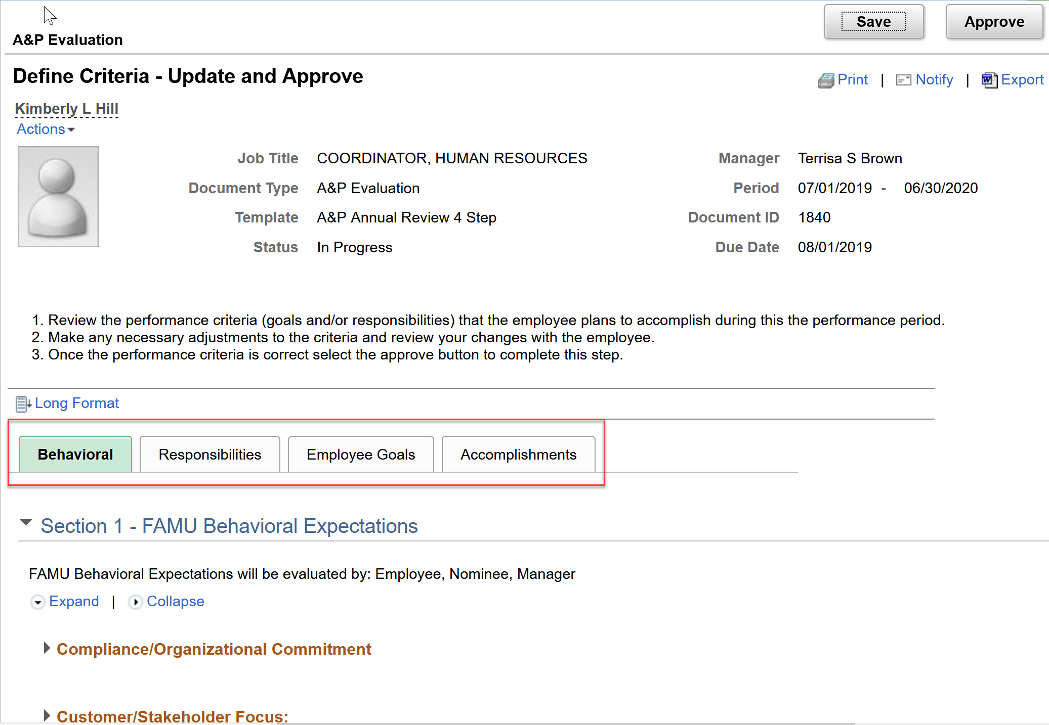
ePerformance Process Setup
Define Criteria
Behavioral Expectations – defined by Leadership
Responsibilities – defined by Manager
Employee Goals – defined by manager and reviewed with employee
Special Accomplishments – defined by employee and manager
Notes:
Now that the documents have been created, let’s talk more about the ePerformance process steps. The first step for both the Manager and Employee is the Define Criteria step. Within this step the Manager and Employee will view the Behavioral Expectations.
Behavioral Expectations are defined by Leadership and cannot be modified or deleted from the performance document.
Responsibilities shall be defined by the Manager. Responsibilities will be added based on the Job Description for the Employee. If Job Descriptions does not accurately reflect an employees current responsibilities it is advised that they should contact HR and update them. An Employee will not have the ability to add, modify, or delete responsibilities. Only Managers can add, modify, or delete a responsibility.
Employee Goals defined by manager and reviewed with employee
Special Accomplishments – Both the Manager and Employee will have the ability to add items to the performance document for these sections.

Slide 25
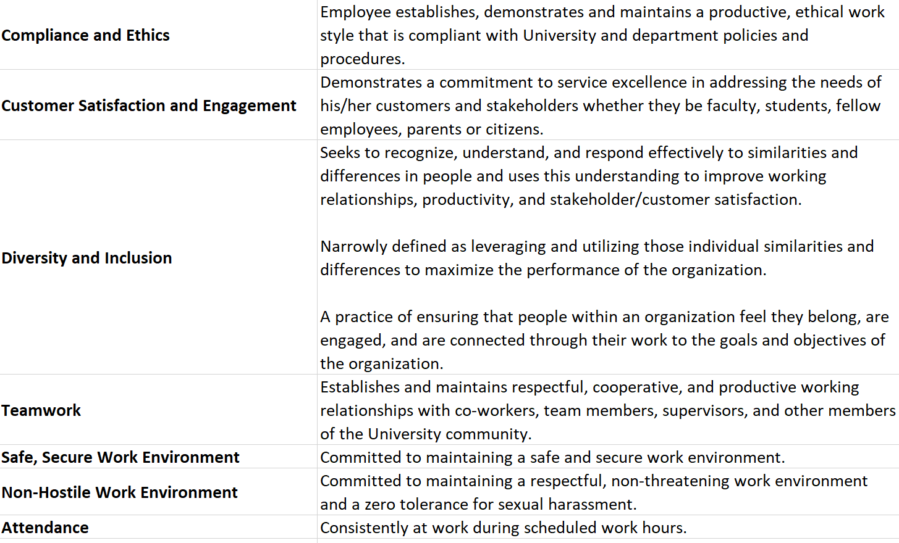
ePerformance Process – Behavioral Expectations
Notes:
Here is the listing of the Behavioral Expectations that have been configured

Slide 26
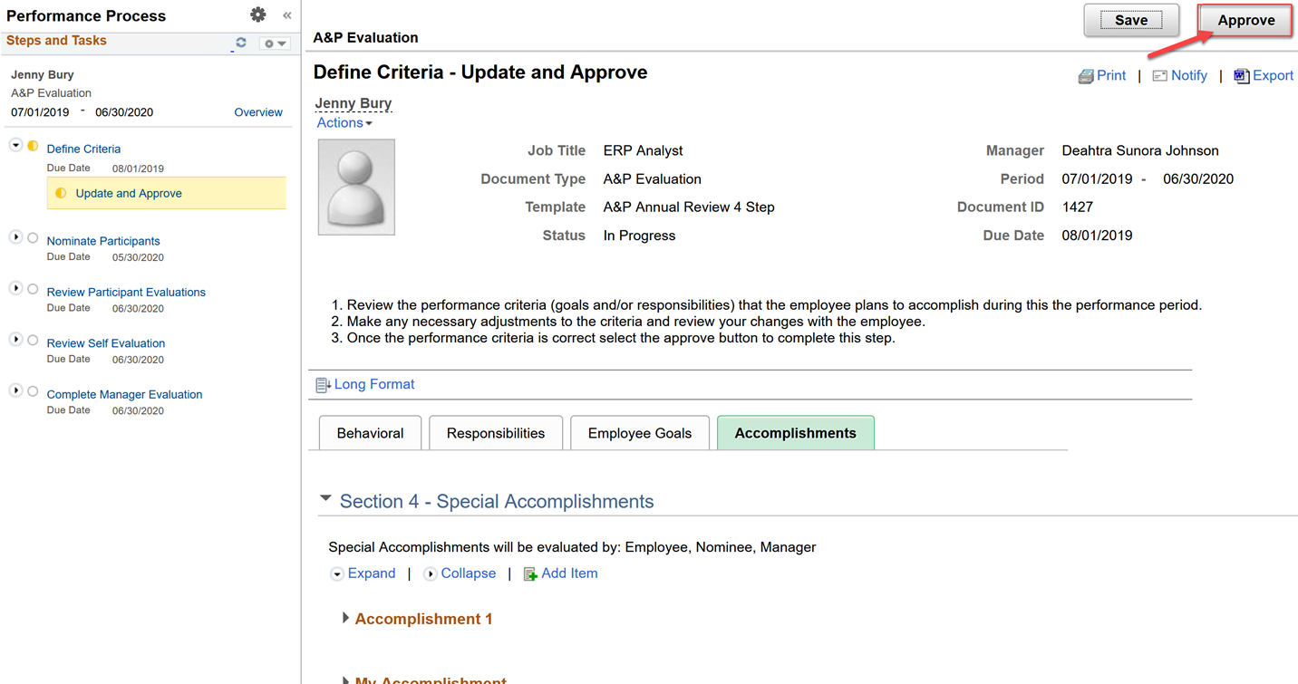
ePerformance Process Setup
Finalize and Approve
Manager will review with Employee to Finalize
Manager will approve the Criteria
Notes:
Finalize and Approve
After Manager and Employee has had the opportunity to add all the criteria that the employee will be evaluated on the Manager and Employee should meet to review the criteria before finalizing. To finalize the Manger will access the performance document and approve the criteria. Once approved the evaluation is open to except ratings and comments.

Slide 27
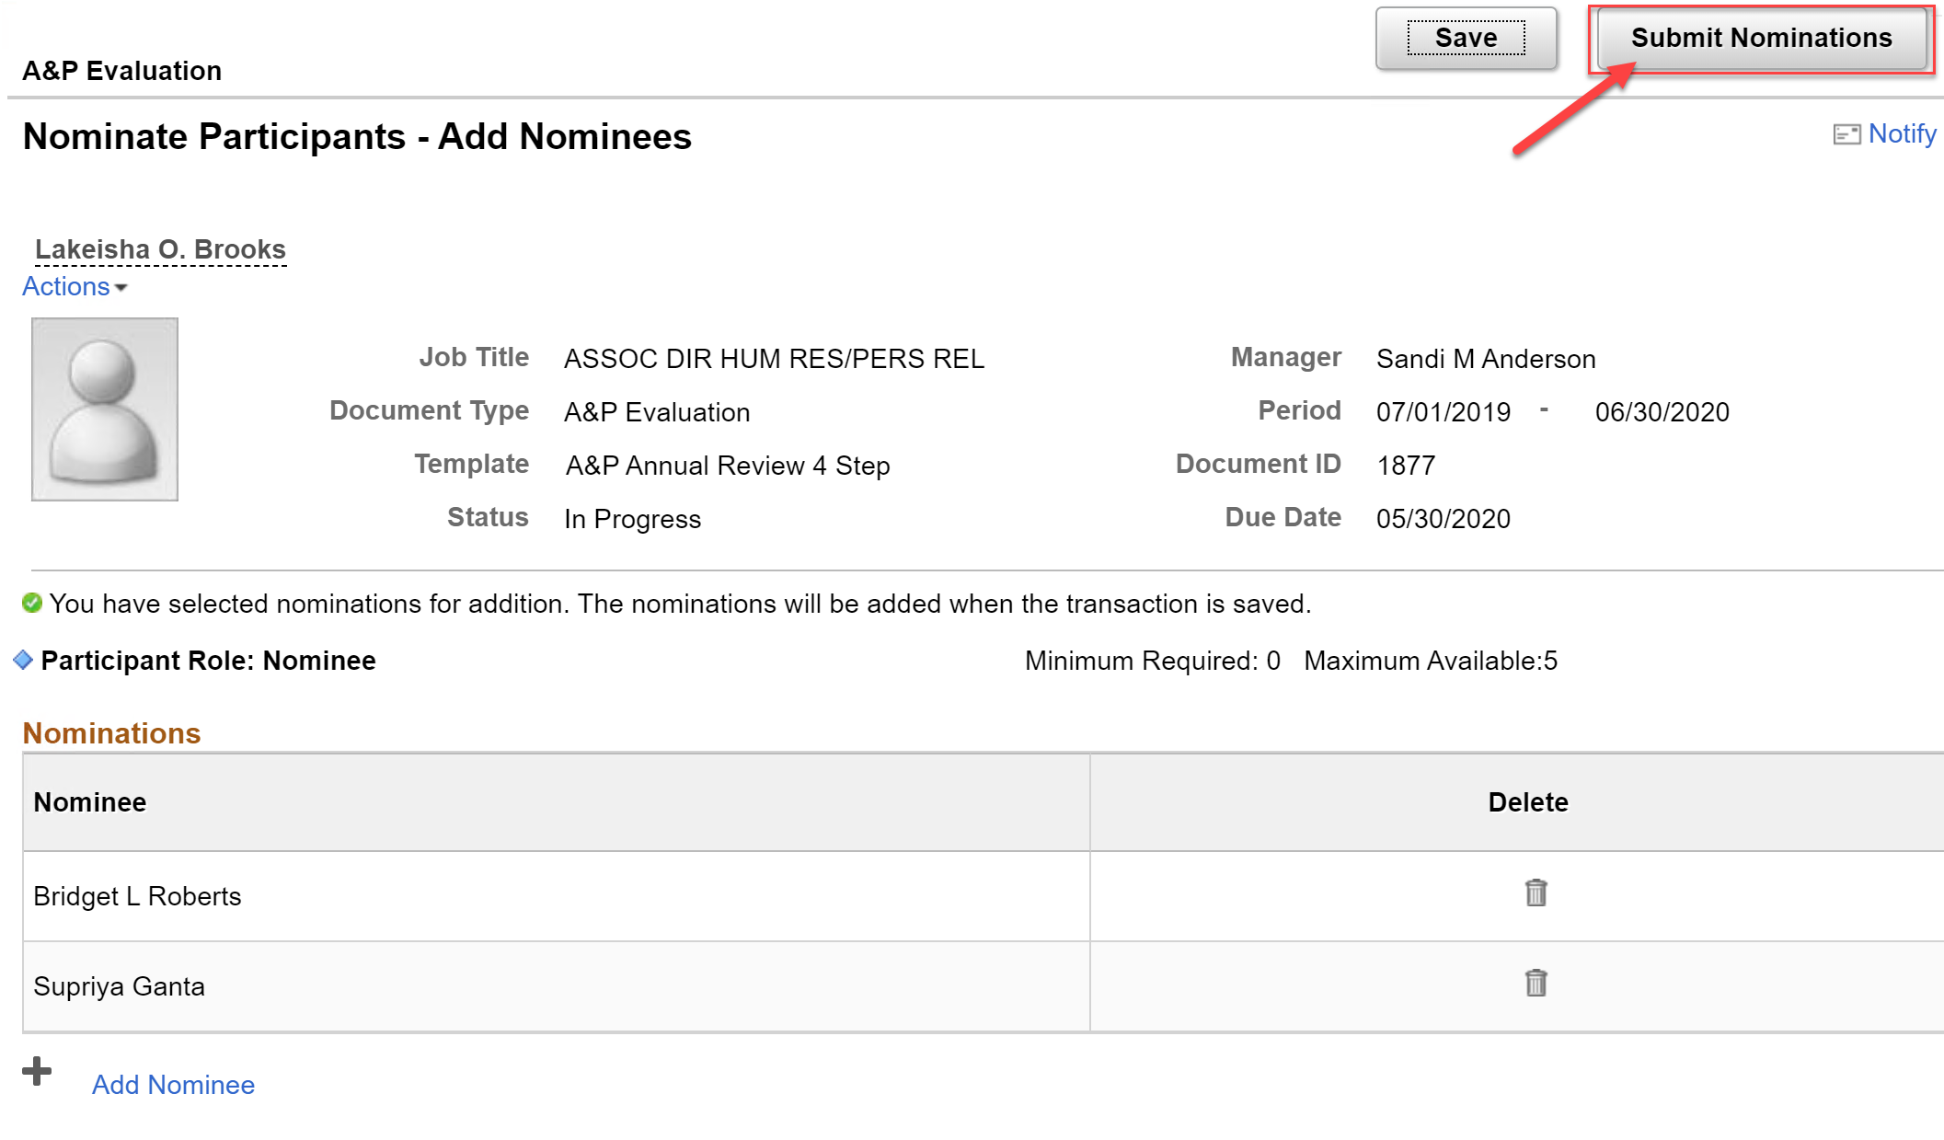
ePerformance Process Steps
Nominate Others (Optional)
Manager invites others to participate in the employee’s evaluation
Notes:
Nominate Participants
Once the criteria has been defined and finalized, the Manager can invite others within your organization to participate in the evaluation process for the employee. This would be applicable for Managers who may not work with an employee on a day to day basis and perhaps there is a supervisor that does, you may want the supervisor to provide input into the employee’s evaluation. A Manager can invite up to 5 participants per evaluation. Please note that the step to nominate others is optional and is not required.

Slide 28
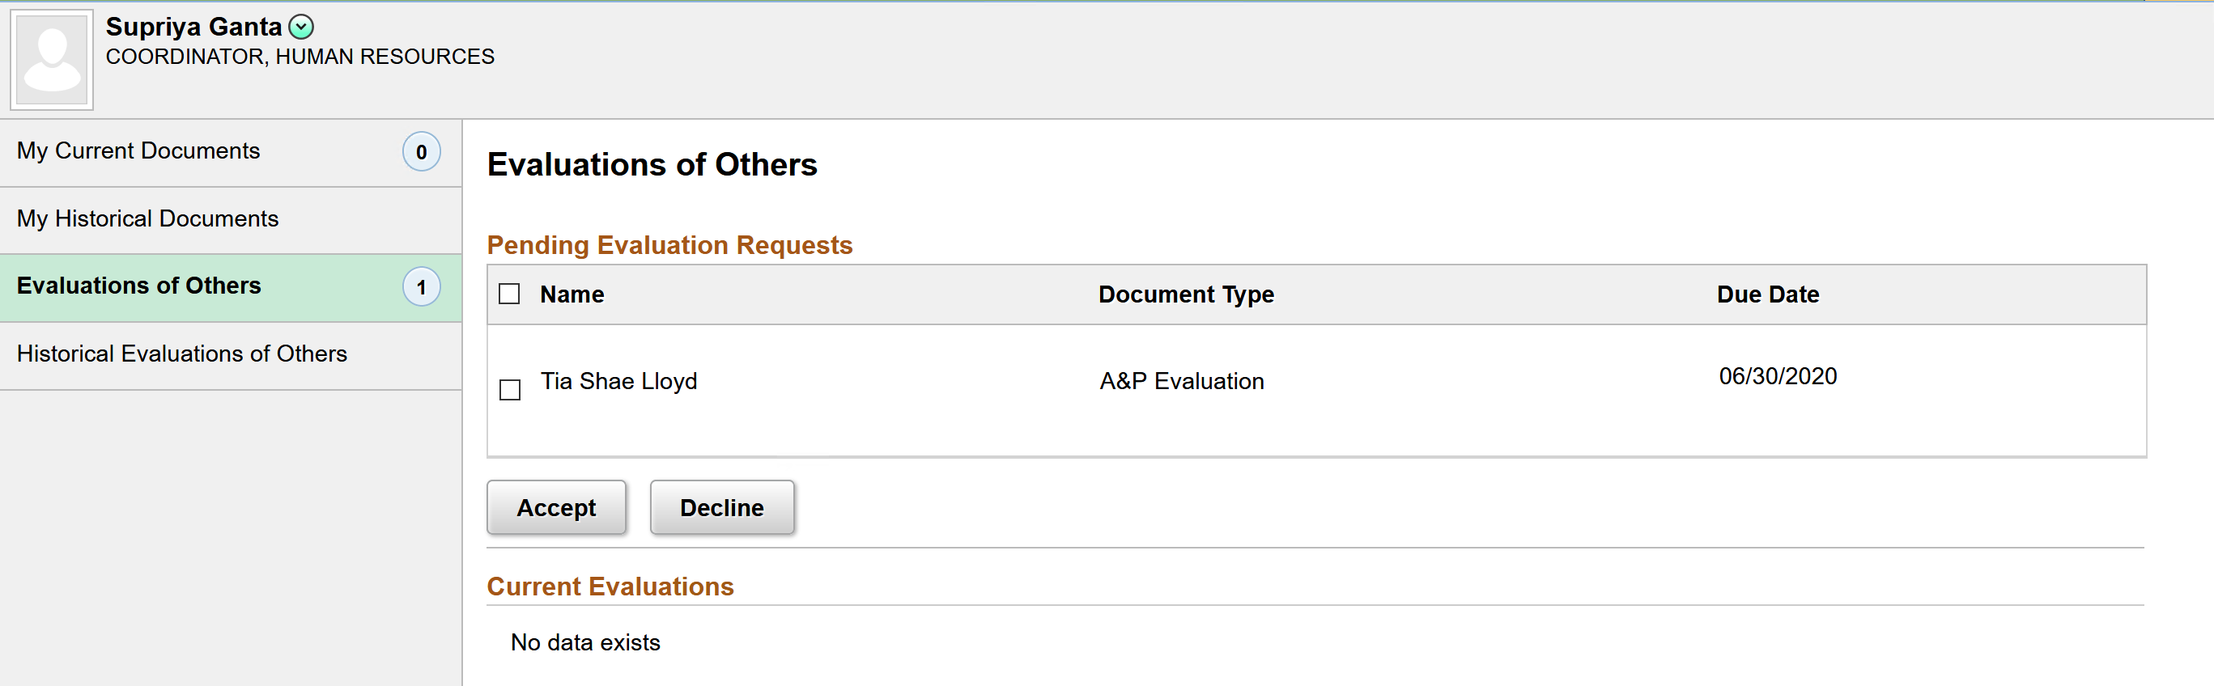
ePerformance Process Steps
Nominee – Review Invite under Employee Self Service
Accepts or Declines
Notes:
Once an invite has been sent to a Nominee the nominee will receive an email notification that they have been nominated to participate in an employee’s evaluation. The nominee will access the invite via Employee Self Service to accept or decline.

Slide 29
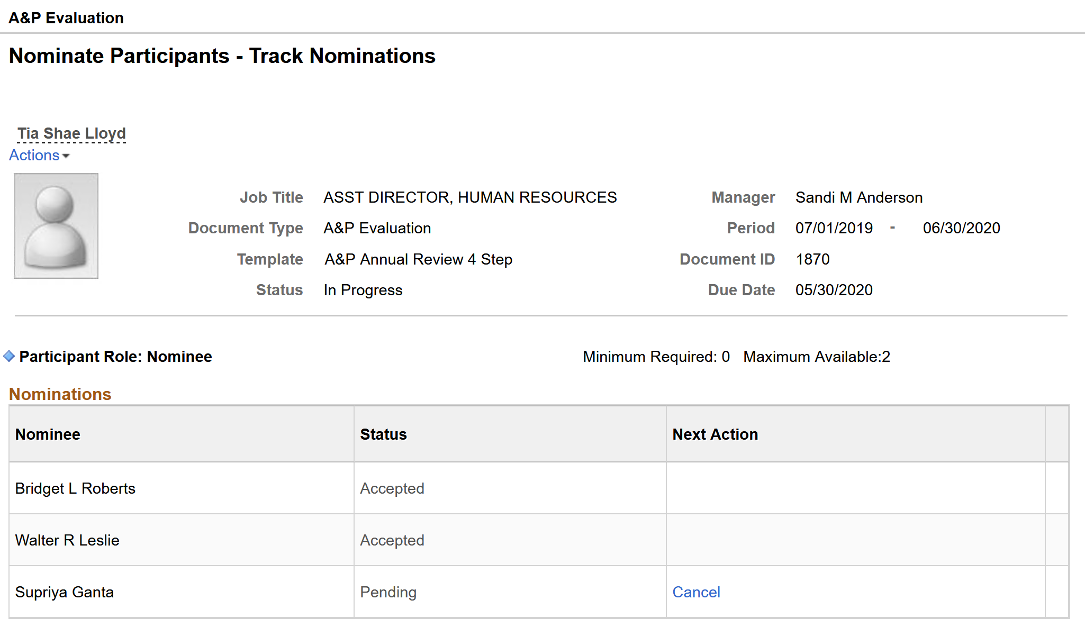
ePerformance Process Steps
Track Nominations
Managers will track the status of the invites
Notes:
Managers will have the ability to track whether a nominee has accepted or declined an invite. They can also see if the invite is still pending. If still pending the Manager can reach out to the nominee to remind them that there is a pending request or the manager can simply cancel the request.

Slide 30
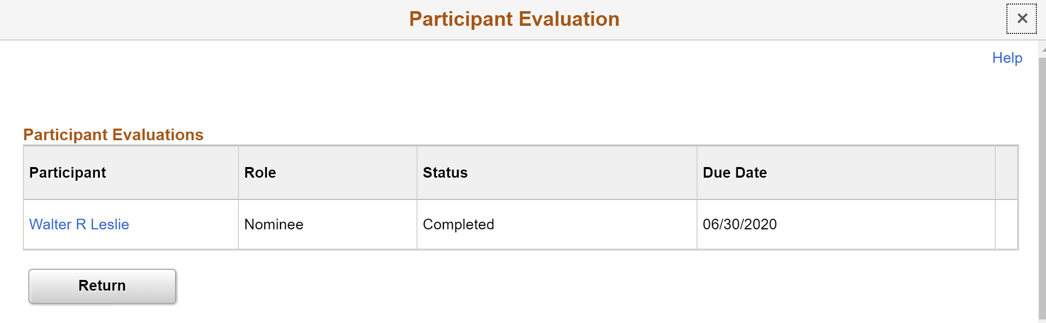
ePerformance Process Steps
Review Participants Evaluation
Both Manager and Employee will review an evaluation that is completed by others
Notes:
Once the Nominee has completed the evaluation for which they were invited to complete. Both the Manager and Employee will receive an email notification and will have the ability to review the completed evaluation. The name of the nominee is visible to both the Manager and the Employee allowing the employee to know who provided feedback on the performance evaluation.

Slide 31
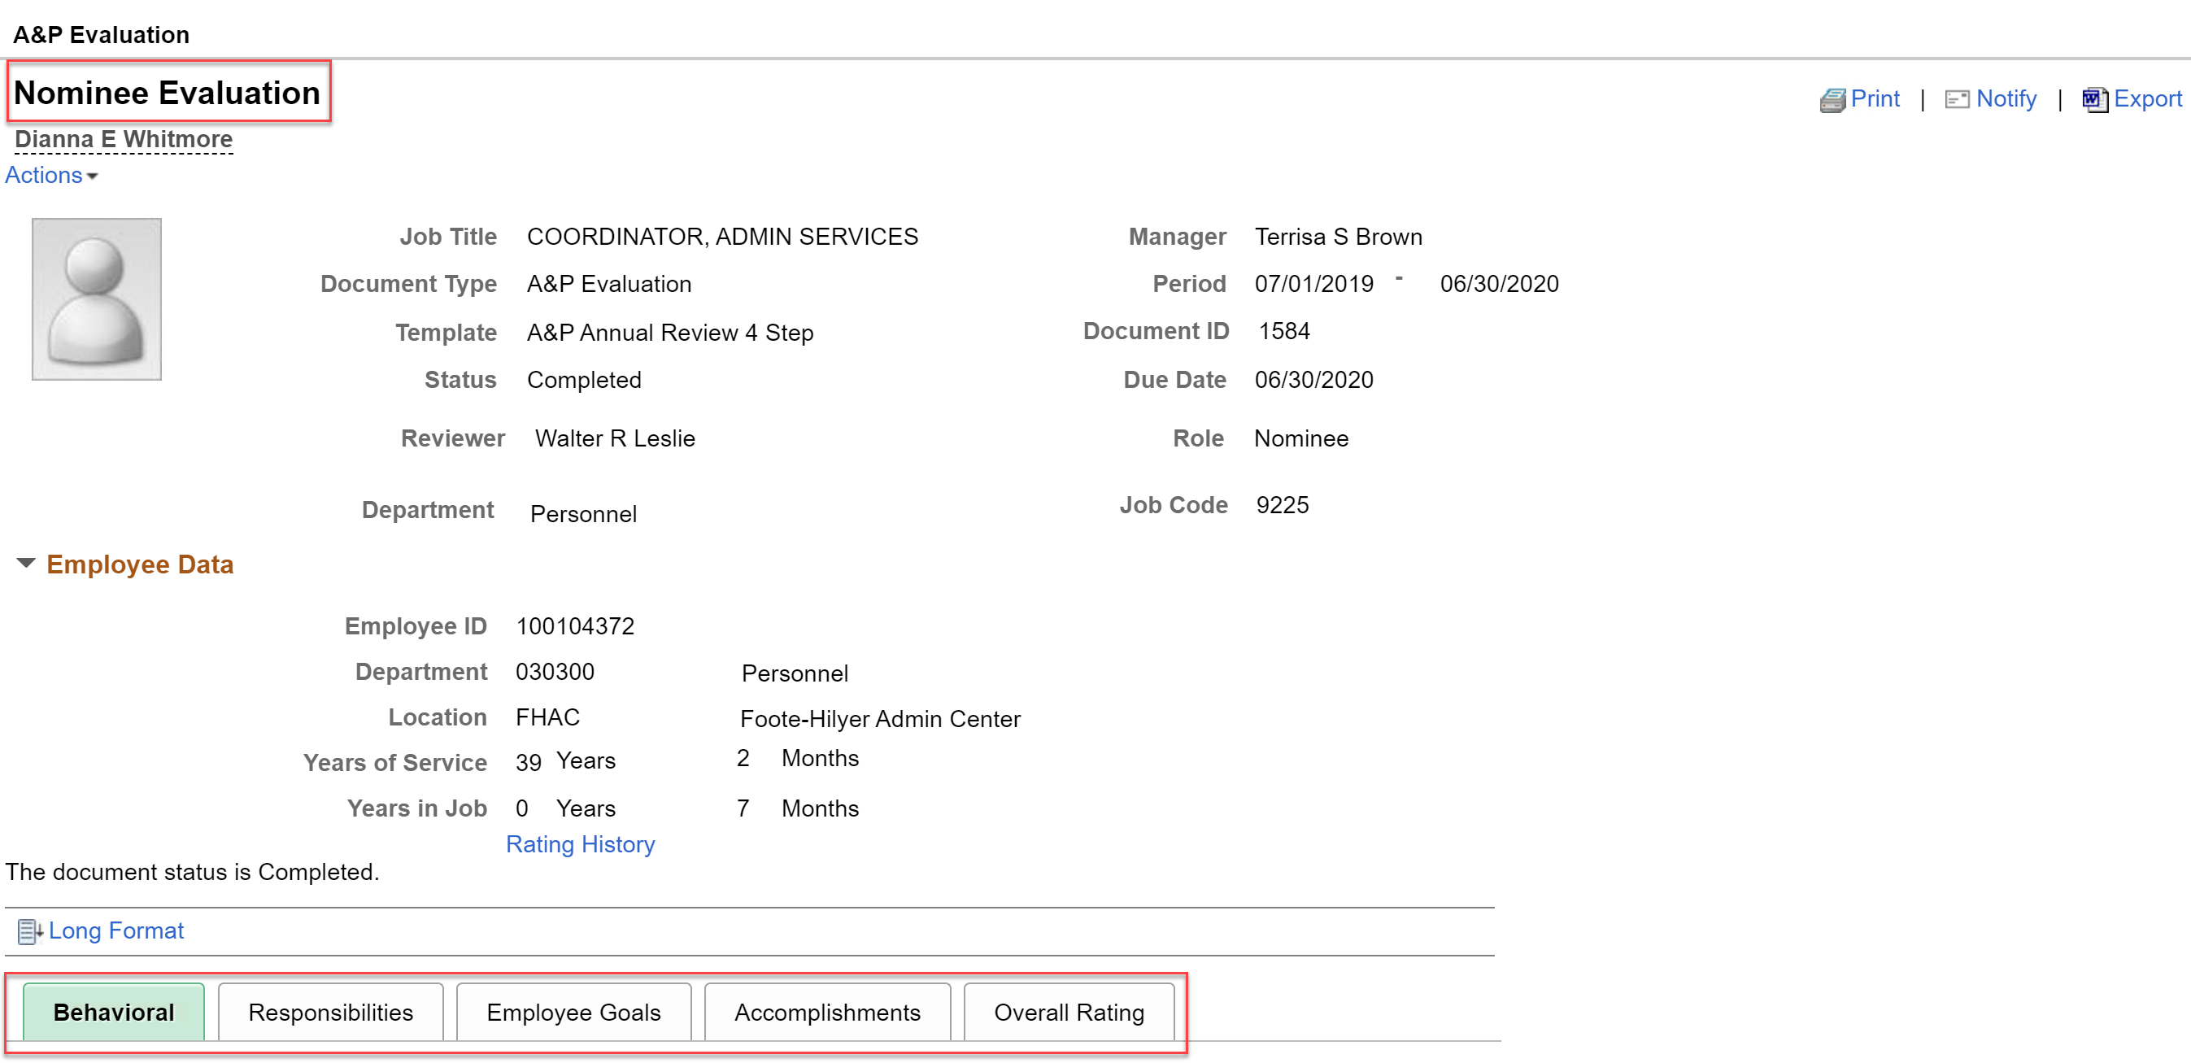
ePerformance Process Steps
Review Participants Evaluation
Nominee Evaluation page and the tabs available to the nominee
Notes:
This slide provides a visual of the Nominee Evaluation page and the tabs that are available to the nominee when completing the evaluation.

Slide 32
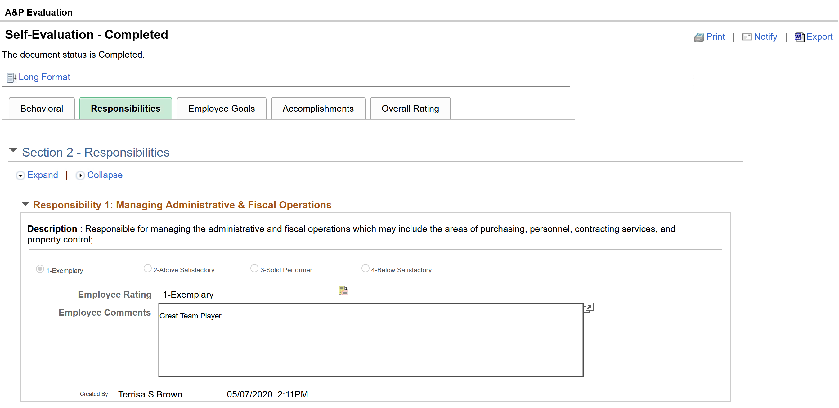
ePerformance Process Steps
Self-Evaluation
Employee complete the self-evaluation where they will rate themselves and enter comments
Notes:
During the Self-Evaluation step, the employee will complete his/her self-evaluation where they will rate themselves on each item within each section and will enter comments. The employee will also have the ability to add a document if needed.

Slide 33
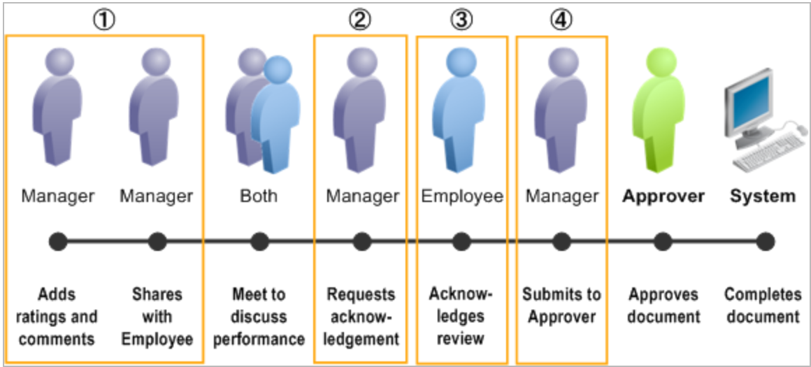
ePerformance Process Steps
Manager Evaluation - Steps
4-step evaluation process
Notes:
Manager Evaluations Step
Once the Manager Evaluation step is started it will follow a 4-step evaluation process. The process is as follows:
Manager will add ratings and comments to the employee performance evaluation
Manager will share the document with the employee
The manager and employee will meet in person to review and discuss
After the in-person meeting, the manager will request acknowledgement from the employee
The employee will acknowledge the document
Manager will then submit evaluation for approval. Document will route to the next level manager
Next level manager will review document and approve
Once approved, document will be closed

Slide 34
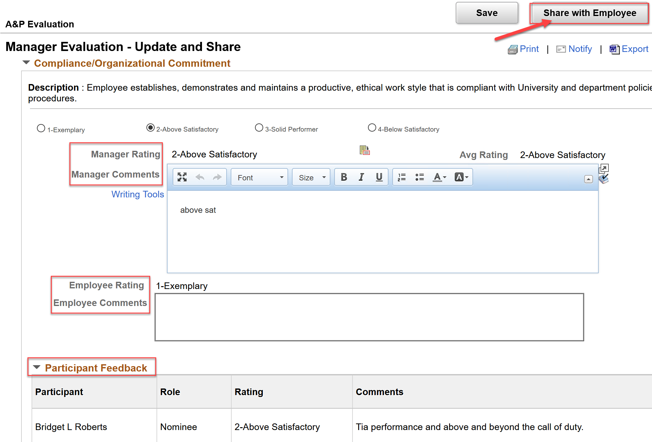
ePerformance Process Steps
Manager Evaluation – Update and Share
- Manager reviews Employees and Nominee’s ratings and comments as he/she completes the Manager’s evaluation
- Will share evaluation with Employee
Notes:
Manager Evaluation – Update and Share
At this step the manager is rating the employee and providing comments. Please note that the manager will have the ability to see any ratings and comments made by the employee and any participants as they work through each section and each item within the section.
Once complete, the managers will share his/her evaluation with the employee.

Slide 35
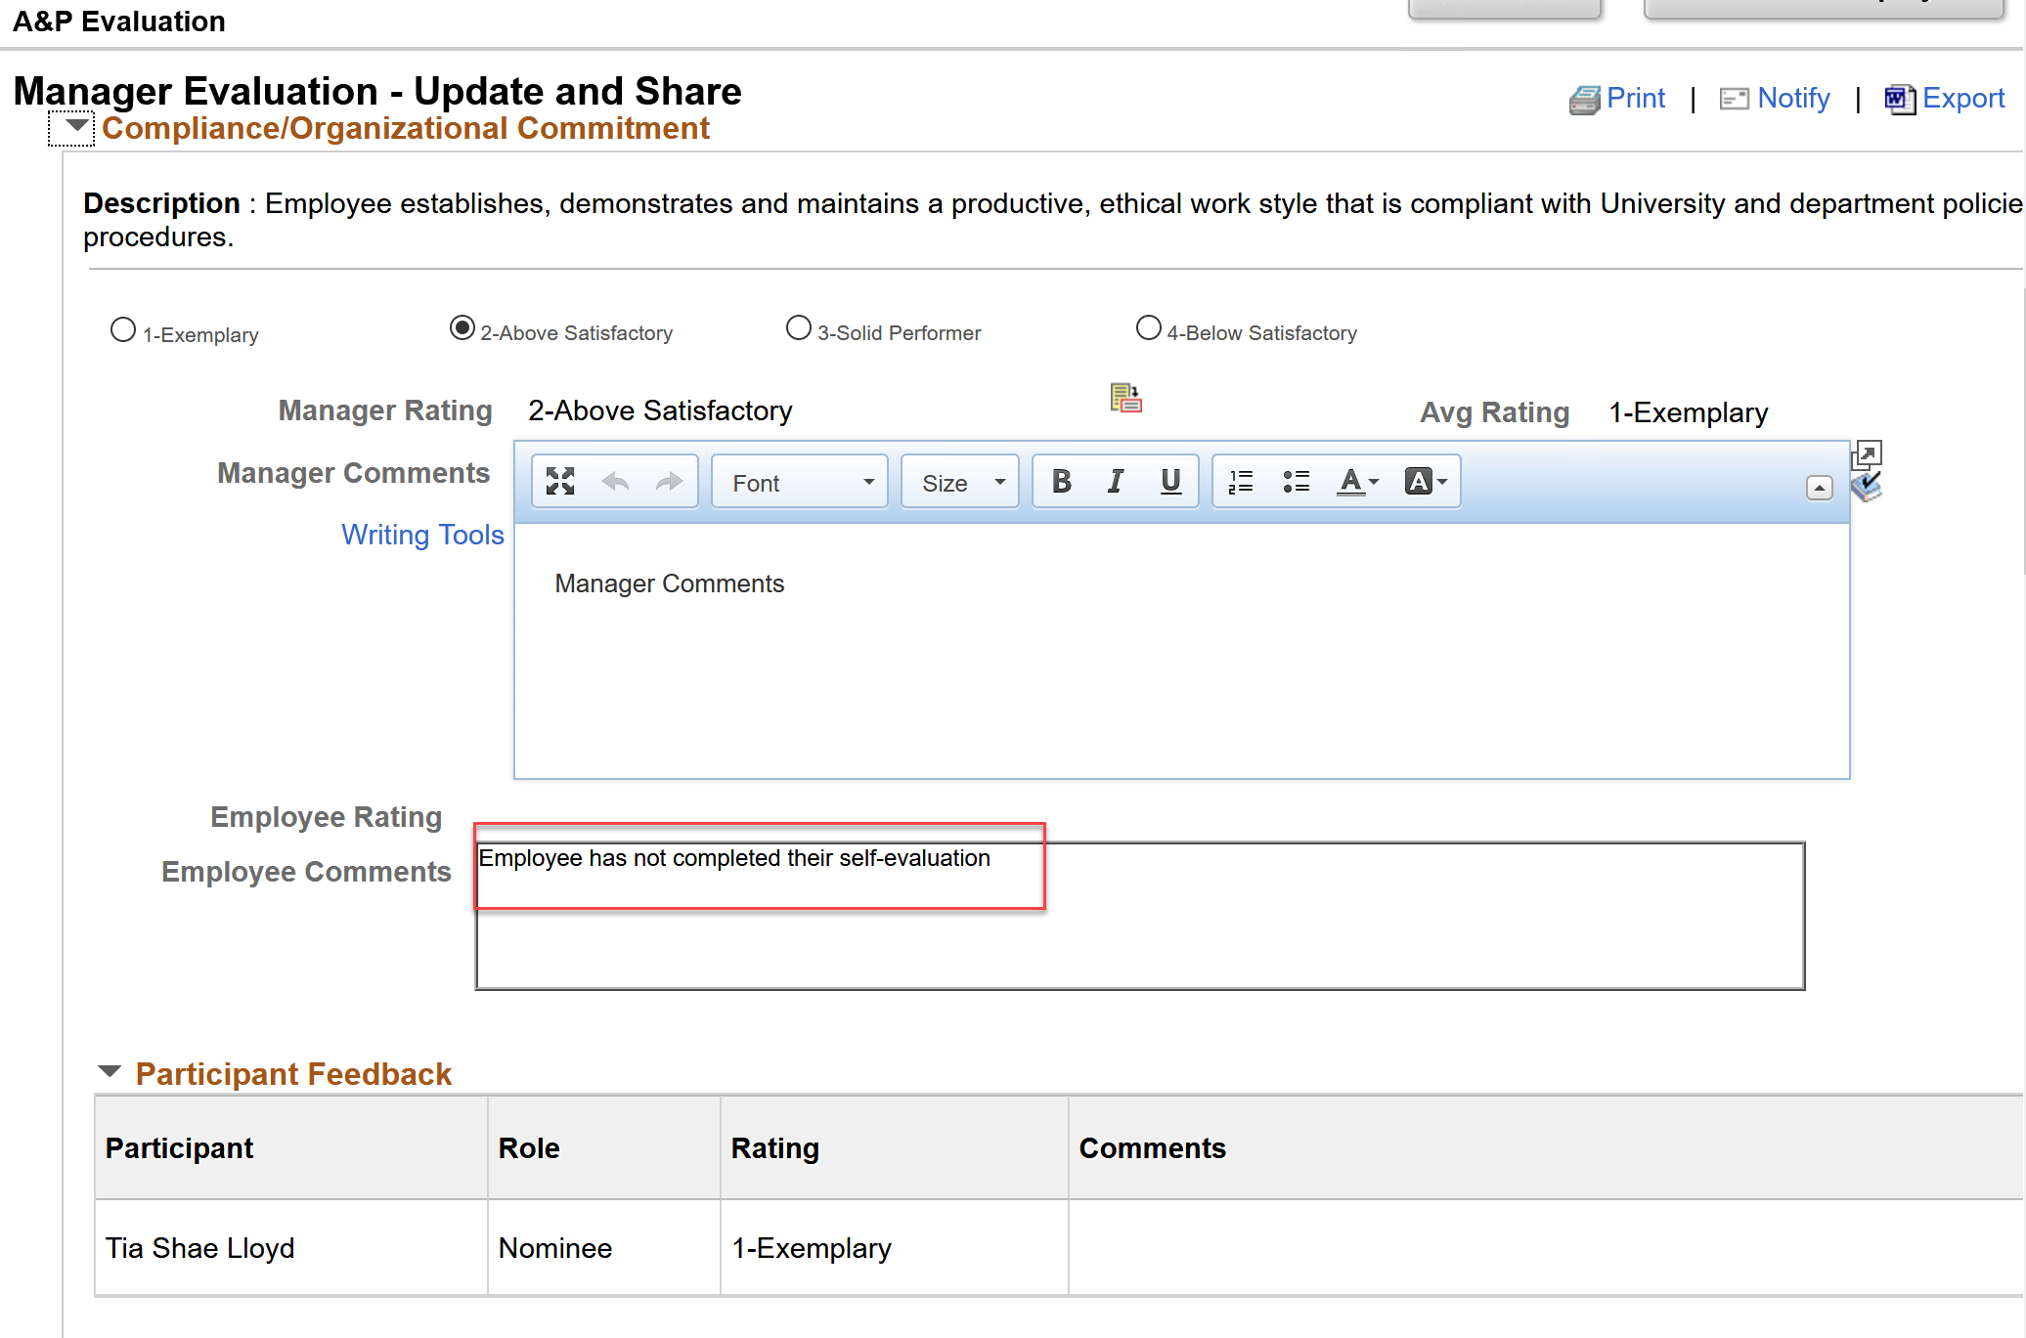
ePerformance Process Steps
Manager Evaluation – Update and Share
Managers do not have to wait on the Employee to complete their self evaluations
Notes:
Please note that Managers do not have to wait on the employee to complete the self-evaluation in order to complete the manager evaluation. Each step comes with a due date and based on the due date the manager can start his/her evaluation but will see in the employee comment box that the employee has not completed their self-evaluation. Manager can choose to reach out to the employee and ask that they complete their self-evaluation or the manager can just move forward and complete the evaluation without input from the employee.

Slide 36
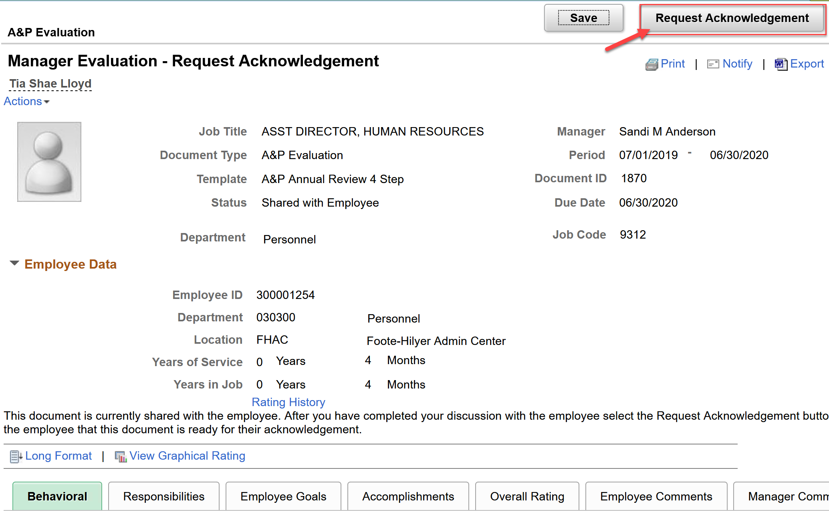
ePerformance Process Steps
Manager Evaluation – Request Acknowledgement
Manager request acknowledgement from Employee
Notes:
This slide is to provide you with a visual of Manager Evaluation step – Request Acknowledgement.
After the in-person meeting which coincides with the Employee, Review Manager’s Evaluation, Review with Manager step.
The discussion takes place, and the manager will request an acknowledgement from the employee

Slide 37
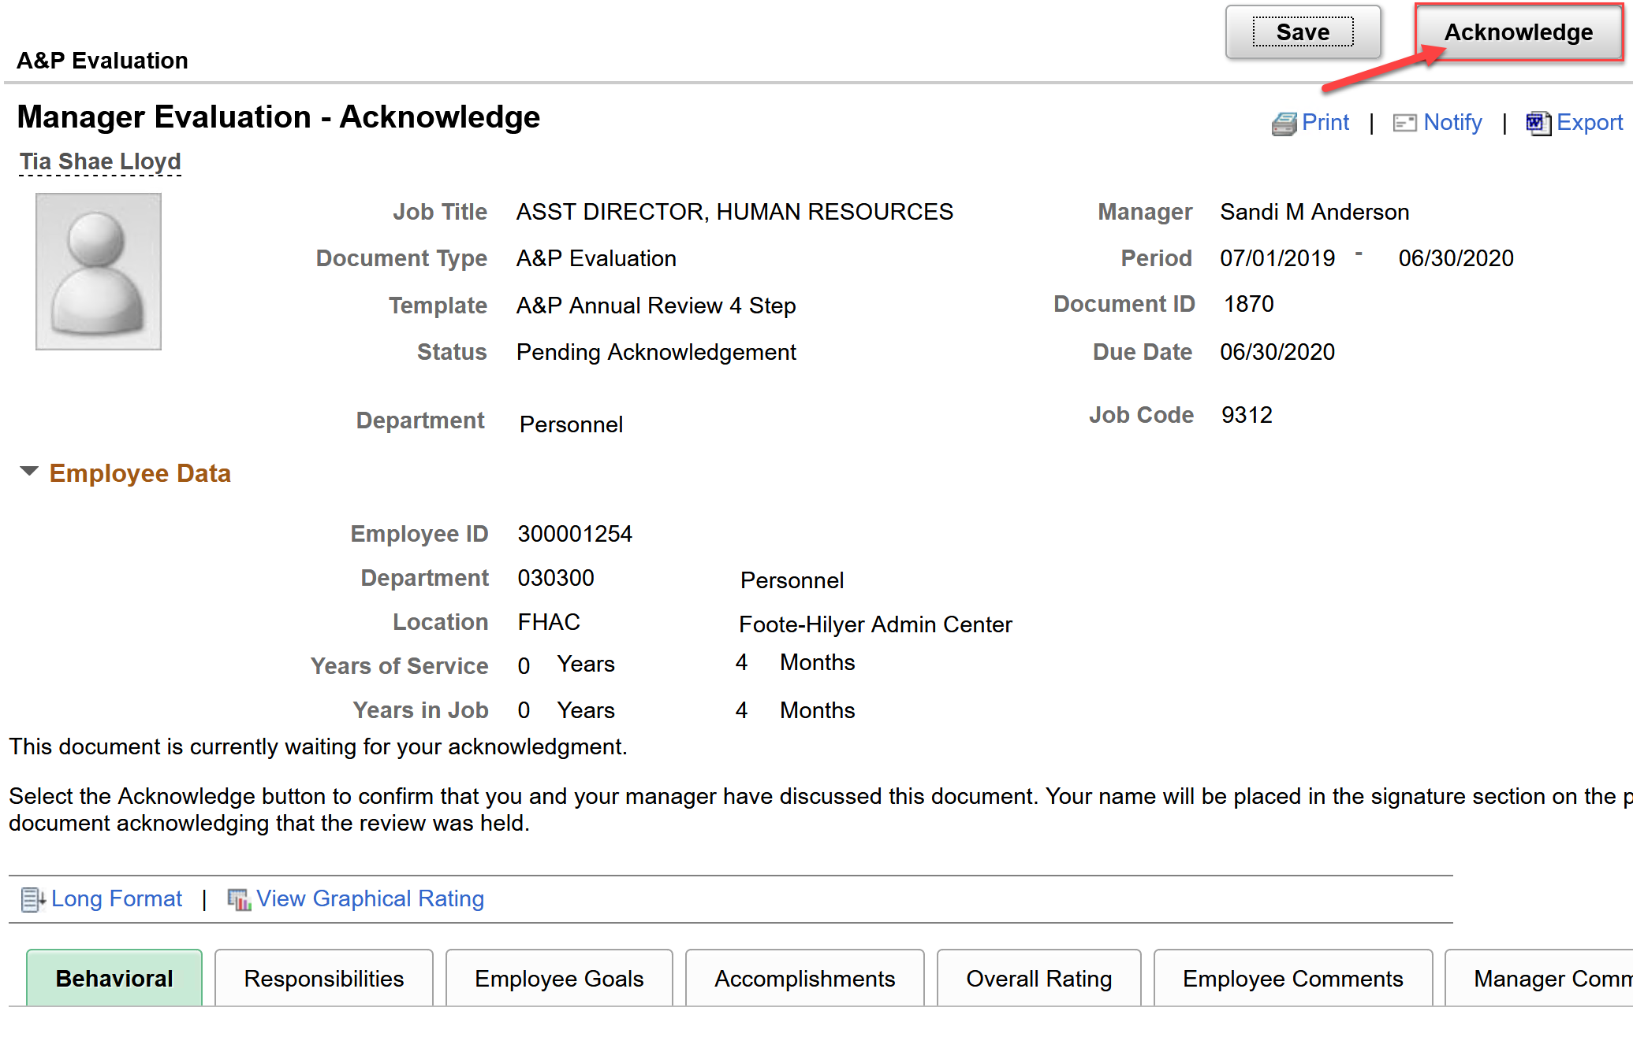
ePerformance Process Steps
Employee Review Manager Evaluation - Acknowledge
Employee will acknowledge the performance evaluation
Notes:
This slide provides a visual of what the employee will see when they access the evaluation to acknowledge.

Slide 38
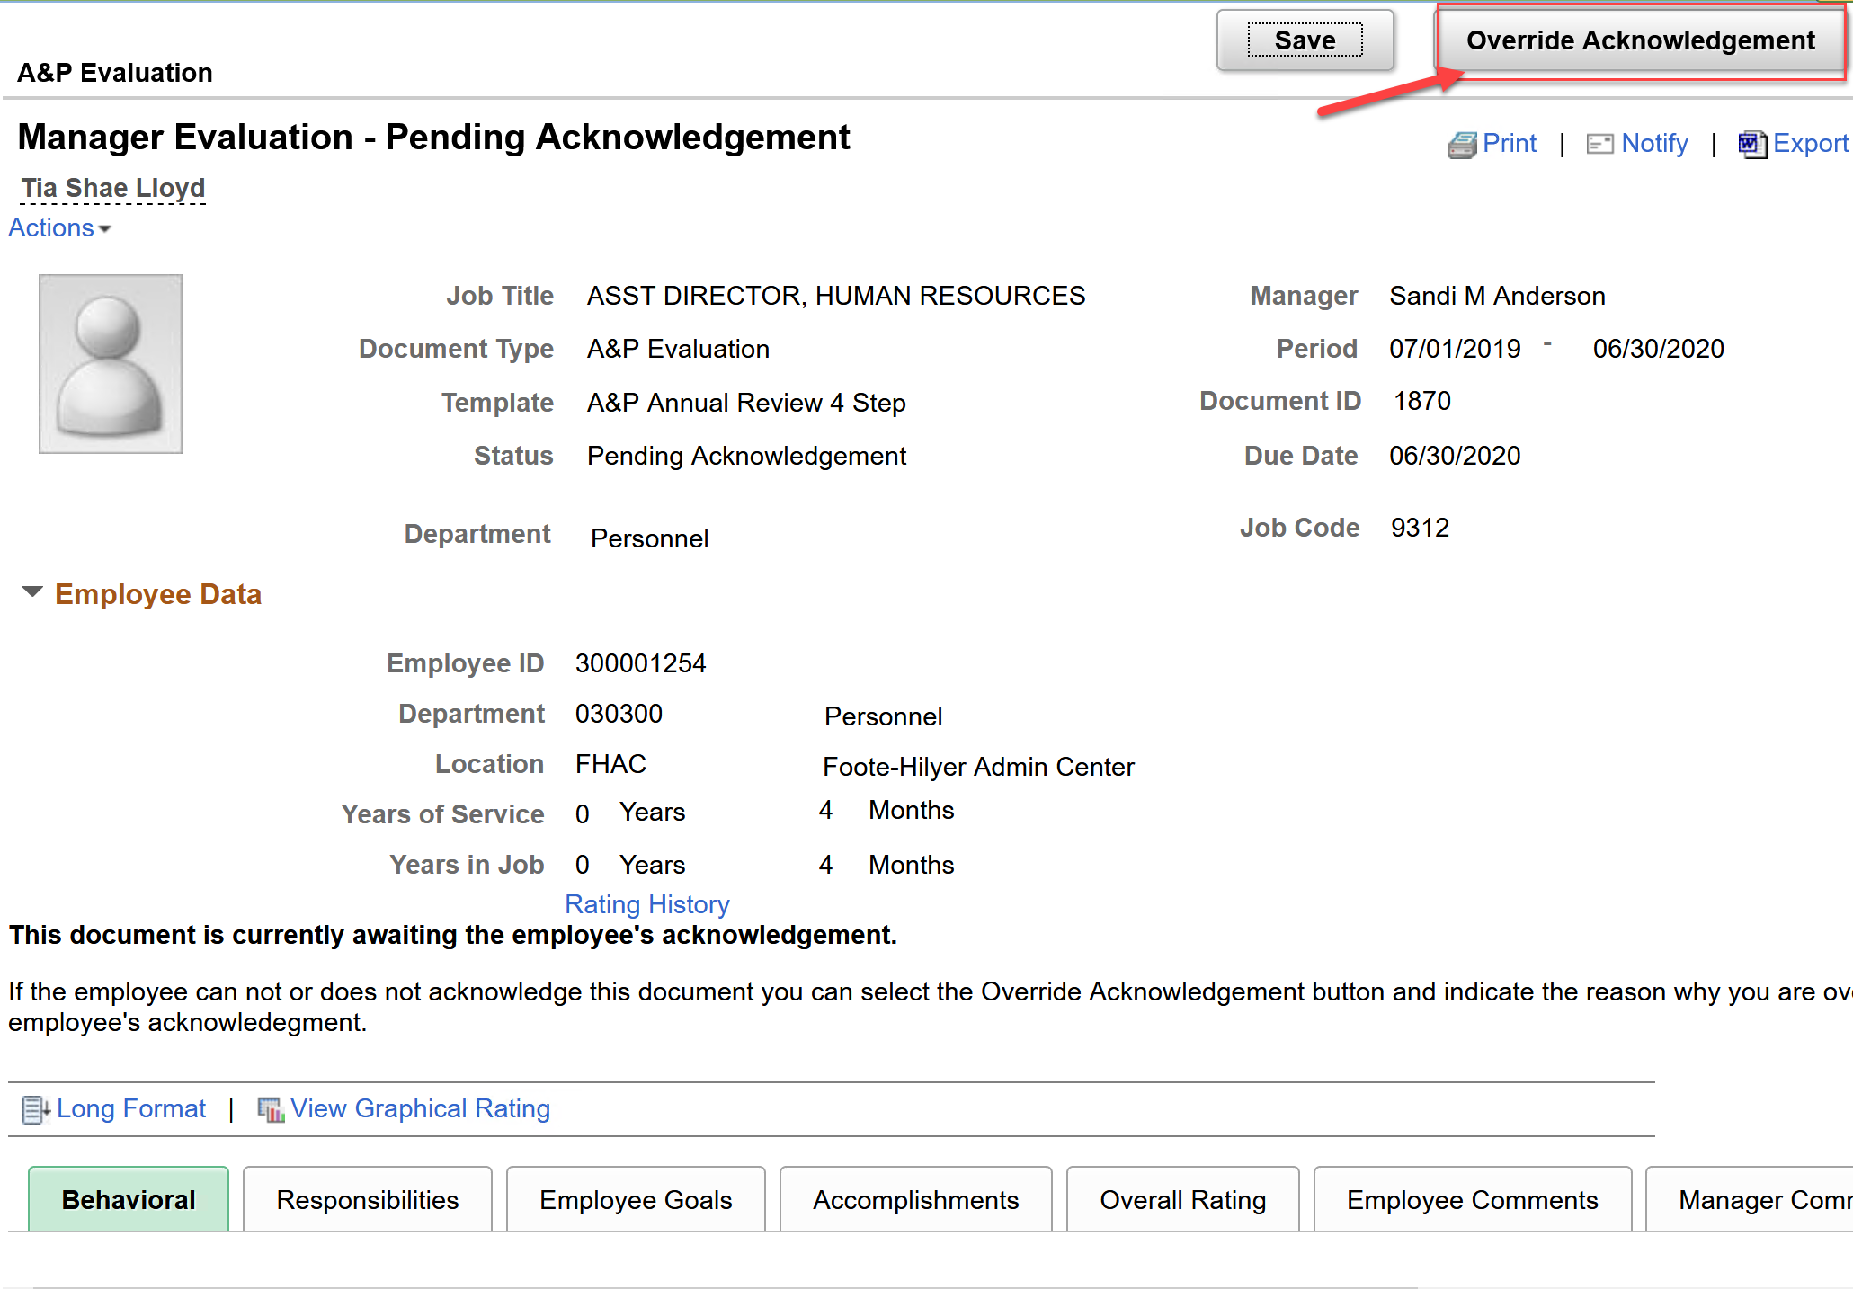
ePerformance Process Steps
Manager Evaluation – Override Acknowledgement
Manager can override the employee’s acknowledgement
Notes:
If the manager has requested acknowledgement from the employee and by the due date employee has not yet acknowledged the evaluation, the manager has the ability to override the employee’s acknowledgement

Slide 39
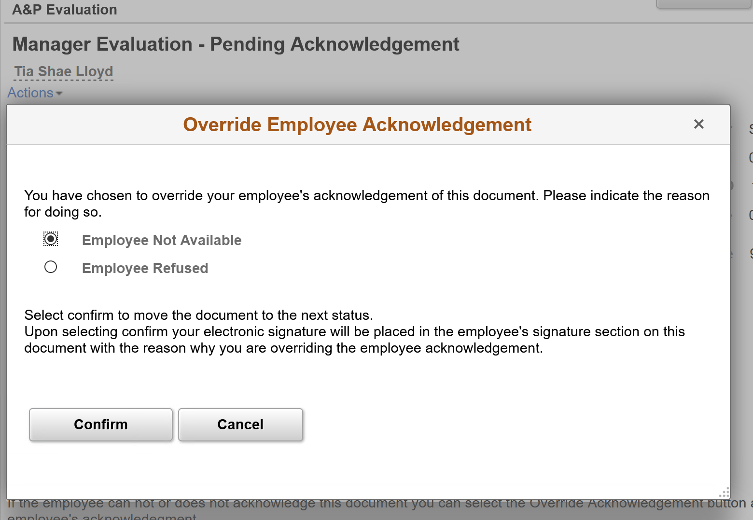
ePerformance Process Steps
Manager Evaluation – Override Acknowledgement
Manager can override the employee’s acknowledgement
Notes:
When overriding the acknowledgment, the manager will select a reason for the override. The two reasons available are: Employee Not Available and Employee Refused.
Once the reason has been selected the manger will confirm the override

Slide 40
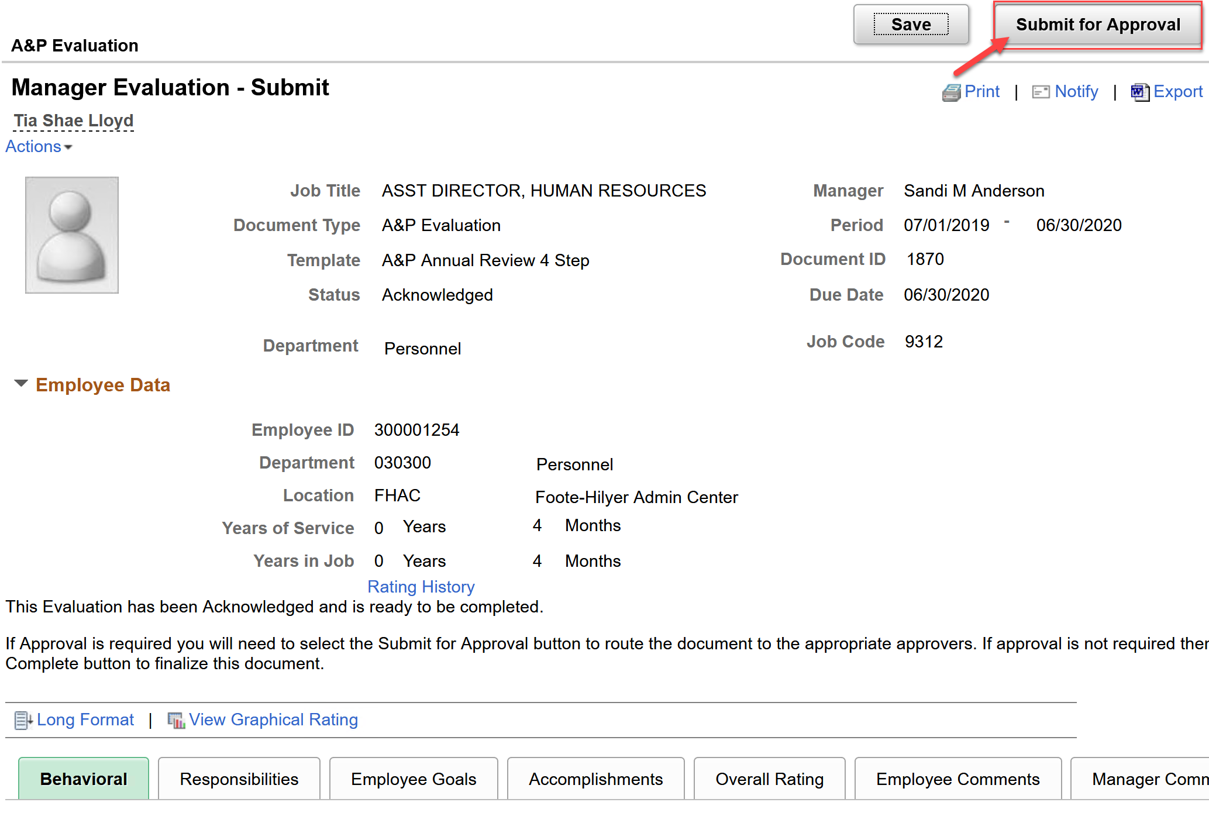
ePerformance Process Steps
Manager Evaluation – Submit for Approval
Document is submitted for approval from next level manager
Notes:
Once the manager’s evaluation has been acknowledged, the manager will then submit the evaluation for approval by the next level manager

Slide 41
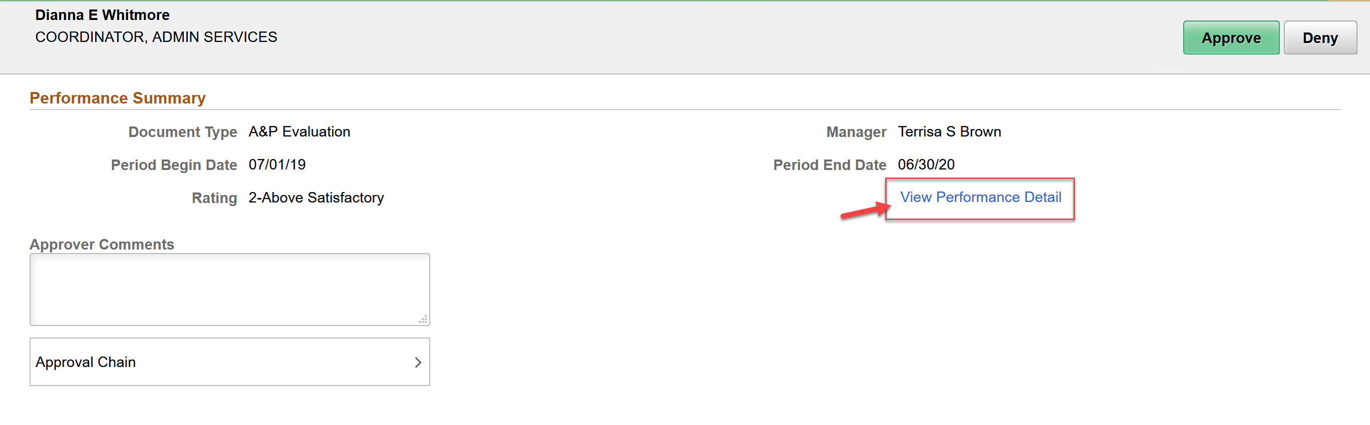
ePerformance Process Steps
Manager Evaluation – Document Approval
Next Level Manager will view the performance document
Add comments, and approve, or deny
Once approved document is closed
Notes:
The next level manager will view the performance document, provide comments and will either approve or deny the performance evaluation.
Once the evaluation has been approved, the document will be closed.

Slide 42
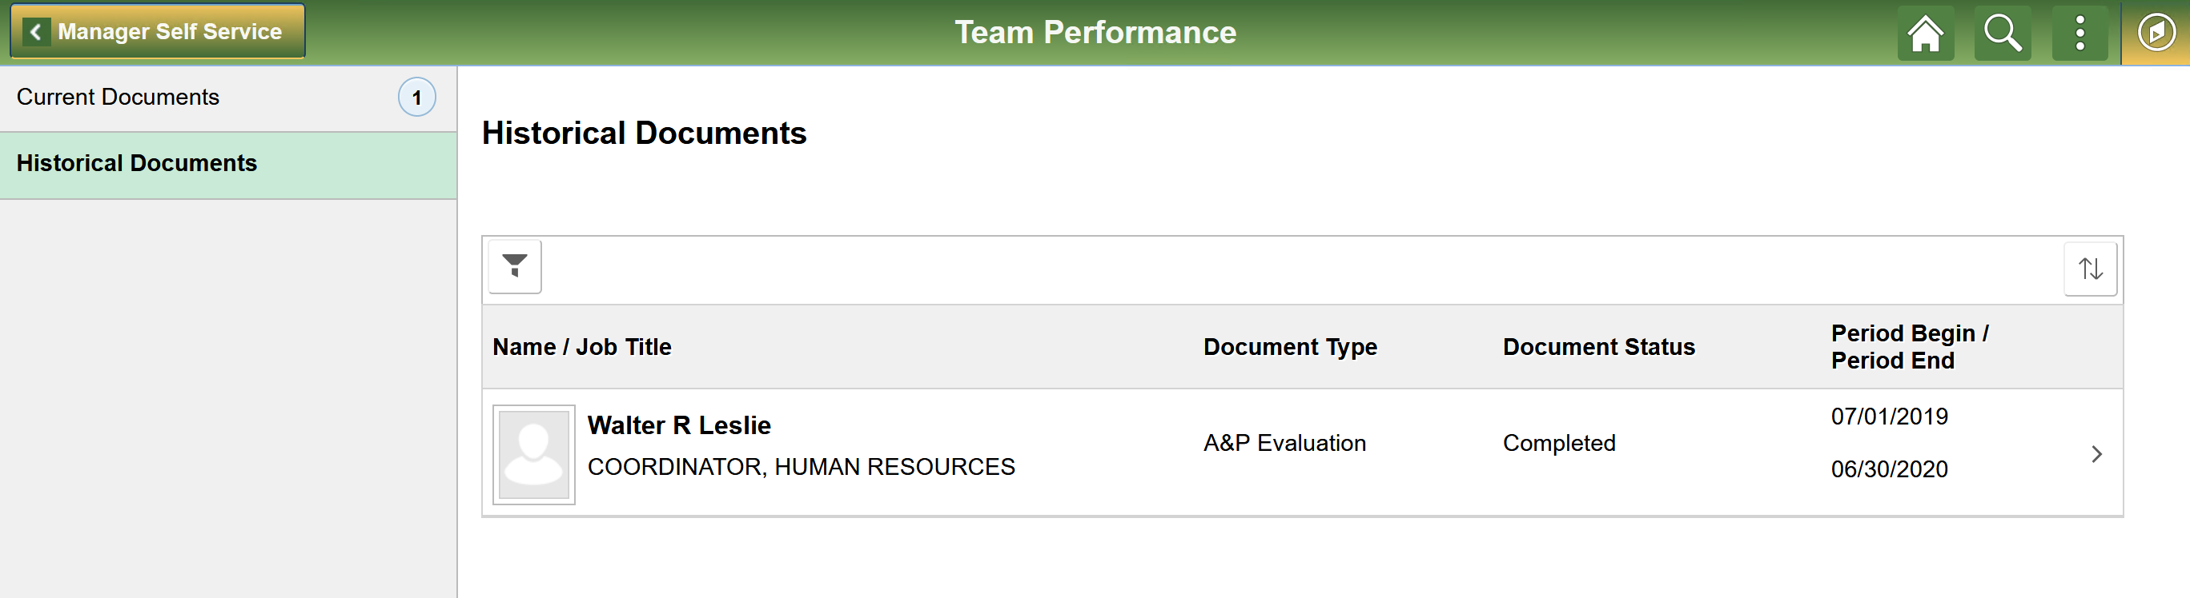
ePerformance – Historical Documents
Managers can review closed evaluations from Manager Self Service – Team Performance - Historical Documents
Notes:
Once performance evaluation is closed the Manager will access all closed documents for his/her team under Manager Self Service, Team Performance, Historical Documents

Slide 43
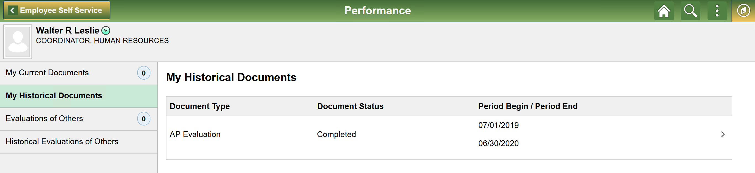
ePerformance – Historical Documents
Employees can review closed evaluations from Employee Self Service – Performance - My Historical Documents
Notes:
For the Employee, they will have access to closed evaluations under Employee Self Service, Performance, My Historical Documents

Slide 44
Resources
ePerformance Guide 101
      Overview of ePerformance Process
      Summary of Changes
      Step-by-Step Training Guide
      Frequently asked Questions (FAQs)
      Links to Other Resources
          HR Website
          HR Contacts
Notes:
For the Employee, they will have access to closed evaluations under Employee Self Service, Performance, My Historical Documents

Slide 45

To send a question, email eperformance@famu.edu
Notes:
Joyce

Slide 46
Closing Remarks/Questions
Thank you!
Notes:
Joyce

