Slide 1


Government Relations Update
Board of Trustees Governance Committee Meeting
December 1, 2021

Slide 2

Florida Legislative Session FY 2022-2023
December: Last Interim Meeting Week
December: Governor’s Recommended Budget
January 11: Regular Legislative Session Begins
February 24: FAMU Day at the Capitol
February/March: House/Senate Budget Release
March 11: Legislature Adjourns
July 1: Beginning of Fiscal Year

Slide 3




Florida Legislative Session FY 2022-2023
Legislative Priorities
Elevating & Sustaining Student Success
FAMU/FSU Joint College of Engineering
University of Distinction
Public Education Capital Outlay
FAMU College of Pharmacy, Peaden Education Center
Elevating & Sustaining Student Success
FAMU/FSU Joint College of Engineering
University of Distinction
Requested resources will accelerate the University’s progress toward achieving targeted student success outcomes including scholarships and financial support, and faculty recruitment and retention.
To sustain the positive momentum of this grand experiment, robust support is needed to support undergraduate student success and recruit new faculty researchers.
Universities that submitted a University of Distinction proposal in 2021-2022 are to submit a proposal for the same area of distinction: Improving 21st Century Health and Wellness.

Slide 4
117th Congress| 1st Session
Infrastructure Investment & Jobs Act
$1 trillion traditional infrastructure package approved by Congress in November.
$42.5 billion for Broadband Equity, Access, and Deployment Program.
$8 billion for Department of Energy-led regional hydrogen hubs.
$500 million for Transportation Resilience & Adaptation Centers of Excellence.
$492 million for the NOAA National Coastal Resilience Fund.
$250 million to create Digital Equity Competitive Grant Program.
$95 million for University Transportation Centers.
1890s Scholarship Legislation
House Agriculture Committee approved H.R. 4252 in October.
H.R. 4252 would provide permanent support to students in agriculture and related majors attending the nation's 1890 land-grant institutions, including Florida A&M University.
Scholarships seek to encourage students to pursue food and agricultural science degrees at 1890 institutions to foster well-trained agricultural and food sciences workforce.
Further consideration pending by U.S. House of Representatives and U.S. Senate.
Not Enacted

Slide 5
117th Congress| 1st Session
FY 2022 Programmatic Requests
Strengthening HBCUs
NOAA National Sea Grant College Program
NOAA Educational Partnership Program/Minority Serving Institutions
Federal Supplemental Educational Opportunity Grants
Education Grants for 1890 Institutions
1890s Extension Program
Scholarships at 1890 Institutions
S. 300 | Justice for Black Farmers Act
Empower HBCUs and advocates for Black farmers
End discrimination within USDA
Enact system reforms to assist all farmers and ranchers
Create Farm Conservation Corps
Restore land base lost by Black farmers
Assist all socially disadvantaged farmers and ranchers
Not Enacted

Slide 6
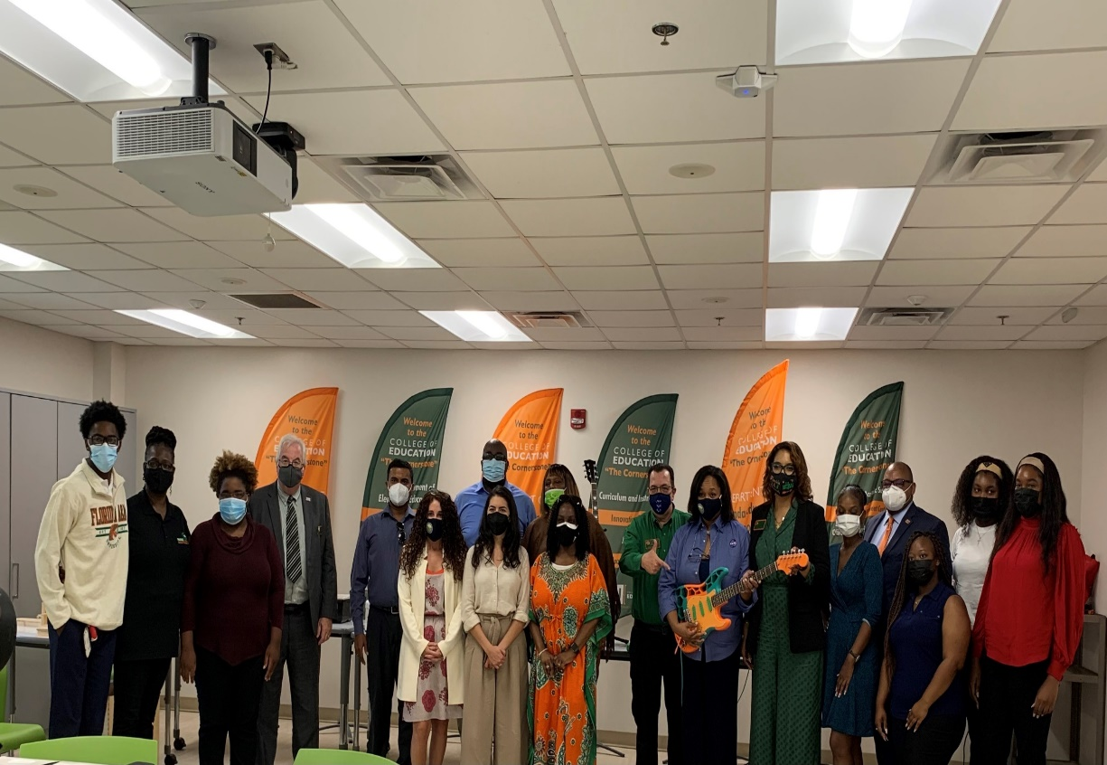
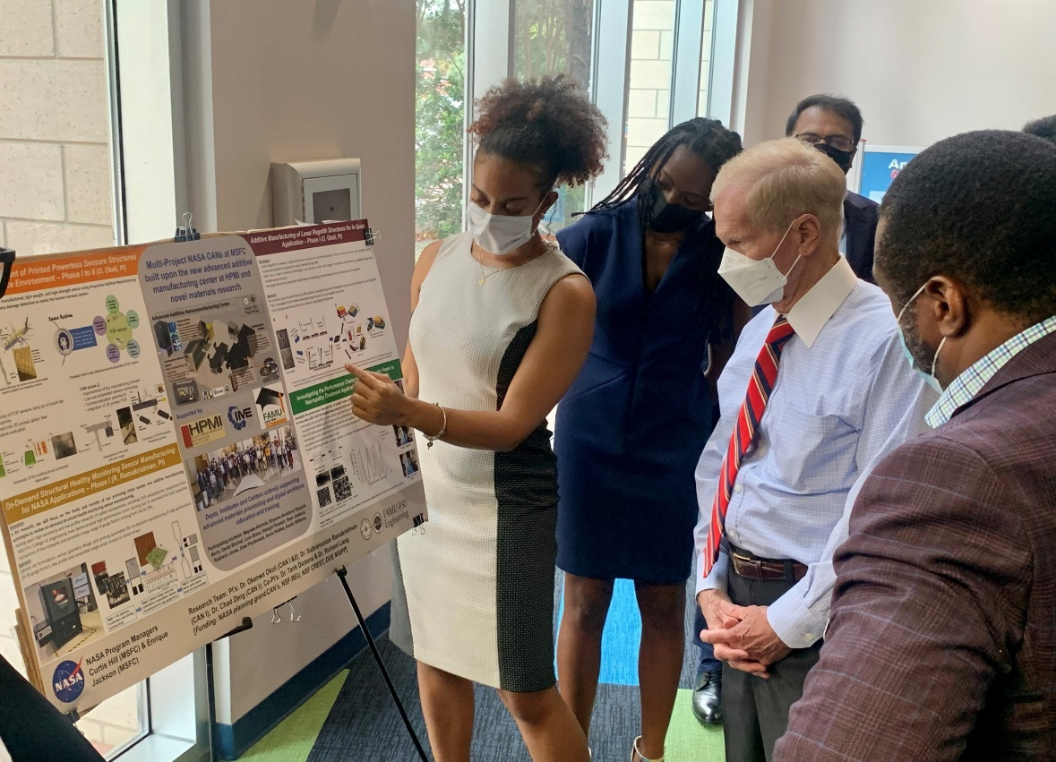
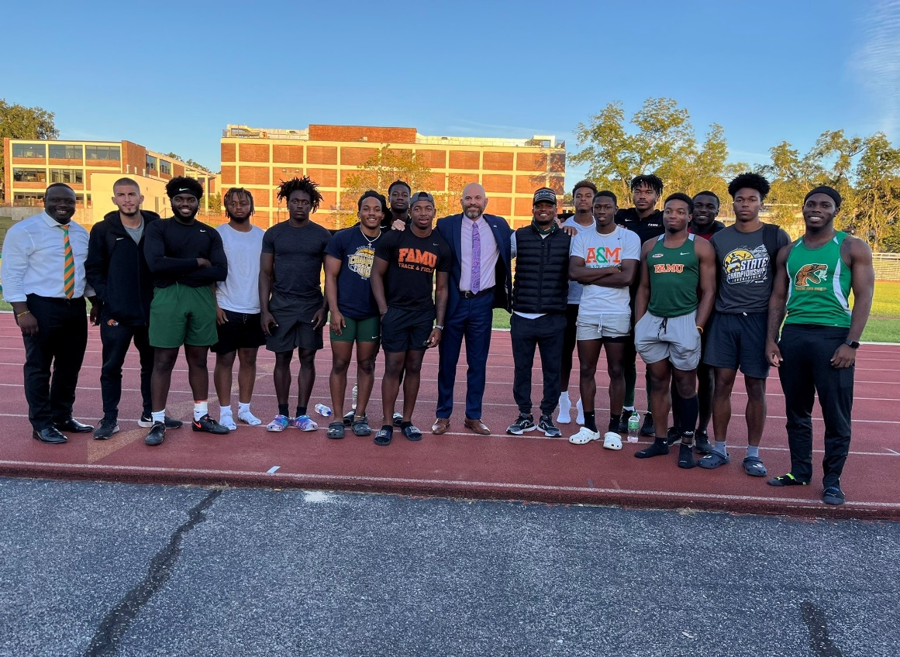
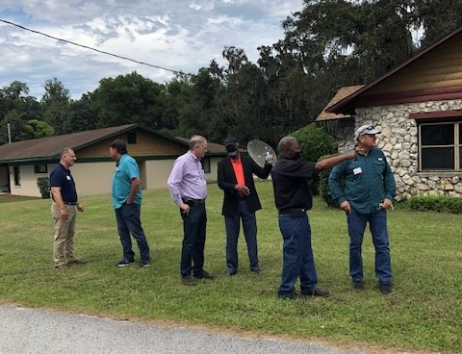
Civic Engagement
NASA Visits College of Education
FAMU Engineering Students Presentation to NASA Administrator Bill Nelson
Chairman Rene Plasencia Visits FAMU Track & Field Team
State Legislators Visit Brooksville Campus

Slide 7

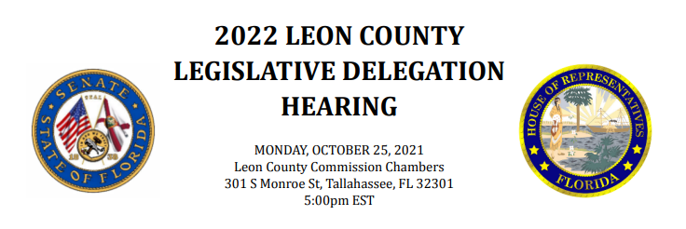
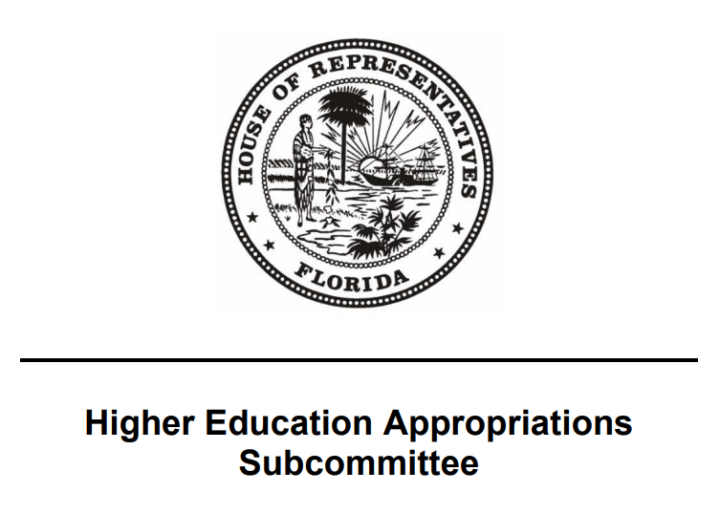

Civic Engagement
College of Agriculture and Food Sciences Innovation & Impact Presentation
Leon County Legislative Delegation Presentation
Textbook Affordability at FAMU
Florida Gubernatorial Fellowship

Slide 8
