Slide 1

Audit and Compliance Committee Meeting
December 1, 2021

Slide 2
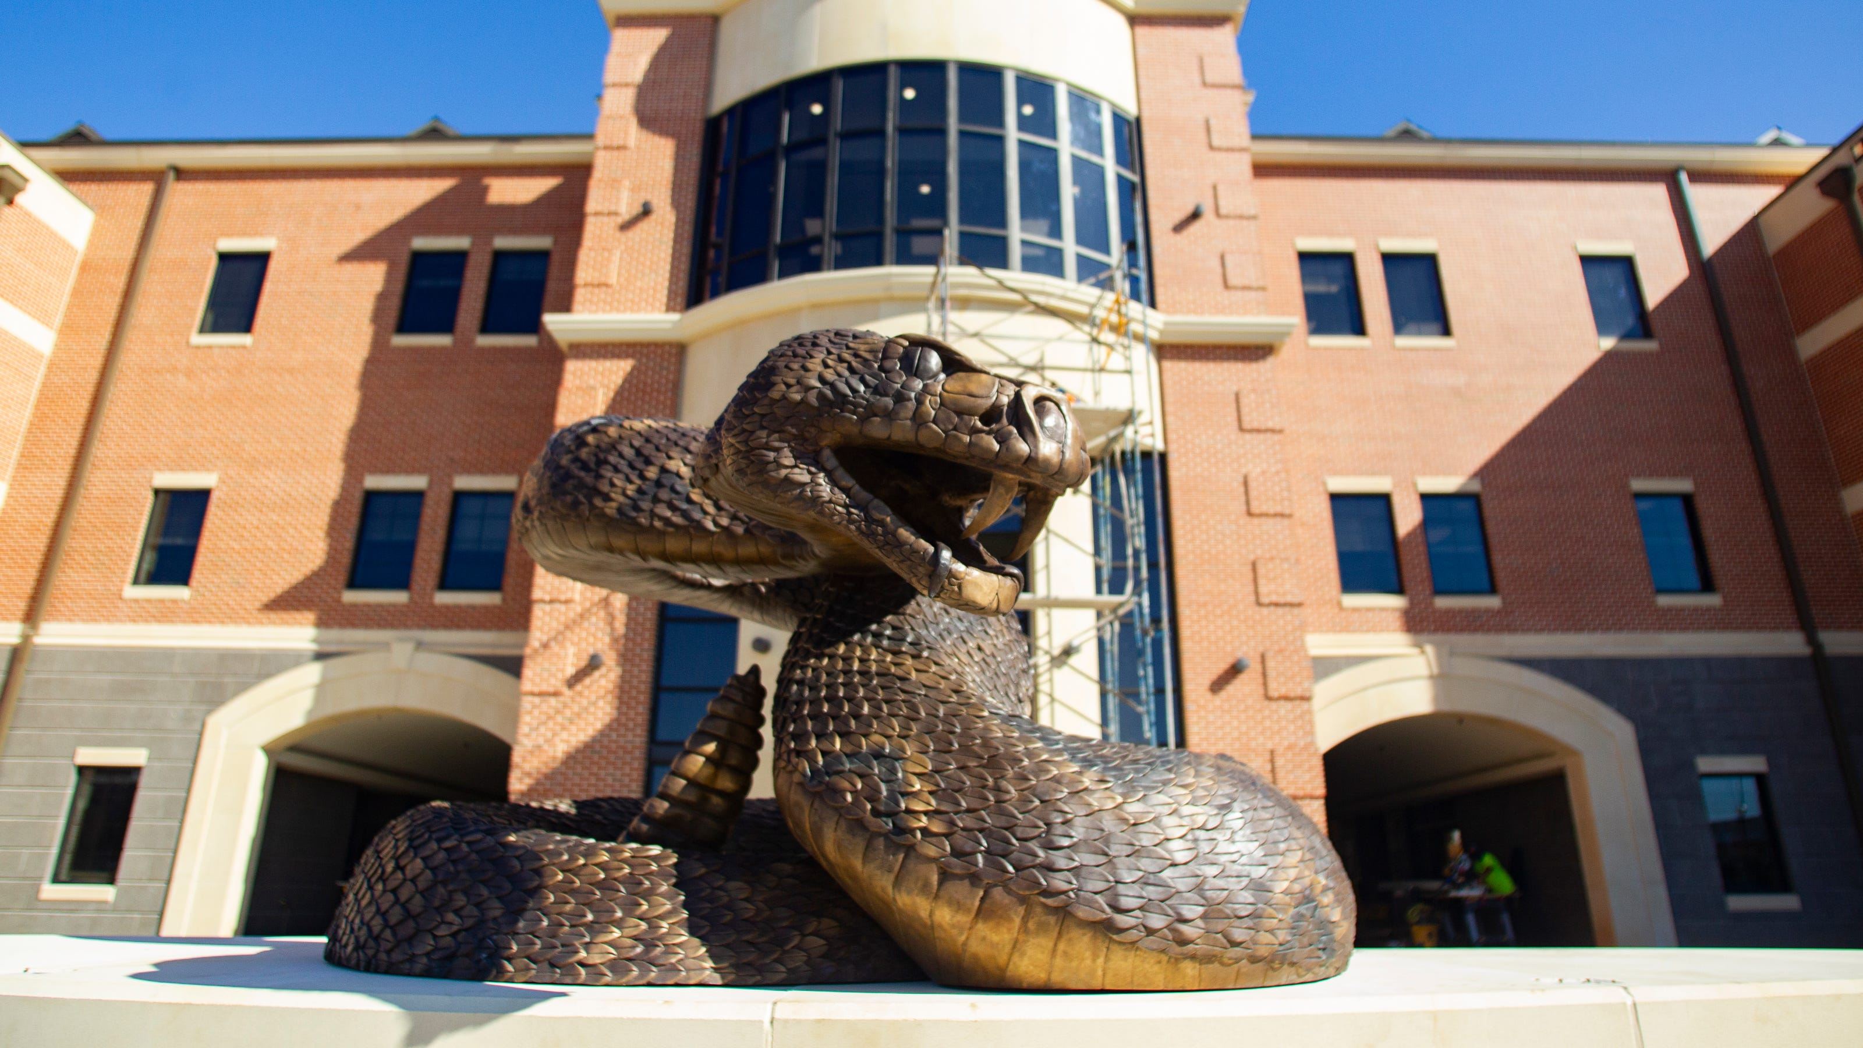



Action Items
AACC Meeting Minutes: September 15, 2021
Audit and Compliance Committee Charter
Division of Audit Charter
Notes:
Replace with OCE Logo

Slide 3



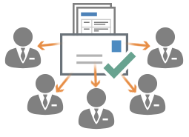
AACC Meeting Minutes:
September 21, 2021
9:45 a.m.
AUDIT AND COMPLIANCE COMMITTEE
Review
Discussion
Approval
Notes:
Update with OCE Logo

Slide 4




AUDIT AND COMPLIANCE COMMITTEE
NOTE: TO CHANGE OUT THIS ICON OUT WITH YOUR OWN YOU MAY HAVE TO CLICK ON THE ICON A FEW TIMES TO HIGHLIGHT IT (SINCE IT IS IN A GROUP). ONCE HIGHLIGHTED…
1*RIGHT CLICK ON TOP OF THE ICON.
2*CHOOSE “CHANGE GRAPHIC”
3* CHOOSE WHERE TO FIND YOUR NEW ICON OR PICTURE AND PLACE IT.
Audit and Compliance
Committee Charter
Key Changes
Internal Audit Professional Standards
Language updated to more closely align with the latest Institute of Internal Audit standards language.
Enterprise Risk Management
Language updated to include the responsibility for facilitating the enterprise risk management program for the University.
Last Updated: September 19, 2019

Slide 5


DIVISION OF AUDIT
NOTE: TO CHANGE OUT THIS ICON OUT WITH YOUR OWN YOU MAY HAVE TO CLICK ON THE ICON A FEW TIMES TO HIGHLIGHT IT (SINCE IT IS IN A GROUP). ONCE HIGHLIGHTED…
1*RIGHT CLICK ON TOP OF THE ICON.
2*CHOOSE “CHANGE GRAPHIC”
3* CHOOSE WHERE TO FIND YOUR NEW ICON OR PICTURE AND PLACE IT.
Division of Audit Charter
Key Changes
Internal Audit Professional Standards
Language updated to more closely align with the latest Institute of Internal Audit standards language.
Enterprise Risk Management
Language updated to include the responsibility for facilitating the enterprise risk management program for the University.
Last Updated: September 19, 2019

Slide 6
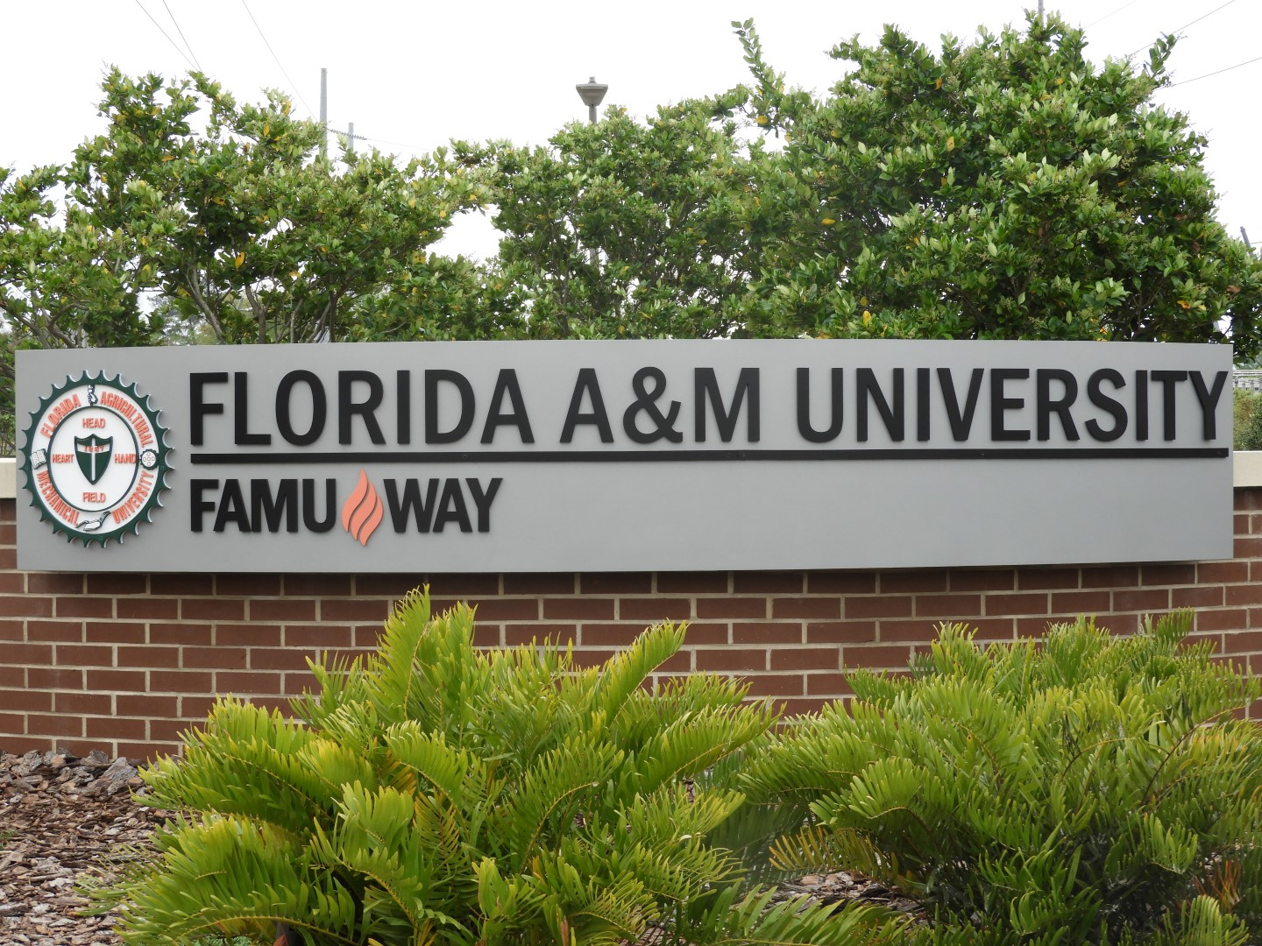

Compliance and Ethics Week 2021
Investigations
Mandatory Training
Telecommuting
Foreign Influence
Conflict of Interest
Notes:
Replace with OCE Logo

Slide 7
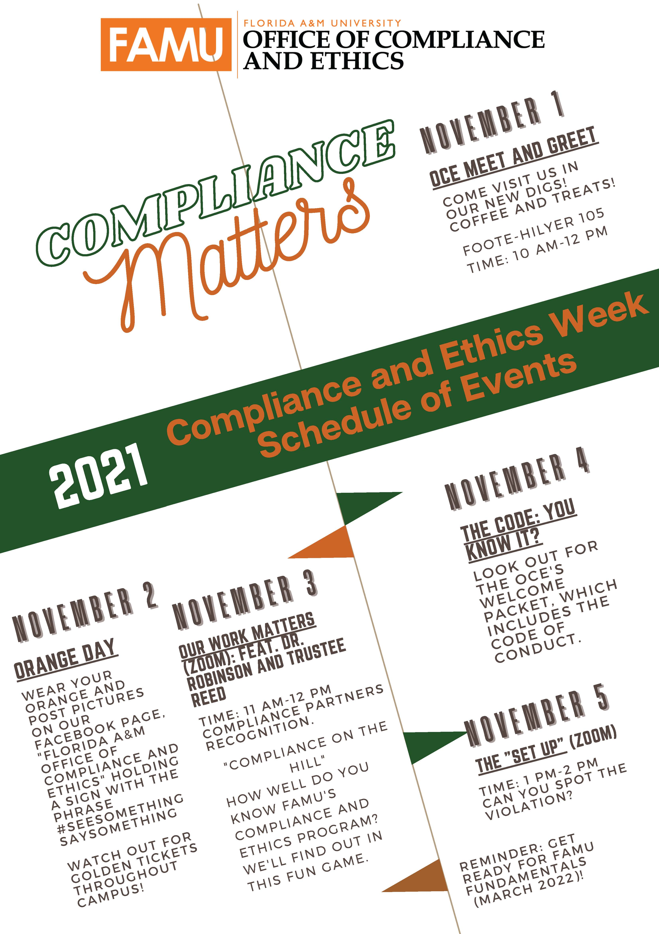
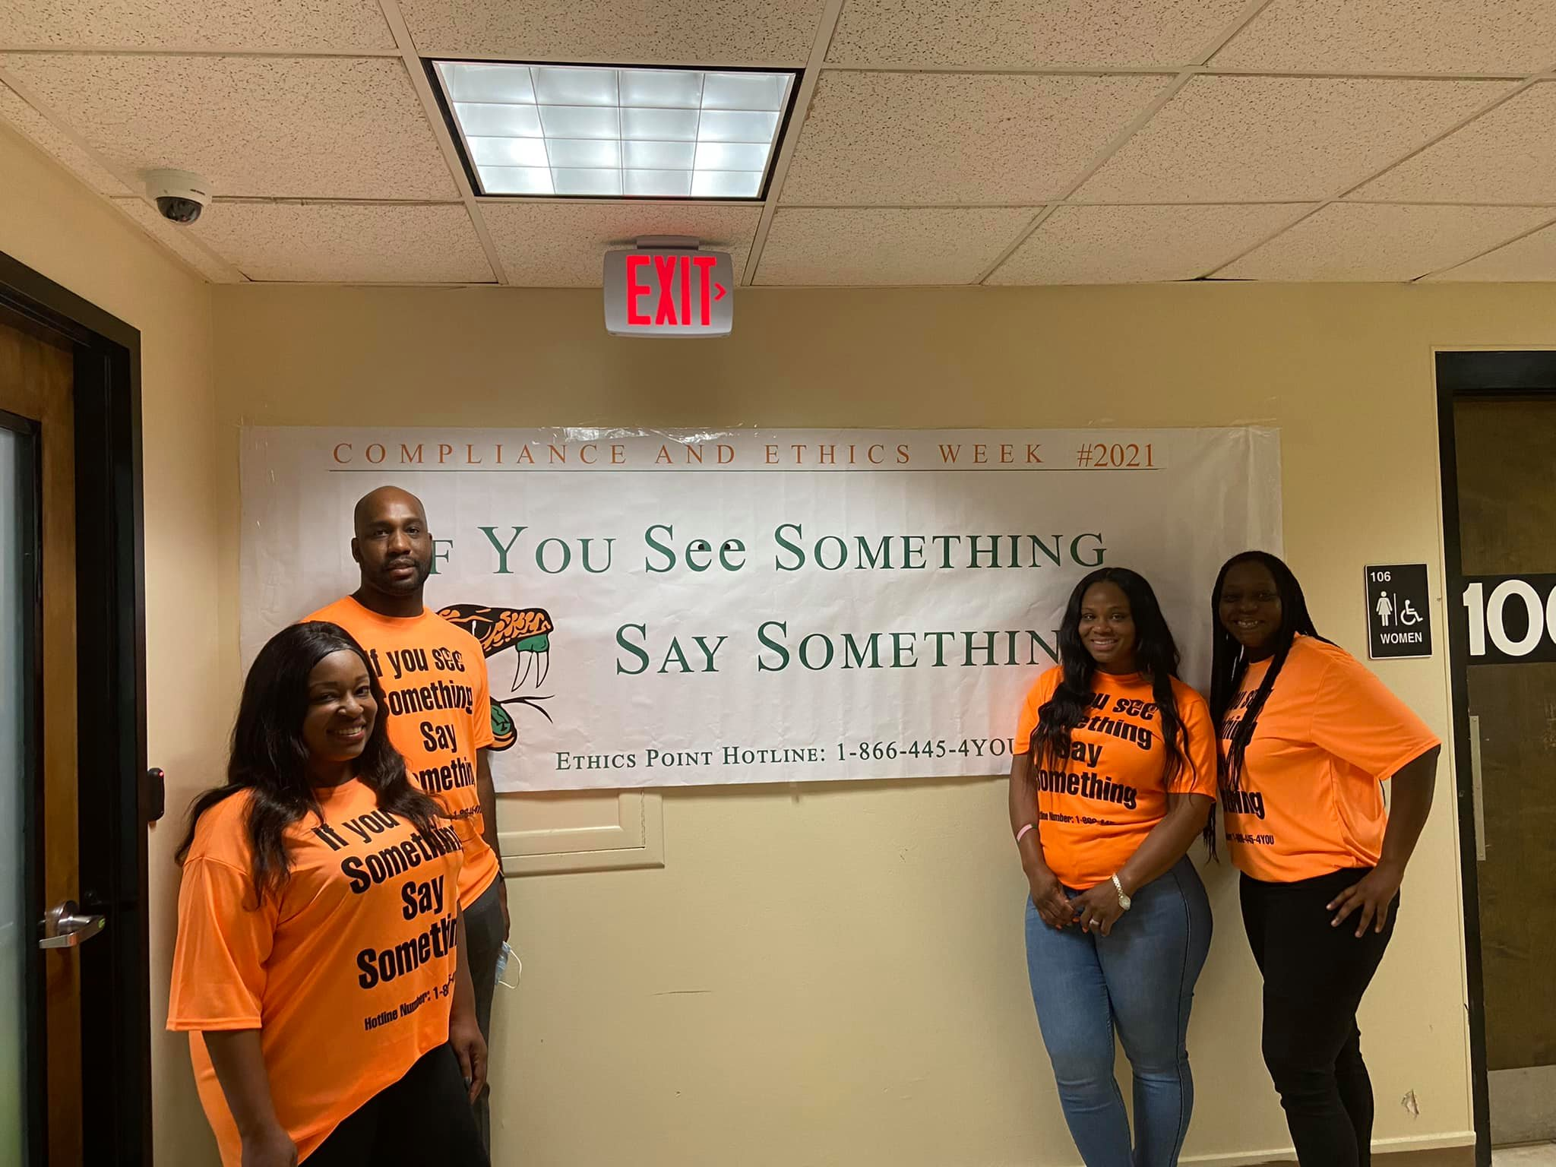
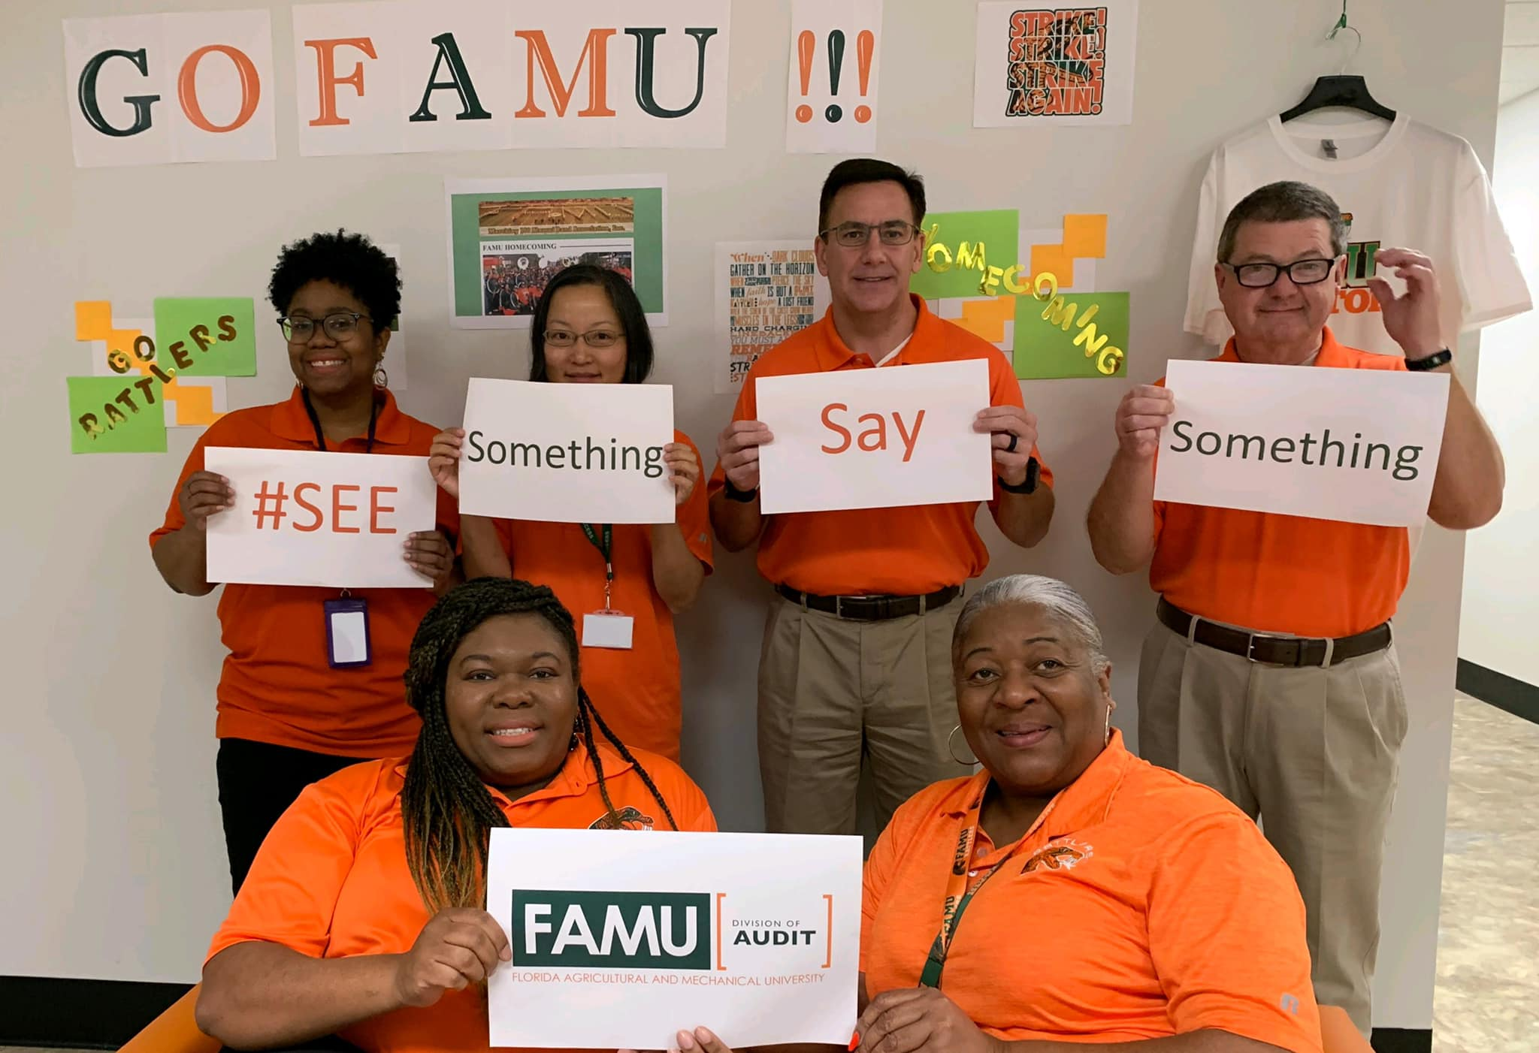
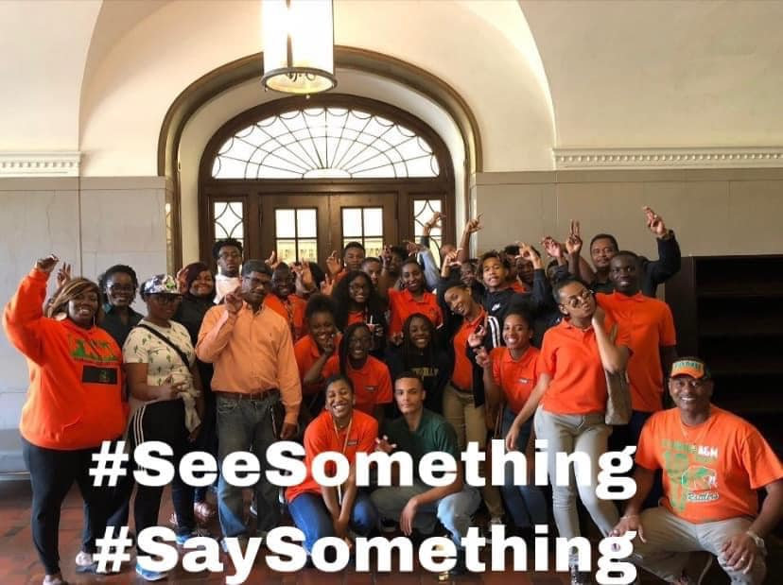
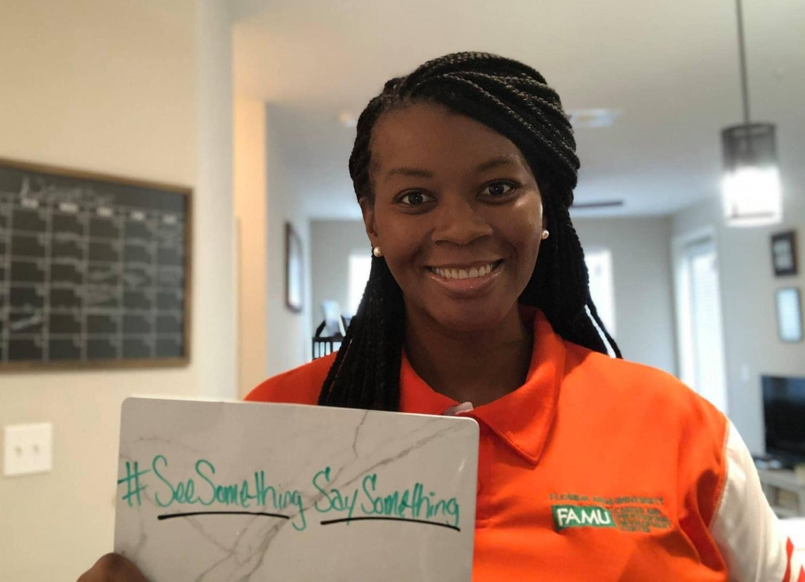
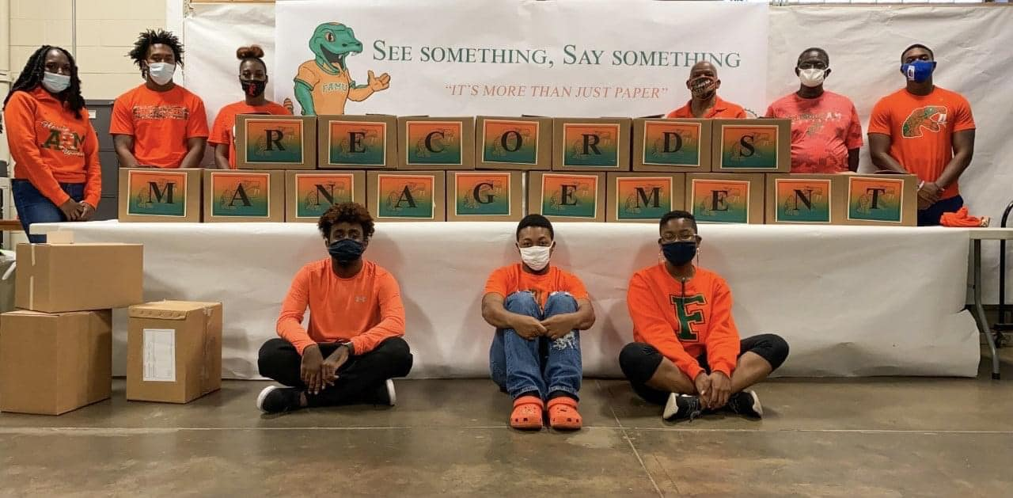
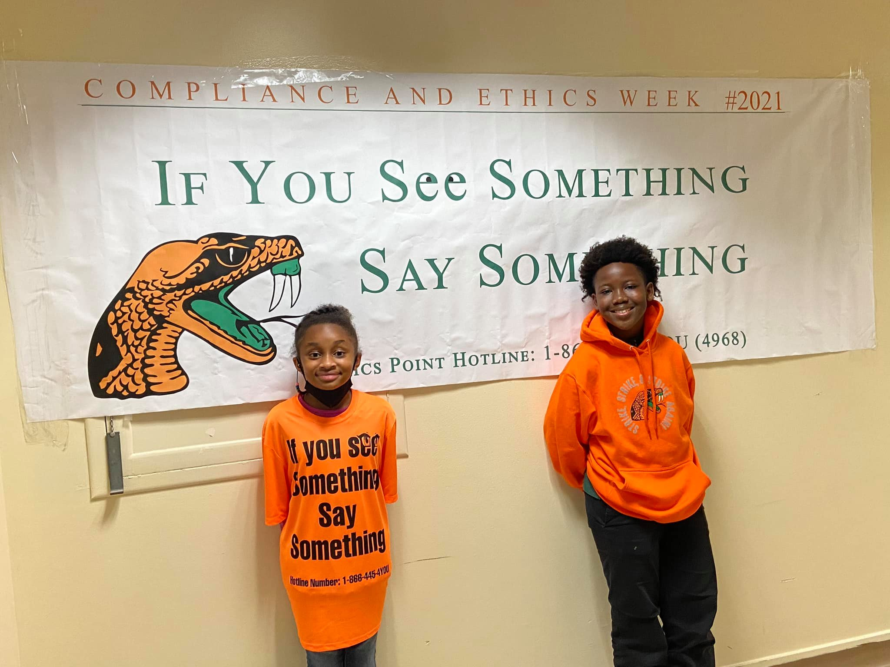

Slide 8
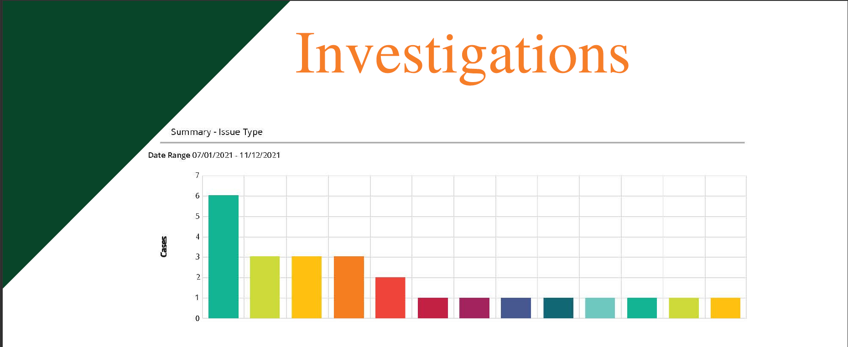
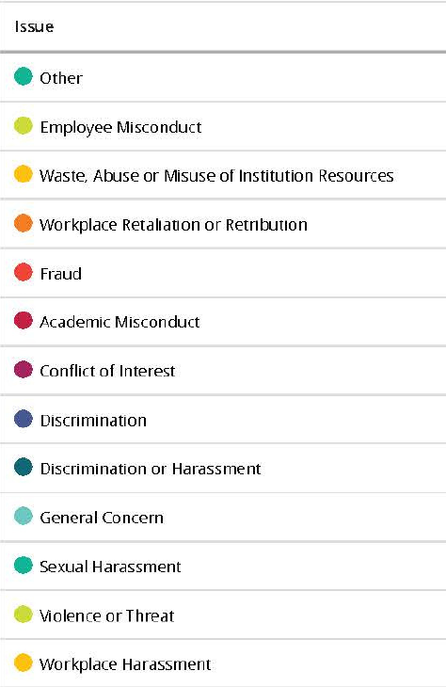

Slide 9
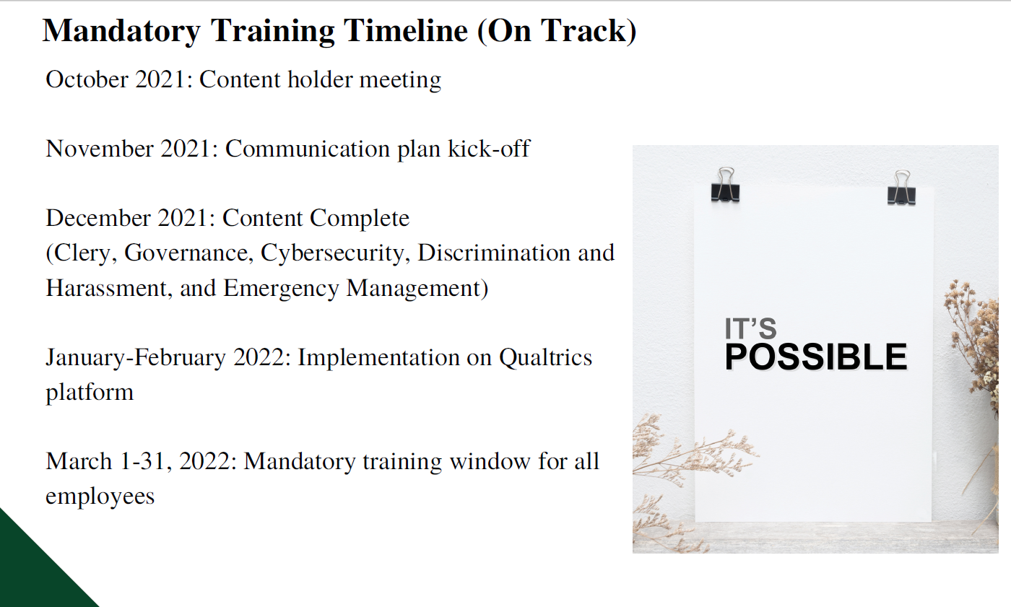

Slide 10




Telecommuting
University Policy 03-01 Implementation Guidelines
Relaunch: October 19, 2021
Foreign Influence
HB 7017 Compliance
Foreign Influence Survey
Demo of Due Diligence Products
Implementation Meeting with Regional FBI Agents
Conflict of Interest
Form Updates
Process Automation

Slide 11





OFFICE OF COMPLIANCE AND ETHICS
Implementation of External Review Recommendations
Increased Resources
Enhanced Monitoring
COMPLIANCE AND ETHICS CULTURE SURVEY
What’s Next?
Analyze Survey Results from September 2021
COI Disclosure Automation
Continued Education Efforts
Rollout of Streamlined COI Process

Slide 12
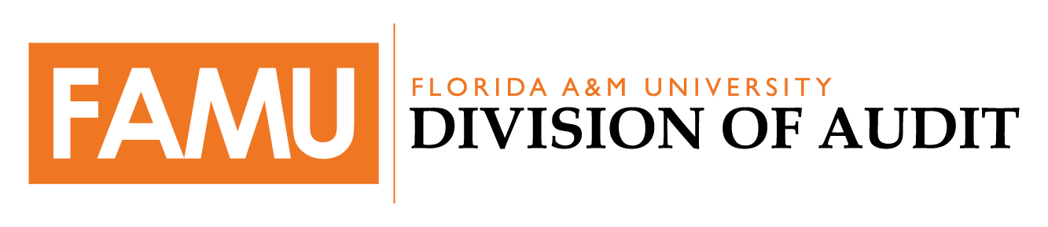
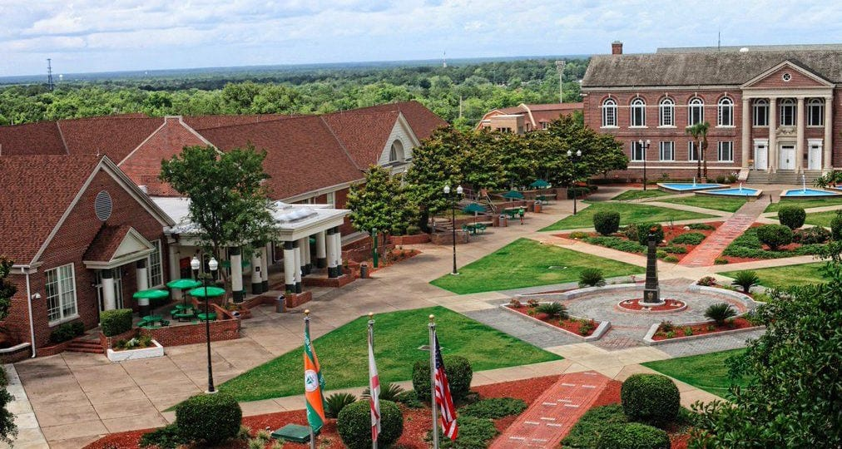




Risk Assessment Follow-Up
If replacing the image use these to bring shapes to the front.
Audit Follow-Up
Investigative
Follow-Up
External Audits
Enterprise Risk Management
Division of Audit:
Updates

Slide 13
Risk Assessment Follow-Up
DIVISION OF AUDIT
Requested Management Action Plans for Risk Assessment and Internal Controls Assessment – 7/19/2021
Not yet Complete: Finance and Administration, ITS, Legal Affairs, Strategic Planning
In the process of placing submitted plans in Highbond to automate follow-up Process: Compliance and Ethics, Audit, Research, Athletics, Academic Affairs, Research, Chief of Staff, Student Affairs, and University Advancement

Slide 14




Audit Follow-up: Open Issues
DIVISION OF AUDIT
01
OPEN – Medium Risk
2018 Operational Audit: Intercollegiate Athletics Programs – Deficit Cash Balances
Balanced 2020-21 Budget, AG Prior-Audit Finding Anticipated to be Resolved
1
02
OPEN – Medium Risk
2018-19 Risk Assessment: Bragg Stadium Safety and Maintenance
Phase 1 Complete, Phase 2 In-Process, Future Scope Items Identified, Monitoring for Resolution of ADA and Safety Issues
2
OPEN – High Risk
2018-19 Risk Assessment – Emergency Preparedness
03
Emergency Director Hired, Reviewing Campus Facilities for Hurricane Shelter Establishment
3
Federal Contracts and Grants Disclosure Audit: Federal Contracts Not Reported to USDOE
OPEN – Medium Risk
4
04
2018-2021 reportable payments disclosures were expected to be made by November 30, 2021

Slide 15




Audit Follow-up: Open Issues
DIVISION OF AUDIT
OPEN – Medium Risk
Federal Contracts and Grants Disclosure Audit: Update University Compliance and Research Disclosure Policies
05
Policy Review Expected to be Completed by November 30, 2021.
5
CLOSED – Low Risk
2019-2020 Knight Foundation Expenditure Review- Academic Affairs Review
06
6
Spending Plans Were Submitted to Academic Affairs to Use in Their Review
CLOSED – Low Risk
2019-2020 Knight Foundation Expenditure Review – Travel Learning Summaries
07
Learning Summaries Were Completed and a Formal Process For Submitted Learning Summaries Was Implemented
7
2019-2020 Knight Foundation Expenditure Review – Spending Plans
8
08
CLOSED – Low Risk
Spending Plans were Submitted to the Knight Foundation for Approval

Slide 16

Investigations Internal Controls Recommendations Status
Report
2020-11-05
Issue: Direct charging of an administrative position to federal grants
Recommendation: Work with the federal funder to determine if monies used for the position should be repaid.
Owner: Dr. Robert Taylor, Dean, CAFS
Status: OPEN (ACD: 1/31/22)
Report
2020-02-19
Issue: Outside employment and undisclosed conflict of interest
Recommendation: Consider automating the conflict of interest disclosure process.
Owner: Sandi Smith-Anderson, HR
Rica Calhoun, Compliance and Ethics
Status: OPEN (ACD: 2/28/22)
Issue: Allocation of administrative salaries to funding sources
Recommendation: Ensure all other administrative positions in CAFS are funded by appropriate sources.
Owner: Dr. Robert Taylor, Dean, CAFS
Status: OPEN (ACD: 12/3/21)
Issue: Unauthorized teaching assistance and remote work; Undisclosed conflict of interest regarding dual employment
Recommendation: Notify the involved parties of the violations
Owner: Dr. Robert Taylor, Dean, CAFS
Status: OPEN (ACD: 1/31/22)
Report
2020-11-05
Report
2020-11-11
Issue: Issue: Telecommuting policy applicability
Recommendation: Consider revising the applicability of the policy to include non-teaching faculty.
Owner: Dr. Maurice Edington, Provost
Status: CLOSED – 10/18/2021
Issue: Undisclosed conflict of interest regarding dual employment
Recommendation: Determine if a portion of the employee’s salary needs to be repaid to the University.
Owner: Dr. Robert Taylor, Dean, CAFS
Status: OPEN (ACD: 1/31/22)
Report
2020-11-05
Report
2020-11-11
Notes:
Report:
Investigation was within the College of Agriculture and Food Sciences
Related to Grant Funds & Telecommuting
Working with the Provost to Provide an Action Plan
Investigation was in the College of Social Sciences, Arts, & Humanities
Related to Outside Employment and Disclosure Requirements
We have had a several instances recently where people failed to disclose outside employment or conflict of interests. Currently management is working to automate the process in efforts to increase compliance.

Slide 17
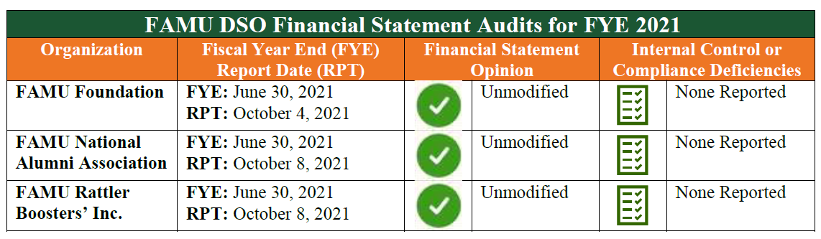
DIVISION OF AUDIT
External Audits Completed
FY 21 DSO Financial Statement Audits

Slide 18

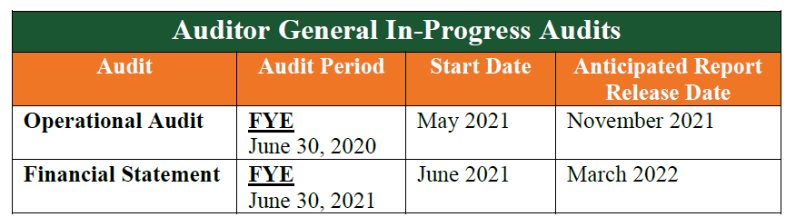
DIVISION OF AUDIT
External Audits in Progress
2021 FAMU Operational Audit Results

Slide 19
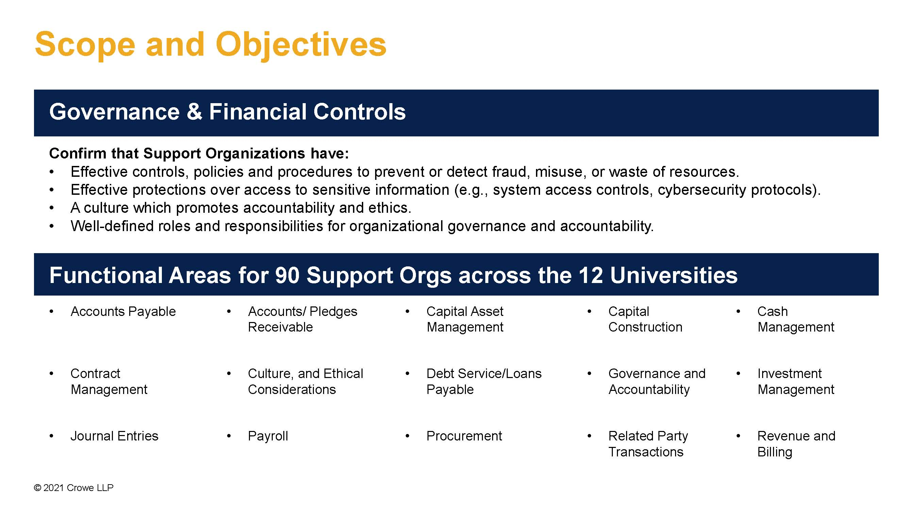
DIVISION OF AUDIT
External Audits in Progress:
CROWE

Slide 20




ERM Updates
DIVISION OF AUDIT
ERM Program Meetings – Structure, Best Practices, Tools
ERM Advisory Committee –
Structure and Charter
ERM
Risk Appetite and Tolerance Statements
ERM Education
Training
Handbook

Slide 21
Division of Audit Updates
DIVISION OF AUDIT
01
04
New Website
DoA has a new website. We are continuing to add additional information to help educate the FAMU community on fraud, risk, internal controls, and governance.
Professional Development
Professional Publication: Data Analytics Kick Starter
Ruoxu Li
Certified in Risk Management Assurance
Deidre Melton
02
05
Staffing
2 New Staff Auditors
ERM Coordinator
Mandatory Trainings
The Division of Audit is hosting mandatory fall training from December 1, 2021 - January 15, 2021. There are two modules on the topics of Internal Controls and Enterprise Risk Management
06
03
Professional Recognition
ACUA’s 2021 Outstanding Professional Contributions Award - This Award recognizes a member who has made outstanding and noteworthy contributions to the profession of internal auditing in higher education.
Deidre Melton.
Committee Development
In order to support the Assurance and Enterprise Risk Management Functions, DoA will be establishing an Assurance Committee and an ERM Committee

Slide 22
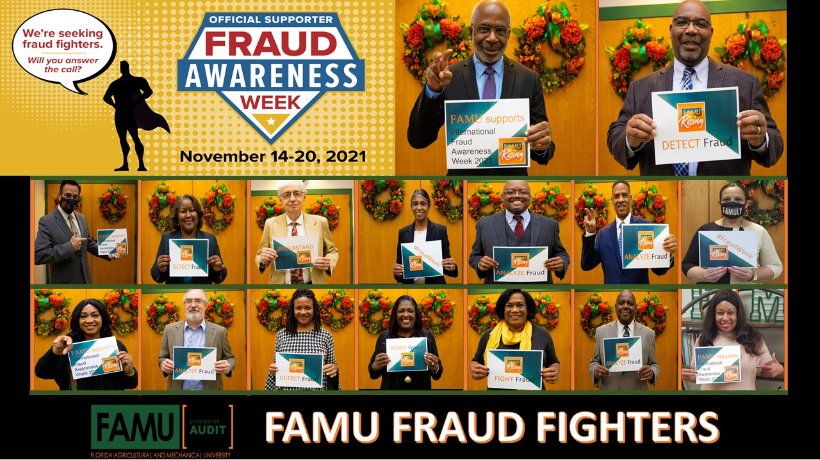

Slide 23
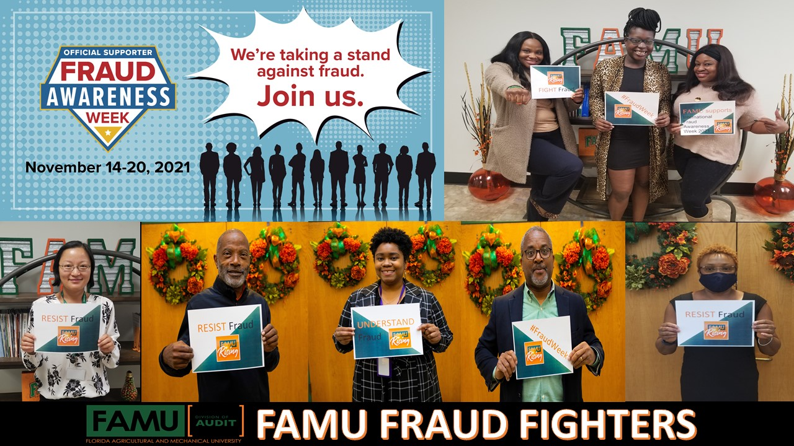

Slide 24

Q&A
Questions
Answers

Slide 25
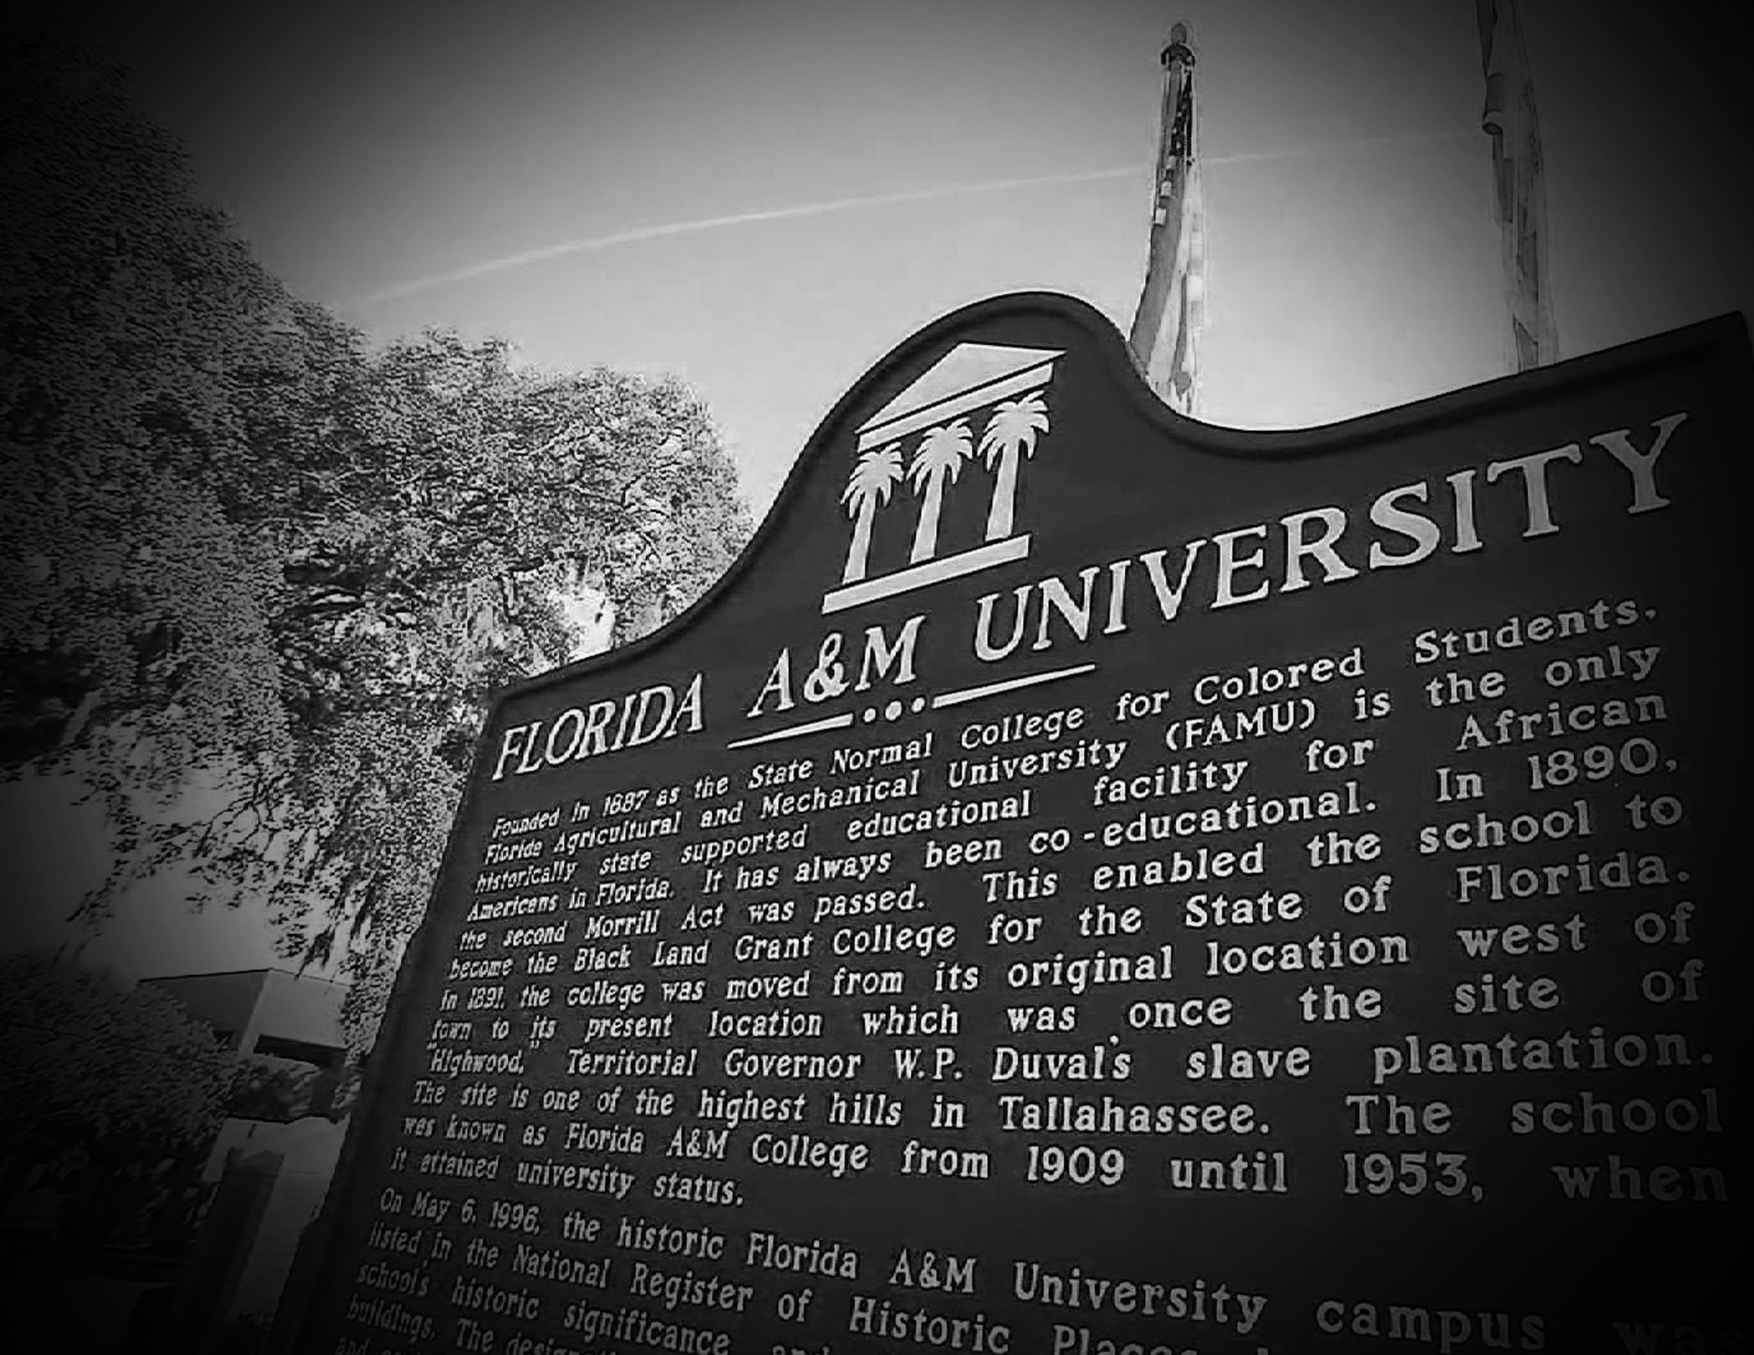
Accountability  Integrity  Efficiency
Thank You!

