Slide 1

FAMU Board of Trustees Meeting
March 6, 2024

Slide 2

Audit and Compliance Committee
Meeting Minutes: 12-06-2023

Slide 3

Action Item: University Regulation 1.022
Title IX and Formal Hearing Process
Regulation Overview
  This amended regulation addresses the process for promptly responding to persons who are alleged to have experienced sex discrimination and/or Sexual Misconduct pursuant to Title IX of the Education Amendments of 1972.
Regulation Amendments
  Clarify its applicability; add and amend definitions; incorporate the role of the advisor in the process; amend the formal complaint process; outline disciplinary sanctions; incorporate an administrative resolution process; and make technical and grammatical changes.
Office of Compliance and Ethics Recommendation
  It is recommended that the Board of Trustees approve the revisions to University Regulation 1.022.

Slide 4

Office of Compliance and Ethics Updates

Slide 5
Mandatory University Compliance Training
Board of Governors Regulation 4.003 requires university employees and board of trustees’ members to receive ethical conduct and compliance training.
2024 Training Modules
Compliance and Ethics
Clery Awareness
Rights, Respect, and Responsibilities with EOP
Fraud and Internal Controls Awareness
Cybersecurity Awareness
Emergency Management: Empowerment through Emergency Preparedness
Guiding Principles in the Art of Policy Management
Foreign Influence Primer (**Researchers and Research Support)
Mandatory Training Window:
March 1 – 31, 2024

Slide 6

Investigations
Complaints Since July 1
  65 Complaints Logged via Hotline
  26 Complaints have been Closed
  39 Complaints are in the investigation processes
Topics of Open Investigations in OCE
  Conflicts of Interest
  Retaliation
  Employee Misconduct
OCE Monitoring of Closed Investigations
  Division of Academic Affairs – Management Plan Implementation
  Athletics – Management Response

Slide 7
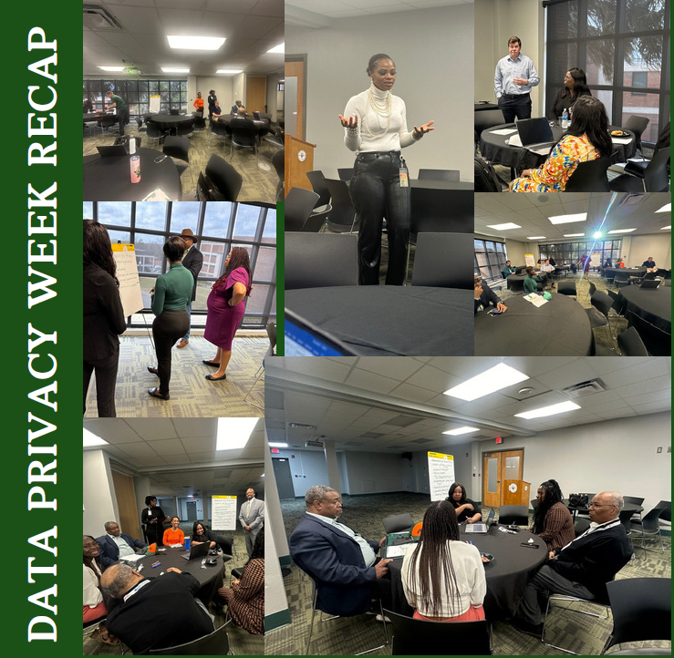
Data Privacy Week
January 22 – 26, 2024
Data Privacy Week Highlights
January 23rd: President Robinson and the Senior Leadership Team completed the Privacy Champion Pledge.
January 24th: Privacy Workshop, led by Chief Privacy Officer LaTonya Baker and Chief Risk Officer Deidre Melton, was held with university privacy and data governance leaders to enhance understanding of best practices and identify measures to mitigate privacy risks.
Created an Instagram reel of campus community members highlighting their take on what it means to be a Data Privacy Champion.

Slide 8
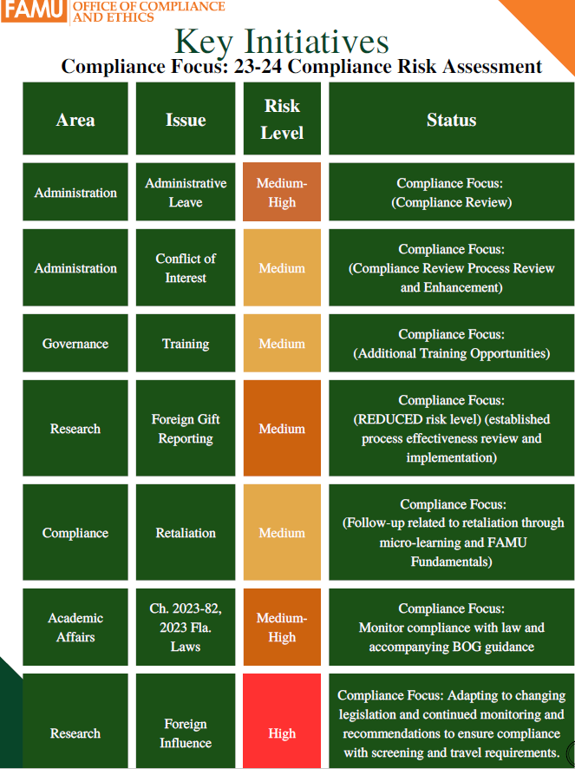
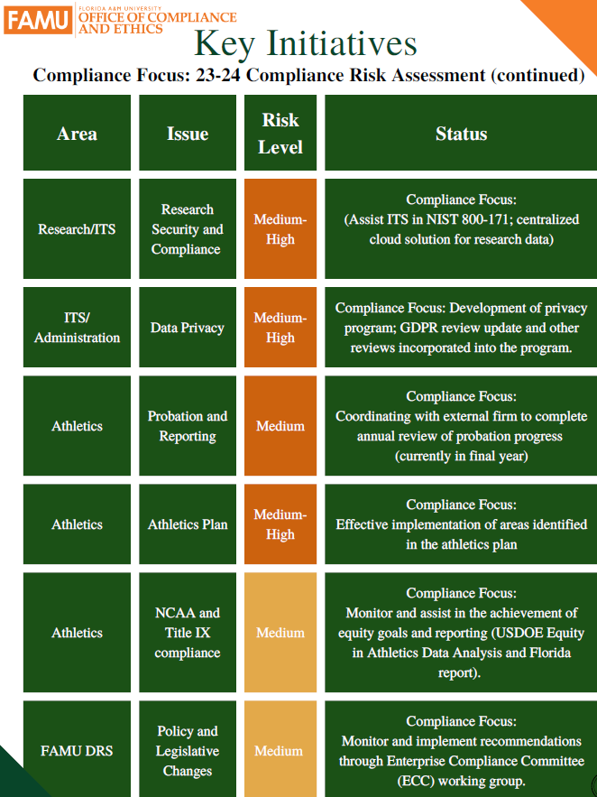

Slide 9
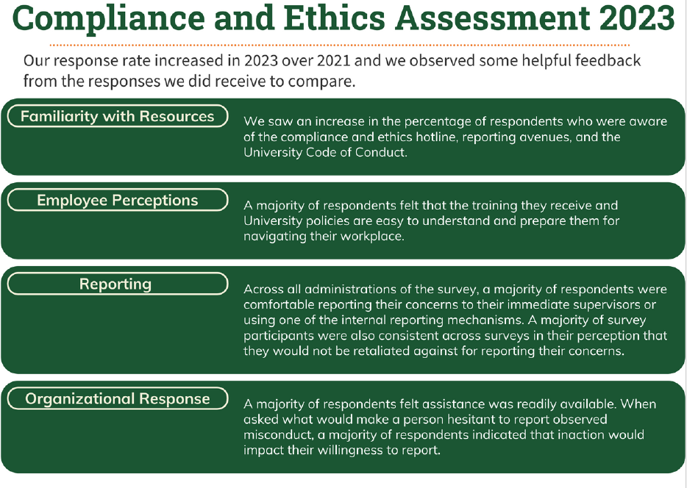
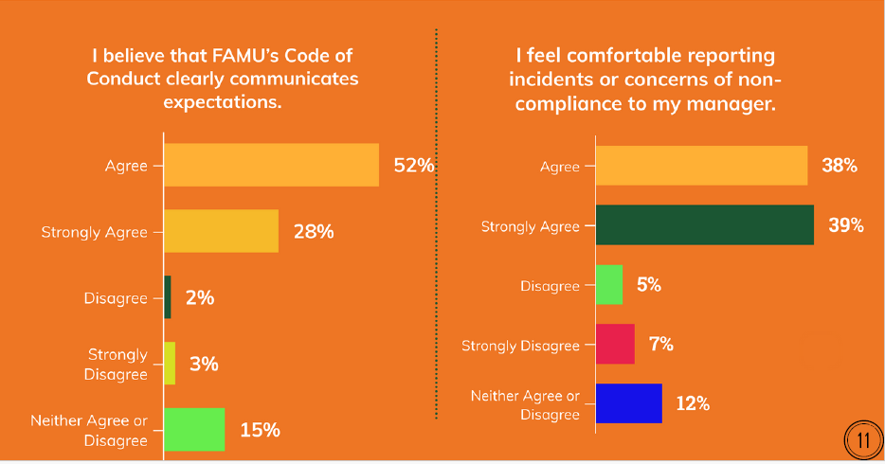

Slide 10

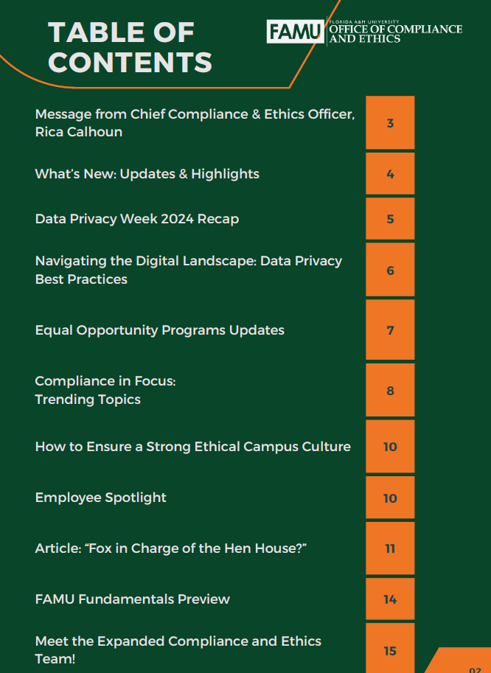

Slide 11
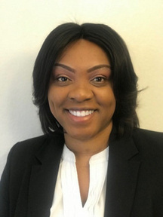



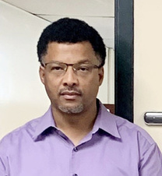
OCE Employee Highlights
Letitia McClellan
Attended ATIXA’s
Winter Symposium and acquired certifications in Sex-Based Harassment Foundations for Higher
Education, Gender Equity Foundations for Higher Education, and Preparing for the Pending Title IX Regulations for Higher
Education.
Allysan McGill
The Office of Equal
Opportunity Programs is thrilled to have Allysan join us as the EOP Coordinator, and we’re
excited about the contributions she will make to the Title IX team.
Aurea Hughes
Aurea Hughes, is a second-year political science major with a minor in criminal justice. She currently serves as an EOP intern who commits to investigate, educating, and advocate for those who feel they've been harmed or discriminated against.
Jeremiah Coleman
Jeremiah Coleman is a second-year Graphic Design scholar. He loves being creative, anime, plants, and animals. He hopes to work in the animation industry and looks forward to making great things happen at FAMU.
Montell Holmes
We highlight Mr. Montell Holmes’s dedicated efforts to raise awareness about the Americans with Disabilities Act (ADA) within the FAMU community. Montell has
consistently worked hard to address concerns from faculty and staff across all campuses.

Slide 12
DIVISION OF AUDIT
Updates

Slide 13

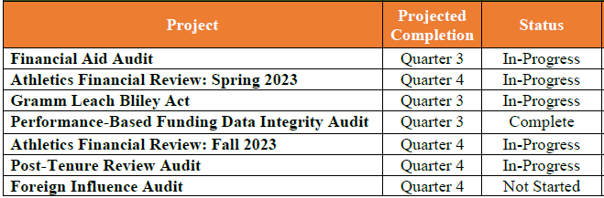
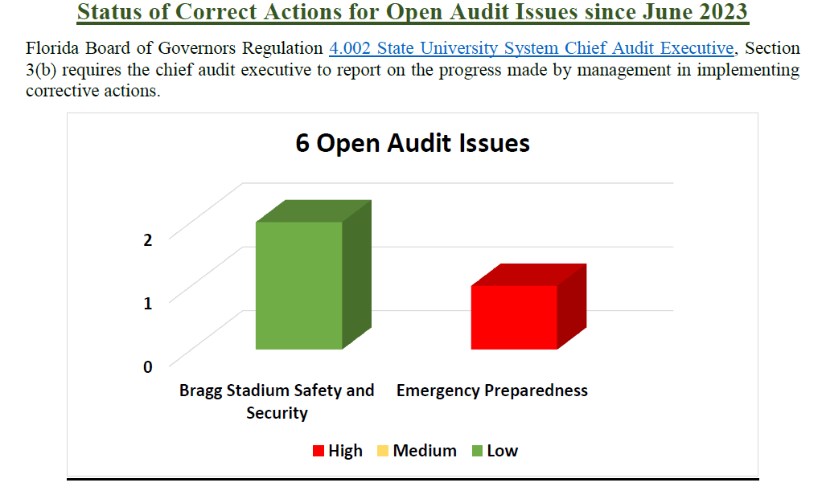
Internal Audit Activities

Slide 14

External Audit Activities
Current Status of External Audits - University
  Financial Statement Audit (FY2023) In-Progress
  Operational Audit (FY2023) Scheduled
  Athletics Financial Statement Audit (FYE 2022 and FYE 2023) In-Progress
  Athletics Agreed Upon Procedures (FYE2023) In-Progress
Current Status of External Audits - DSO
  FAMU Boosters – Financial Statement Audit (FYE 2023)
    Complete: Financial Statements Presented Fairly in All Material Respects, No Opinion Expressed Regarding Internal Controls or Compliance Issues
  FAMU Foundation – Financial Statement Audit (FYE 2023)
    Complete: Financial Statements Presented Fairly in all Material Respects.
  FAMU National Alumni Assoiciation – Financial Statement Audit (FYE 2023)
    Complete: Financial Statements Presented Fairly in all Material Respects.
Athletics Action Plan Assurance Services Corrective Action Monitoring
  Recommendations were integrated into a Modified Athletic Action Plan in November 2023
  Athletic Action Plan Workgroup has not met to begin implementing modified action plan.

Slide 15

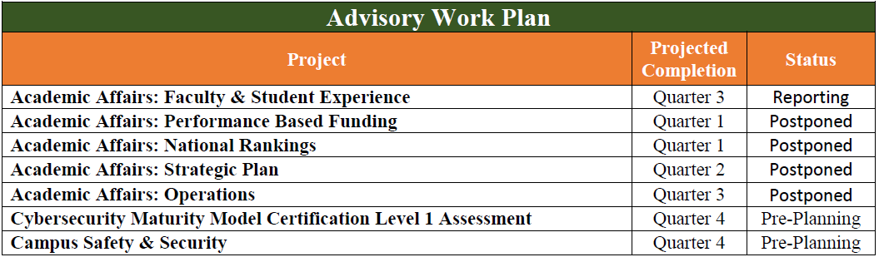
Advisory Activities
Status of Corrective Action for Open Advisory Issues
  2022 Procurement Services (34 Recommendations)
    6 Recommendations Successfully Implemented
    7 Recommendations are Past Due
    21 Recommendations Are On-Schedule
  2022 Title IX Control Self Assessment (12 Recommendations)
    4 Recommendations Successfully Implemented
    5 Recommendations are Past Due
    3 Recommendations Are On-Schedule

Slide 16

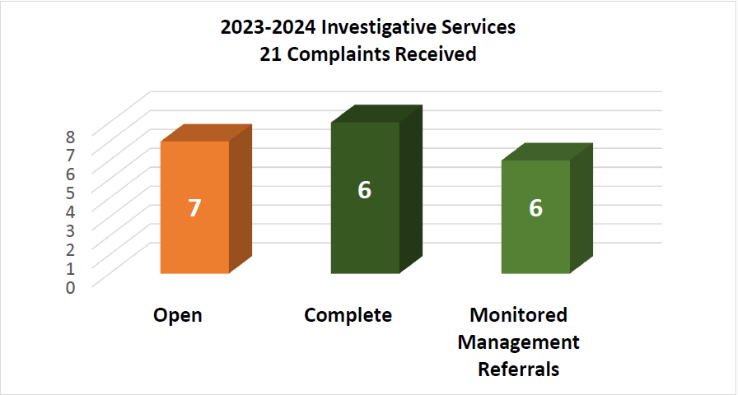
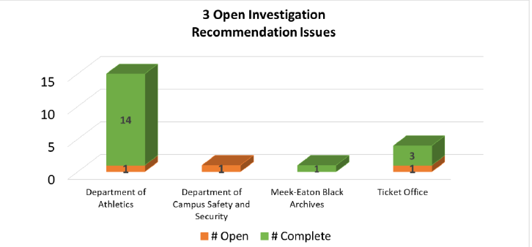
Investigation Activities

Slide 17
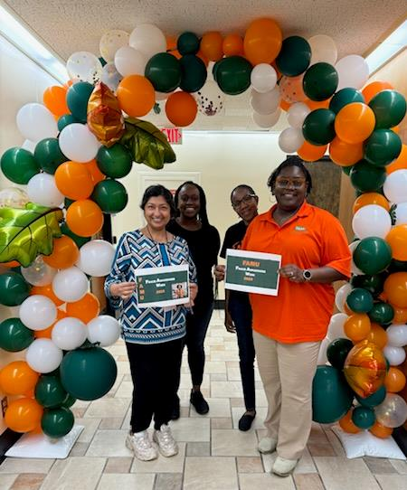

Audit Q2 Highlights
International Fraud Awareness Week
DoA Toy Donations for the President’s Toy Drive

Slide 18

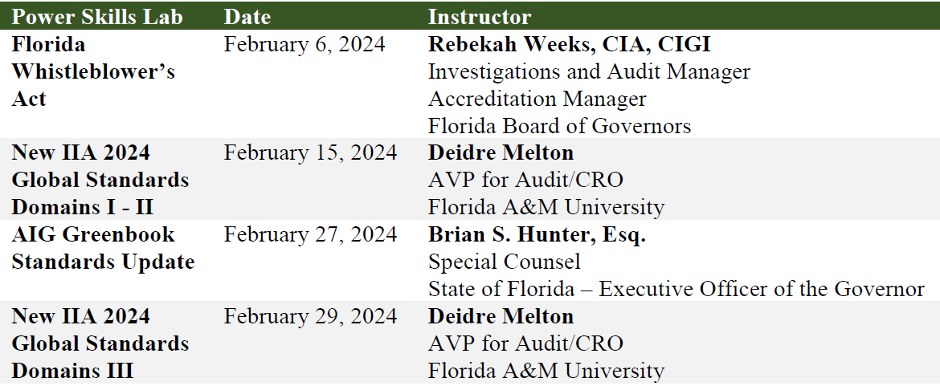
Professional Development

Slide 19

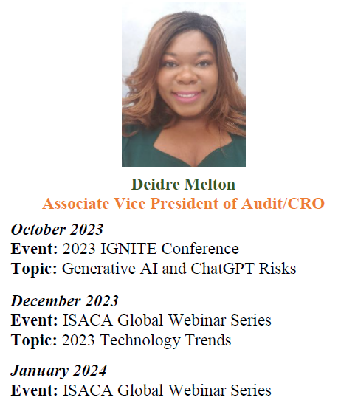
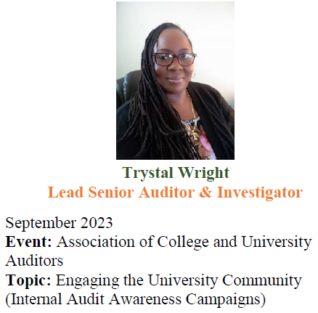

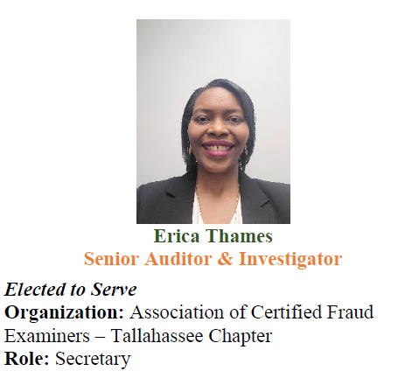
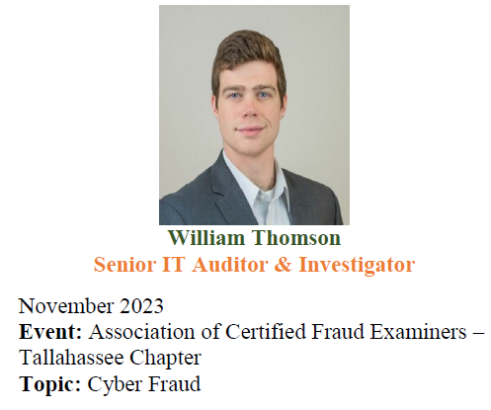
Leveraging the Brand
Locally and Globally

Slide 20



ERM Reports Released

Slide 21
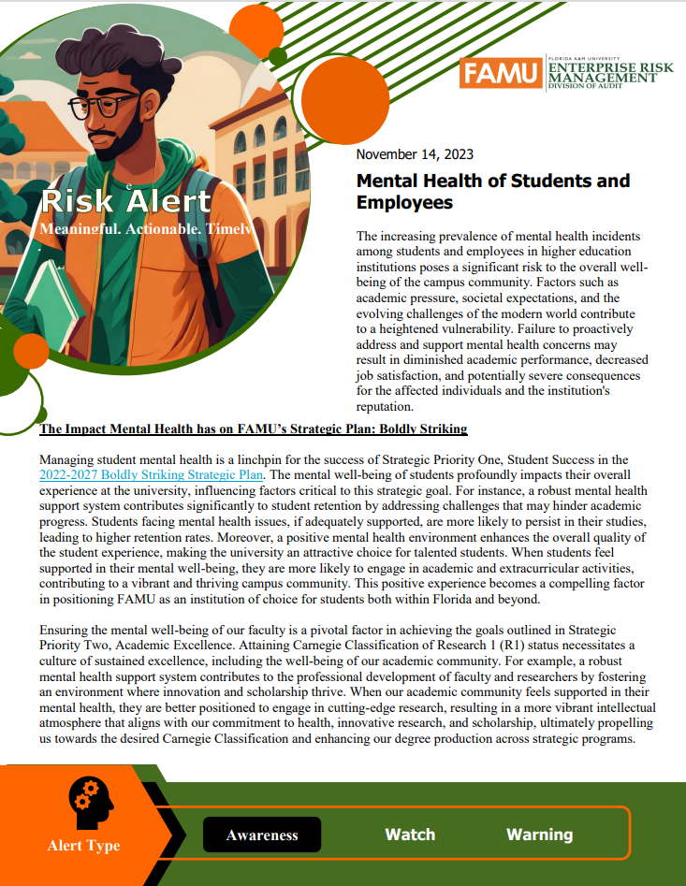


ERM Risk Alerts Released

Slide 22




ERM Activities
Privacy & Data
Governance Workshop
Human Resources Outreach
SLT Risk Workshop: Top University Risks

Slide 23


"We inspire Excellence by showing kindness and delivering exceptional Service."

